Slide 1


Research Administration Certification Program (RACP)

Slide 2

Module 4 Export Reporting and Export Controls
Learning Objectives:
Examine Export Control regulations, how they apply to the University and why they are significant
Understand the three main agencies that regulate export control activates and what their individual responsibilities involve.
Understand when an export control license is needed and what activities can trigger the need for a license
Understand the three main exceptions whereby an export control license is not needed.
Understand what to do and or who to contact in the event that there is a question or an export license may be needed

Slide 3

Effort Reporting

Slide 4
Effort Reporting
Effort reports are the source documents that validate all personnel charges to an award.
Identifying and tracking effort should follow a consistent process, with the goal of creating a reliable record for employee effort and salary.
This process should involve:
  1. Proper due diligence to determine effort at the start of award.
  A communication system for indicating effort changes
  throughout the grant.
  Proper guidance to individuals for use in certifying their
  effort.

Slide 5


Effort Reporting
Uniform Guidance
DEFINED
Effort reporting is a federal requirement for institutions receiving federal funds for sponsored agreements. The federal government requires institutions to maintain an effort certification process that complies with the requirements set forth in the Uniform Guidance and OMB Circular A-21.
As a recipient of significant external funding, the University must assure Federal and other sponsors that the assignment of time and associated salary and fringe benefit costs to the projects they sponsor is fair, consistent, and timely.

Slide 6
Effort Reporting Requirements
On Federal Awards:
Provide verification of salary charges through effort reporting
The university must have a payroll distribution method that reasonably reflects the activity being paid for by the sponsor
The distribution must reflect all institutional activities of the person reporting

Slide 7
Additional Requirements Uniform Guidance
WHY is Effort important at UH?
Salary and benefits on sponsored projects typically make up the majority of expenditures
Constant audit target:
  i.e.. system weakness, salary cap and salary limitation violations, late payroll reallocation and late effort certification, improper signatures, failure to include institutional effort, policy and procedure non-compliance
EFFORT
100%
Public Service 10%
Research 25%
Administration 10%
Teaching 55%

Slide 8
Effort Reporting - The Cycle
Appointing Faculty & Staff
Employment terms are established,
including # of months (contract period), % full time, salary base
Preparing the Proposal Budget
Effort is proposed,
a commitment is made to the sponsor (may change during award negotiation)
Charging Salary
Certifying Effort
Effort is attested to,
after activity has occurred
Effort is charged,
contemporaneously with activity
Pre-Award
Post-Award

Slide 9
Person Month (Effort)
Person months is a way to express the effort (amount of time) PI(s), faculty, and other senior personnel devotes to a project.
The effort is based on the type of appointment of the individual; e.g. calendar year, academic year, and/or summer term.
To calculate effort percentage to person months, multiply the effort percent by the appointment type.
    33.33% effort x 9 mo. appt. = 3 person months
To calculate person months to effort percentage, divide the proposed time by the appointment type.
    1.5 person month ÷ 3 summer mo. appt. = 50% effort

Slide 10
Committed Effort…The Risks
  UH and Principal Investigators risk penalties if the minimum obligated effort is not met.
  Examples of such risks are:
    Sponsor refusing to pay outstanding invoices
    Sponsor canceling the agreement, or
    Sponsor refusing to award pending proposals for other faculty at the university

Slide 11
Effort Reporting Roles and Responsibilities
Faculty: Reviews, adjusts effort percentage allocation (as necessary) and legally certifies by e-signature the accuracy of the effort report.
Department Administrators (DBA): Review effort reports online for payroll accuracy, process payroll reallocations to update distribution of effort charged, update any cost sharing information, and send forms electronically to Principal Investigator for e-signature.
Office of Contracts and Grants (OCG): Releases effort forms for certification, track the receipt of forms to ensure 100% compliance, and contact DBA and Faculty regarding outstanding effort forms

Slide 12
Committed Effort
Total Effort =100%
Awarded Committed Effort is the amount of effort the PI and Sponsor has agreed upon at the award stage.
Meet the level of effort obligated
  25% reduction of committed effort is considered significant, and is a change in the scope of work
100%

Slide 13
How Effort is Calculated
Effort
Account | Effort (Sept – Nov)
G111122 | $4,500 / $13,500 = 33.33%
G222233 | $4,500 / $13,500 = 33.33%
NA | $4,500 / $13,500 = 33.33%
Total 3mth Effort | $13,500 / $13,500 = 100%
Payroll
Account | Salary (Sept – Nov)
G111122 | $4,500
G222233 | $4,500
NA | $4,500
Total 3mth Salary | $13,500

Slide 14
Payroll vs. Effort
Payroll showcases the allocation of salary
Effort showcases the allocation of an activity
  Payroll is the basis for accessing the effort worked on an activity based on the accounts salary is initially allocated too.
  Other factors, such as cost share, is used to accurately reflect the effort worked on awarded projects

Slide 15
Salary Cap
There are some Sponsors that impose a salary limitation that Key Personnel can directly charge to the project.
  National Institutes of Health (NIH)
    $185,100 per year for awards issued/modified between January 10, 2016 through September 30, 2016
    $185,300 per year for awards issued/modified between January 11, 2015 and January 9, 2016
  National Science Foundation (NSF)
    Limiting faculty summer salaries to no more than 2/9th of the academic salary

Slide 16
Example of Salary Cap:
Salary requested (committed effort), is based on the salary cap, when the annual IBS is greater than the cap.
Institutional Base Salary (9 month appointment) | $200,000
NIH Salary Cap | $185,100
Committed Effort | 3 person month (3/9 = 33% effort)
Proposed salary @ 33% effort (w/o salary cap limitation) | $66,000
Proposed salary @ 33% effort (w/ salary cap limitation) | $61,083
Difference charged to non-sponsored account | $4,917
FTE distribution to NIH project (equitable to 33% committed effort) | 30.5%

Slide 17
Effort Reporting Process
Flow Chart
Pre-Reviewer (Department Staff)
Certifier (PI/Faculty or PD)
If effort % is correct, certifies actual effort
Post-Reviewer (Department Staff)
This step is necessary if Certifier makes changes to the effort percentages
Central Administrator (CA) (Office of Contracts and Grants)
Initializes Quarterly Effort Reporting Cycle
Sends notification to Pre-Reviewers
When completed and/or approved, automatic e-mail notification is sent to Certifier
If effort % is incorrect, contact pre-reviewer
Reviews Effort Forms

Slide 18
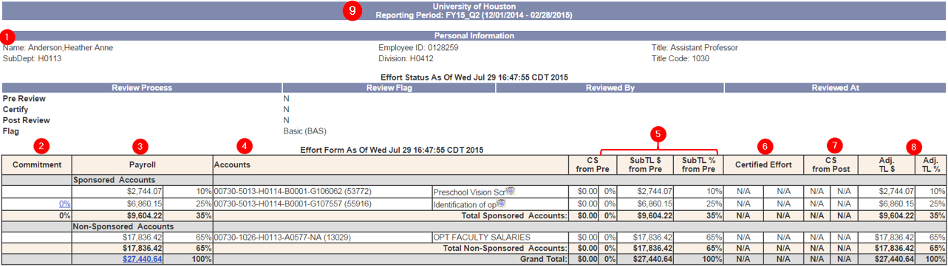
MAXIMUS Effort Reports
Employee Information: Demographics on the employee e.g. Name/EMPL/Title/Department
Commitment: Cost Share and Committed Direct Charges are group together under this column
Payroll: Payroll from PeopleSoft only on viewable effort forms (not on the print out of the effort form)
Accounts: List of all accounts for the PI’s only, even if payroll was not charged.
Cost Share: Changes to effort percentages on the form are updates to cost share.
Certified Effort: Percentage and dollar value the PI certified too
Post Review Information: Changes to the effort form after the form was certified by the PI and adjusted by Post-Reviewer
Adjustments: any adjustments to the original form
Effort Report Information: Shows the reporting period for the effort form
Notes:
2. The importance of updating RD2K with the commitments to reflect on the effort forms
4. Non-PI’s who do not direct charge a sponsored award will not have an effort form
5. If the employee has to report cost share, the percentage and dollar value of the cost share is shown here. If changes to effort percentages directly charged to the award need to be made, department must submit a cost transfer and wait for it to post before the form is Pre-Reviewed
6.

Slide 19
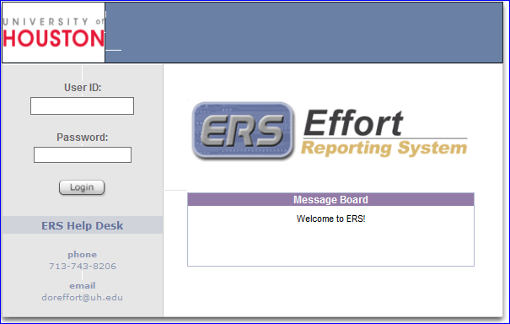
Effort Reporting System (the online process...)
What to do and Who to Contact:
EFFORT REPORTING SYSTEM (ERS)
Log on: Use your CougarNet ID and Password
Click on the number “Status/My To-Do” box
Click on the individual (s) listed as requiring certification to view the effort form
Review the form to confirm the % of effort contributed to each project
If correct click the certify button. If incorrect, contact your DBA
To print a summary of the report, click on the printer icon located in the upper right hand corner of the effort form
* For more information send inquires to OCG at doreffort@uh.edu or review the policy and procedures via Effort Reporting Website

