Slide 1

Global Card Management System (GCMS)
GCMS Training for Business Contacts

Slide 2
Training Topics
Access to GCMS
Reviewing transactions
Entering account codes/cost centers
Splitting transactions
Printing Expense Reports

Slide 3
Access to GCMS
How to gain GCMS Access

Slide 4
Steps for GCMS Access
Access to GCMS will come from
Taking the current fiscal year training of SFxx03
CDA approval
Once you have taken the business office training and have CDA approval, Accounts Payable will set up your access.

Slide 5
Logging on
Link to GCMS….
https://www.globalmanagement.citidirect.com
For Local Funds Access, your username will be your last name, first name initial underscore LF. Example : smithj_LF
For State Funds Access, your username will be your last name, first name initial underscore SF. Example : smithj_SF
A temporary password will be emailed to you via MasterCard/Citibank
If you are ever locked out of your account, email Accounts Payable; the password reset on Citibank’s website does not reset your password

Slide 6
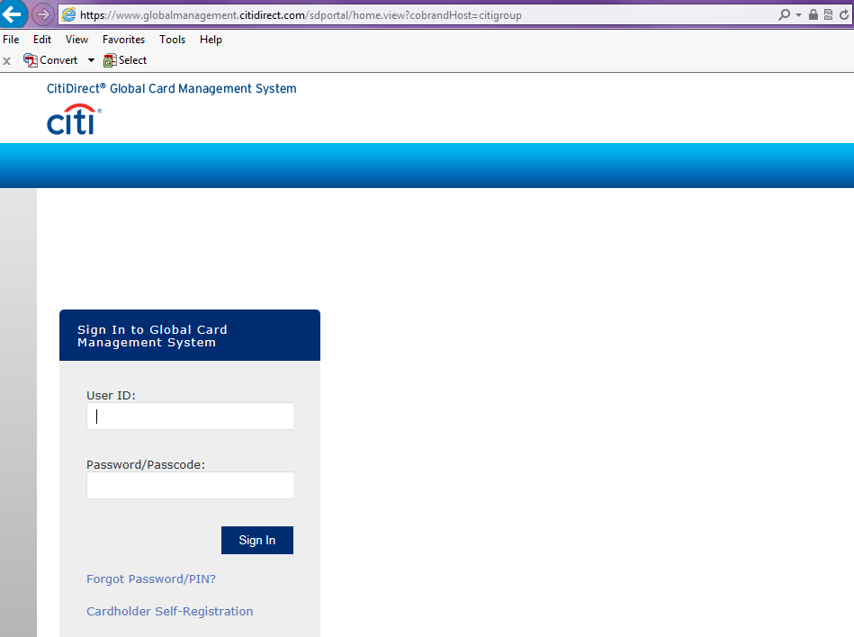
Log on Screen

Slide 7
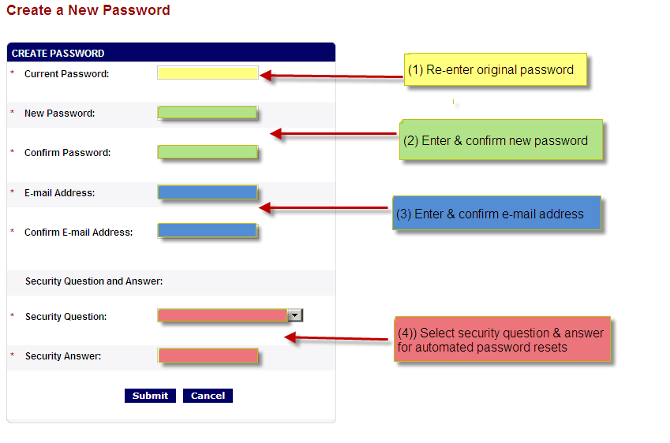
Creating a new password

Slide 8
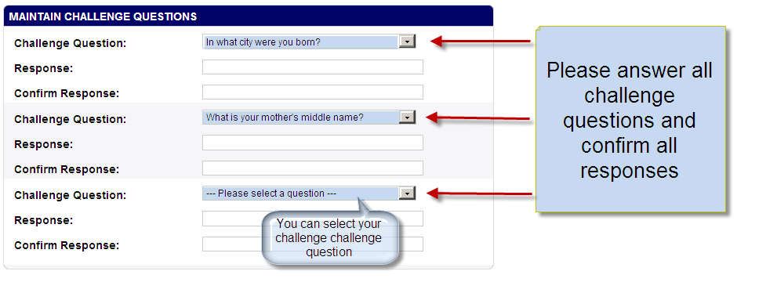
Select Challenge Questions

Slide 9
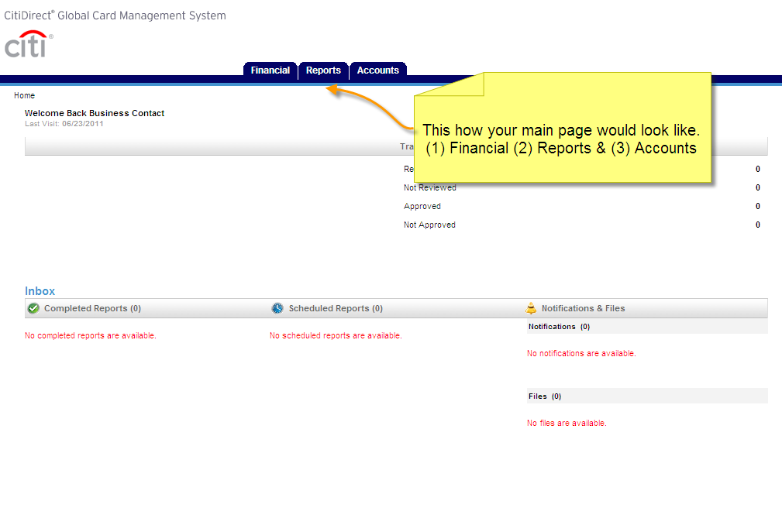
GCMS Home Page

Slide 10
Financial, Reports, & Accounts Tab
Under the Financial Tab, you will be able to search transactions from previous billing cycles and the current open one.
Under the Reports Tab, you will be able to run and print previous billing cycle reports and the current open one.
Under the Accounts Tab, you will be able to select the p-cards you have access to and then view the previous or current billing cycle activities for one p-card or all of them.

Slide 11
Reviewing Transactions
How to view transactions you have access to

Slide 12
Steps to review transactions
Select Financial
Select Account Summary
Search Cardholder
Select Reporting Cycle
Select Search
GCMS will show your transactions for the selected reporting cycle only

Slide 13
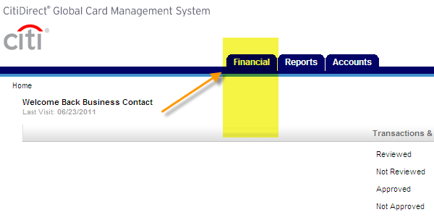
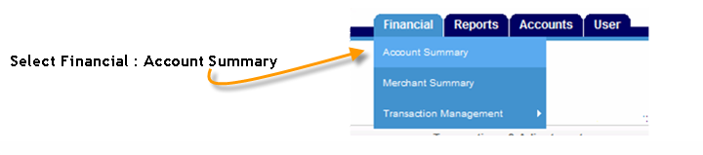
Select the Financial tab and click on Account Summary

Slide 14
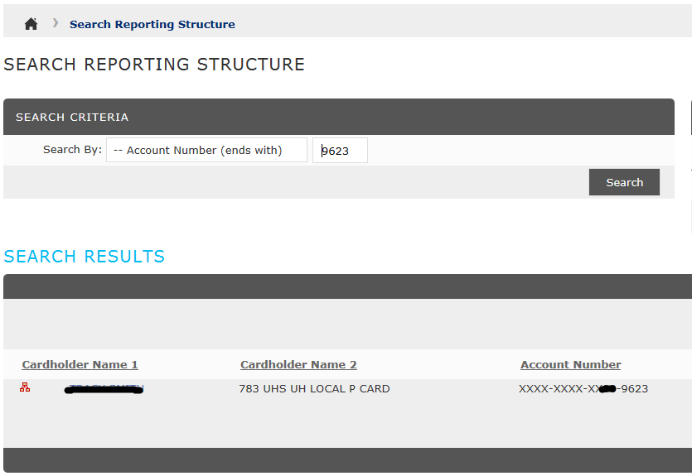
Search for Cardholder by account number ends with and enter in the last 4 digits

Slide 15
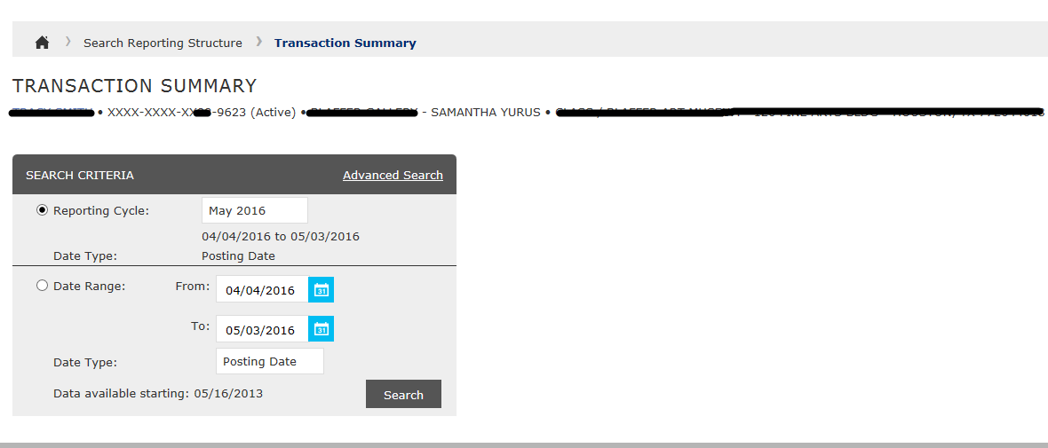
Select Reporting Cycle and click on Search

Slide 16
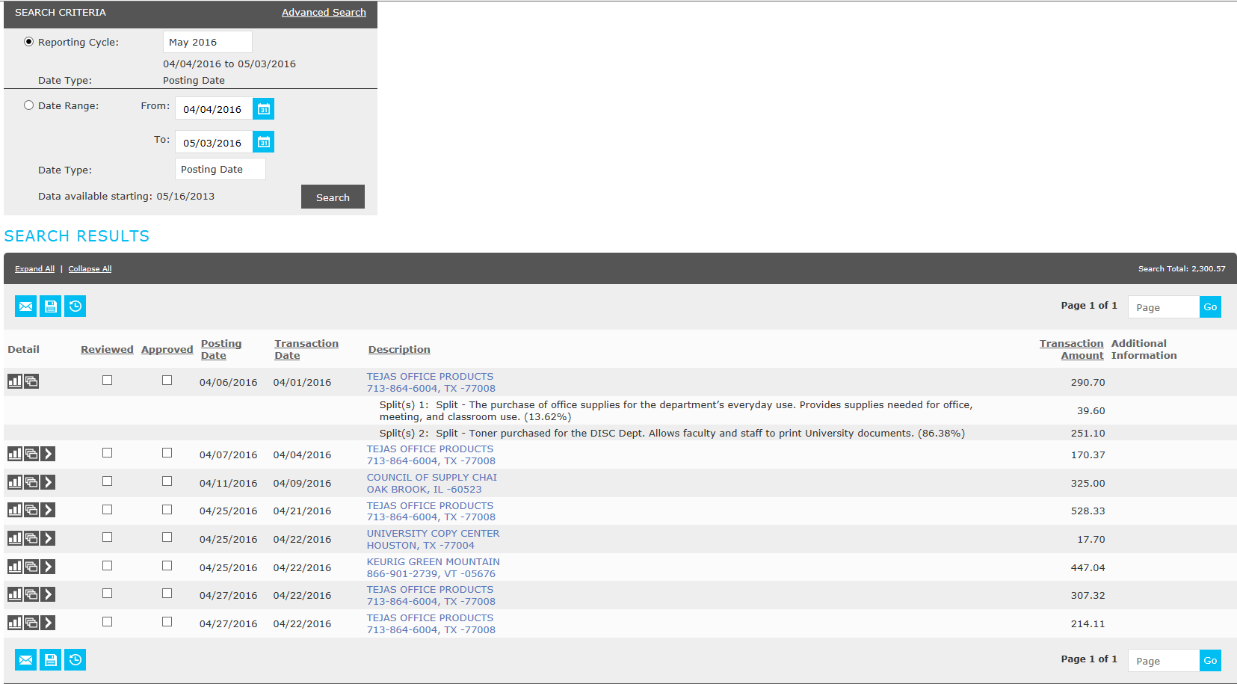
Transaction Summary

Slide 17
Entering in Account Codes
How to enter in account codes and cost centers

Slide 18
Entering in Data
The following is needed for each transaction:
Purpose and benefit
Account code
Cost center
The default cost center will automatically populate for each transaction, however, if you do not want to charge the transaction to the default cost center, you will need to enter in a different cost center.

Slide 19
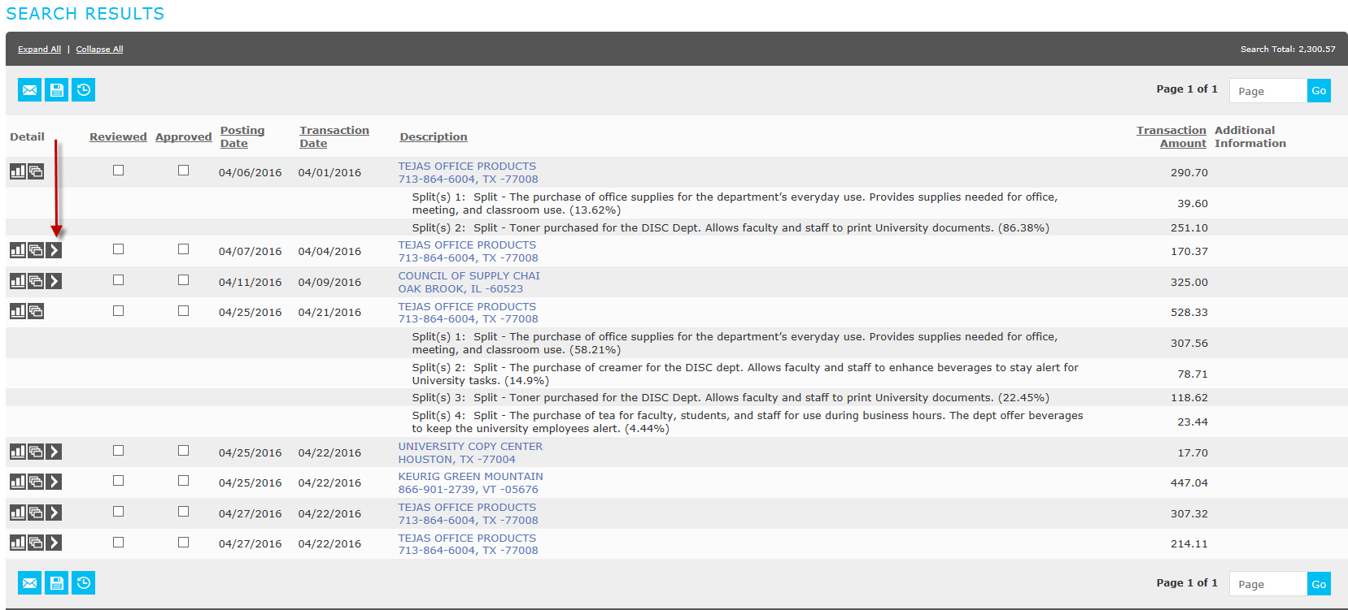
Select the icon that resembles an arrow

Slide 20
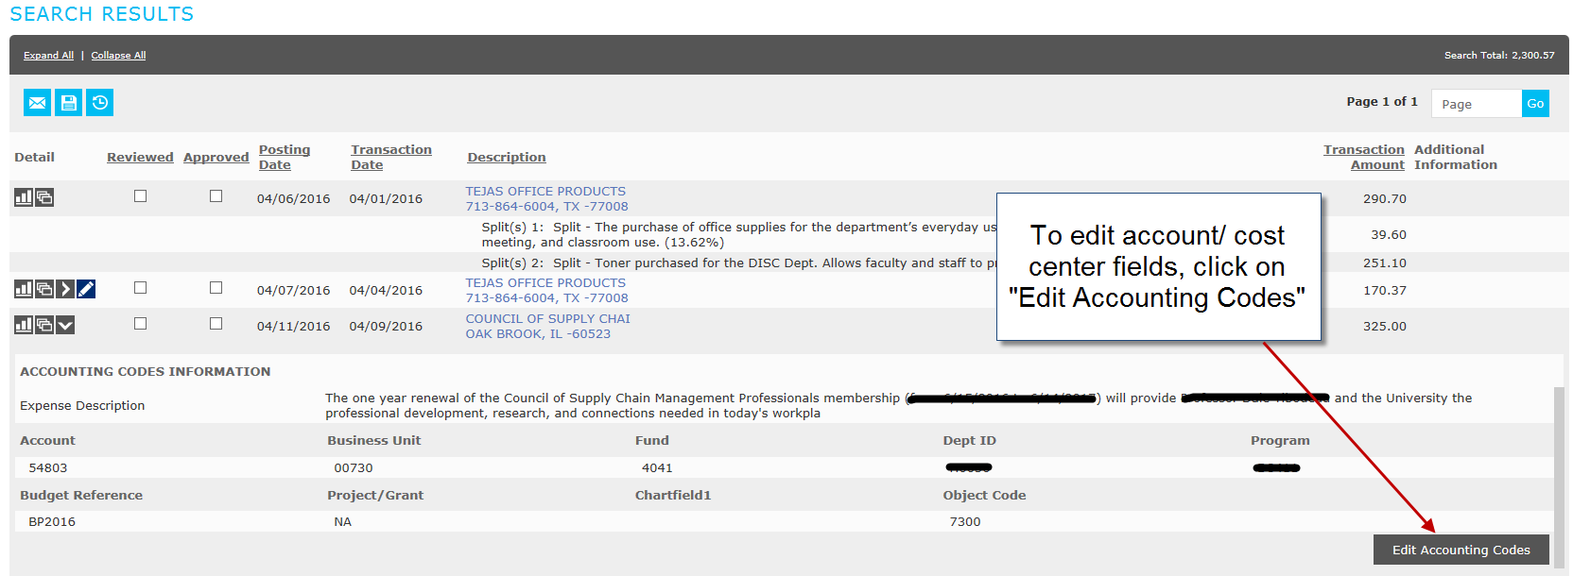
How to edit transactions

Slide 21
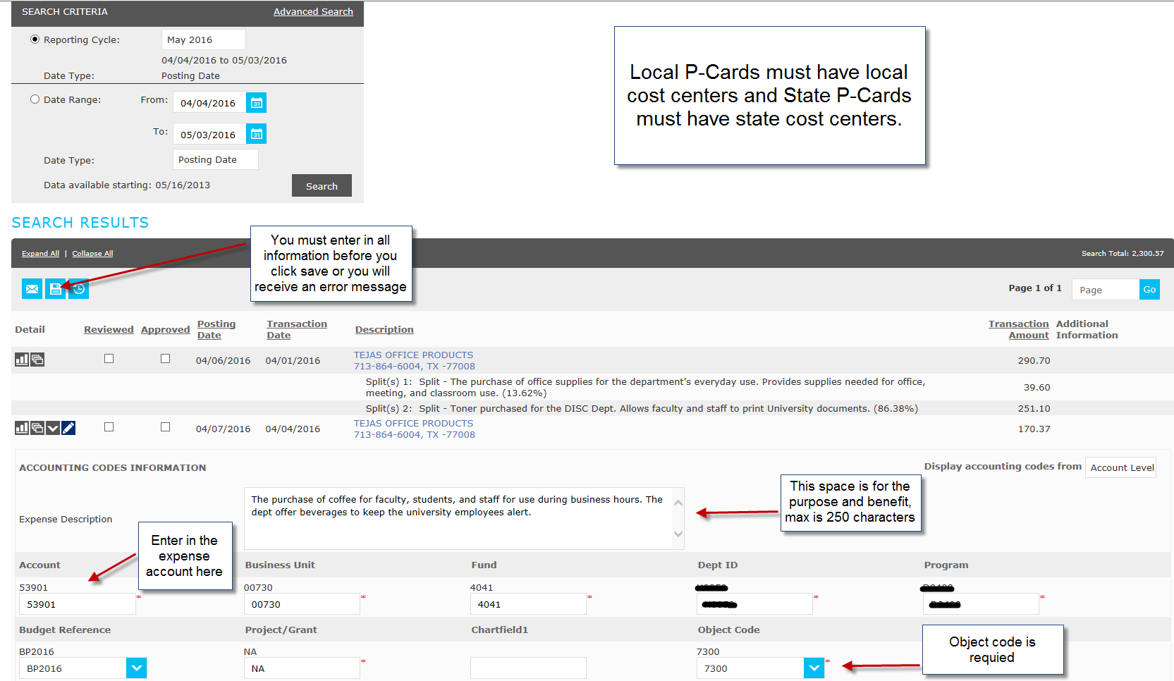

Slide 22
Splitting Transactions
How to split a transaction

Slide 23
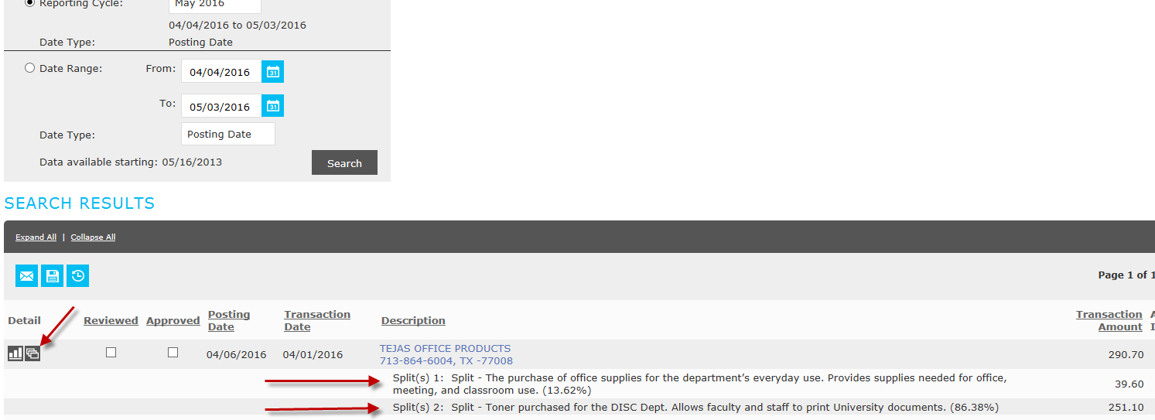
To split a transaction select the symbol that resembles three documents that overlap each other

Slide 24
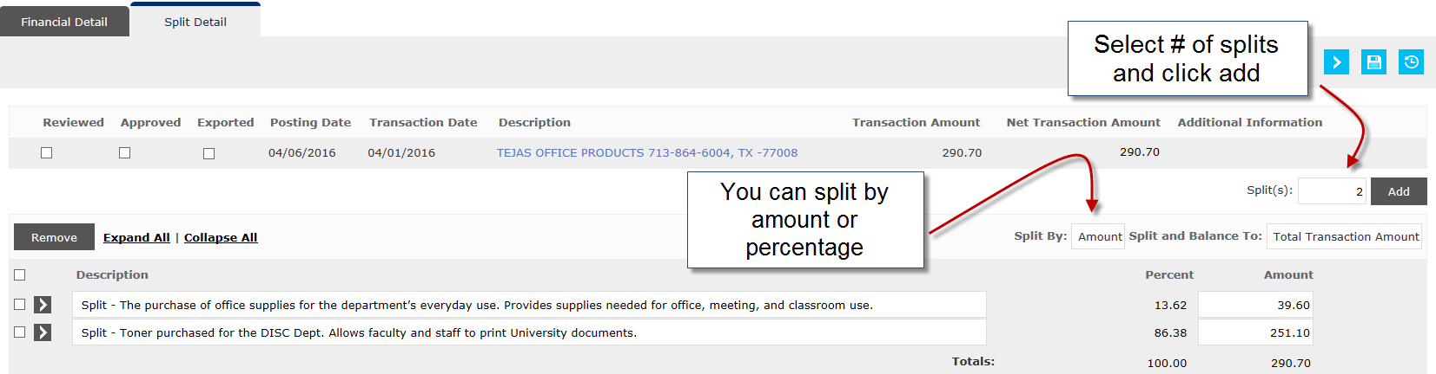
Options when splitting a transactions

Slide 25
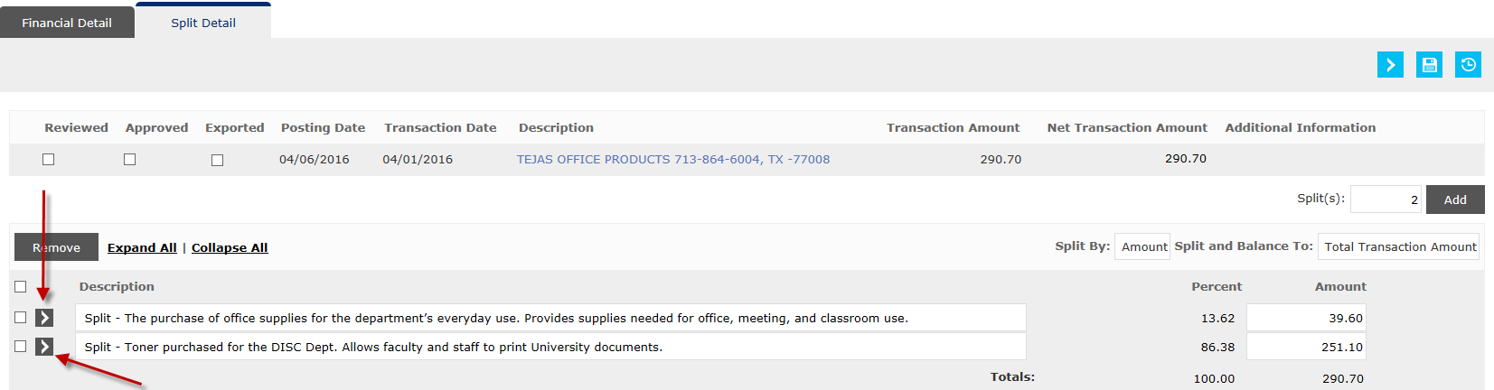
To edit a split click on the arrow button

Slide 26
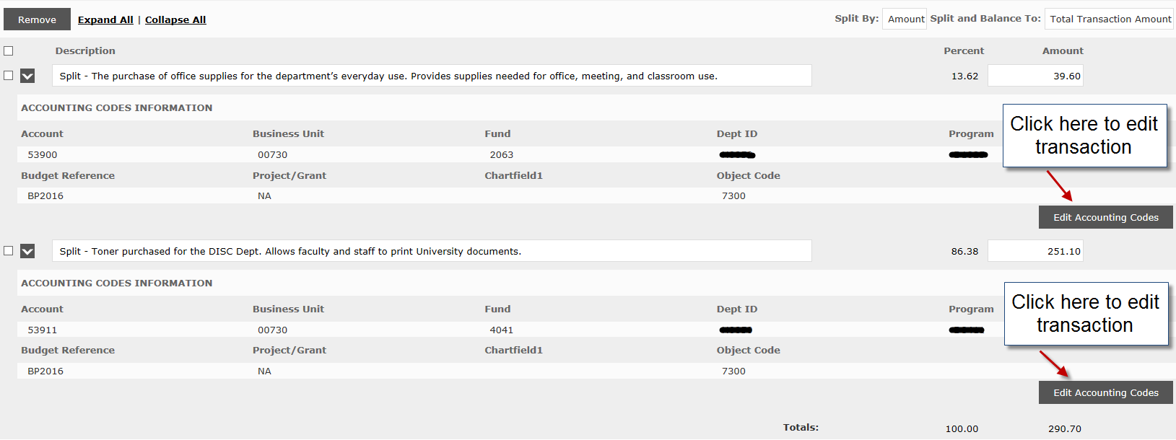
Split function is used to pay for a transaction using multiple cost centers

Slide 27
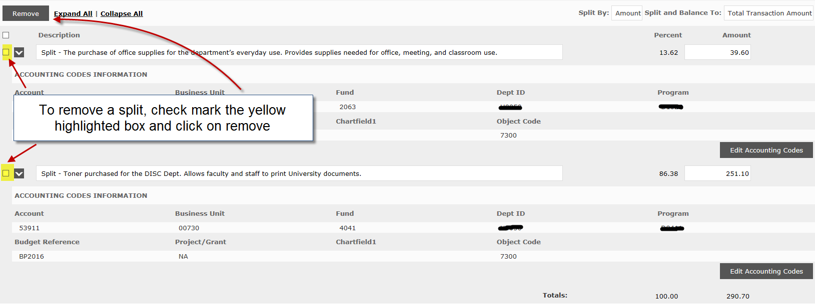
To remove a split….

Slide 28
Printing the Expense Report
Steps to print an expense report

Slide 29
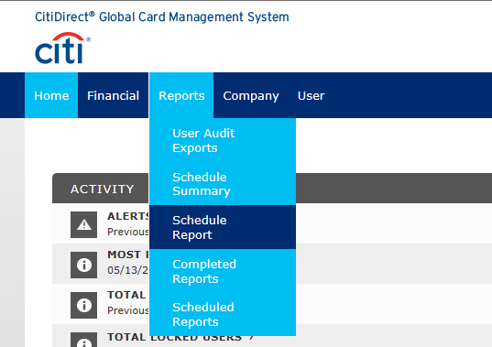
Under the Reports Tab, select Schedule Report

Slide 30
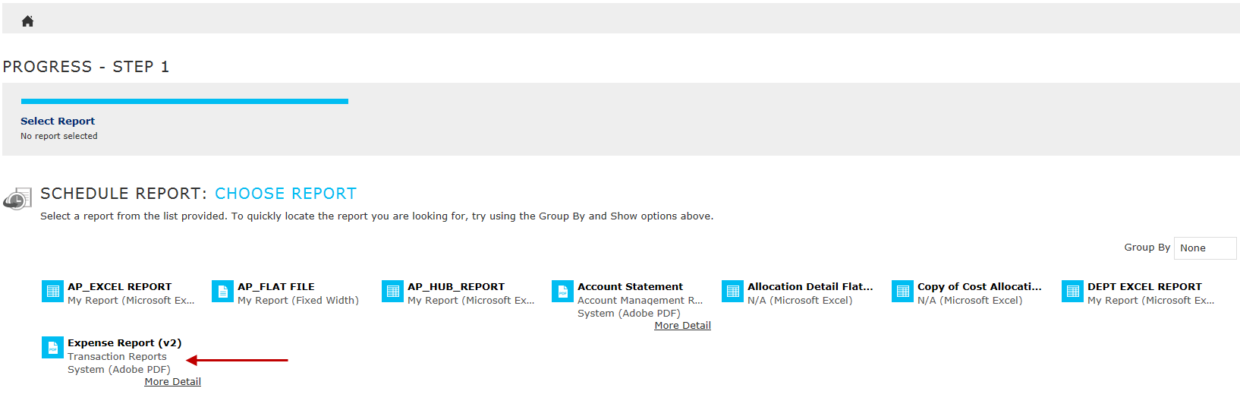
Next select “Expense Report (v2)”

Slide 31
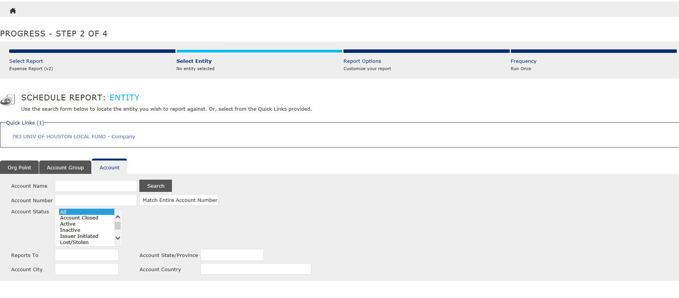
Here you can click on your name or search by the last 4 digits of the P-Card

Slide 32
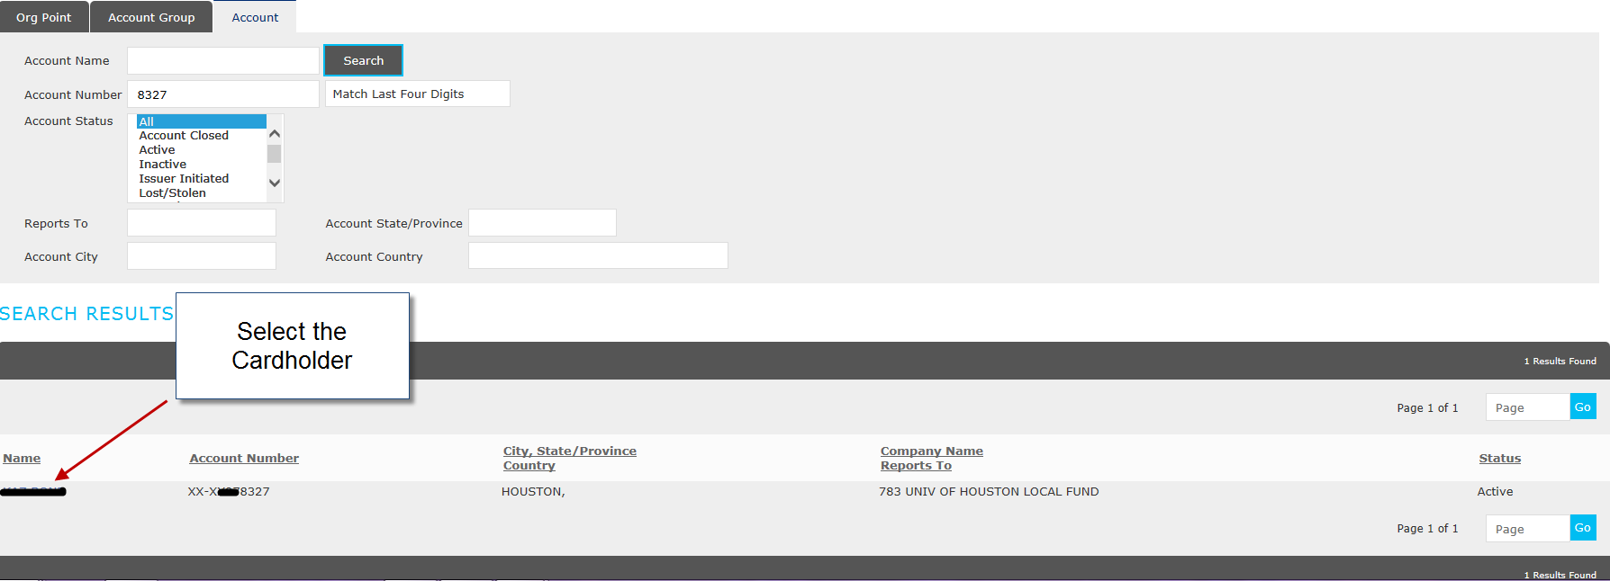

Slide 33
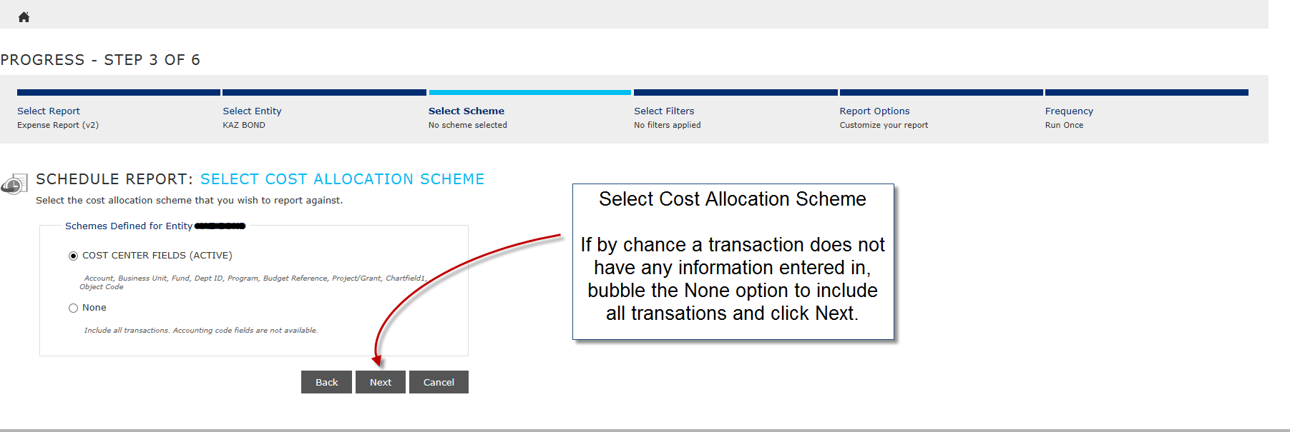
Report Options/Filters

Slide 34
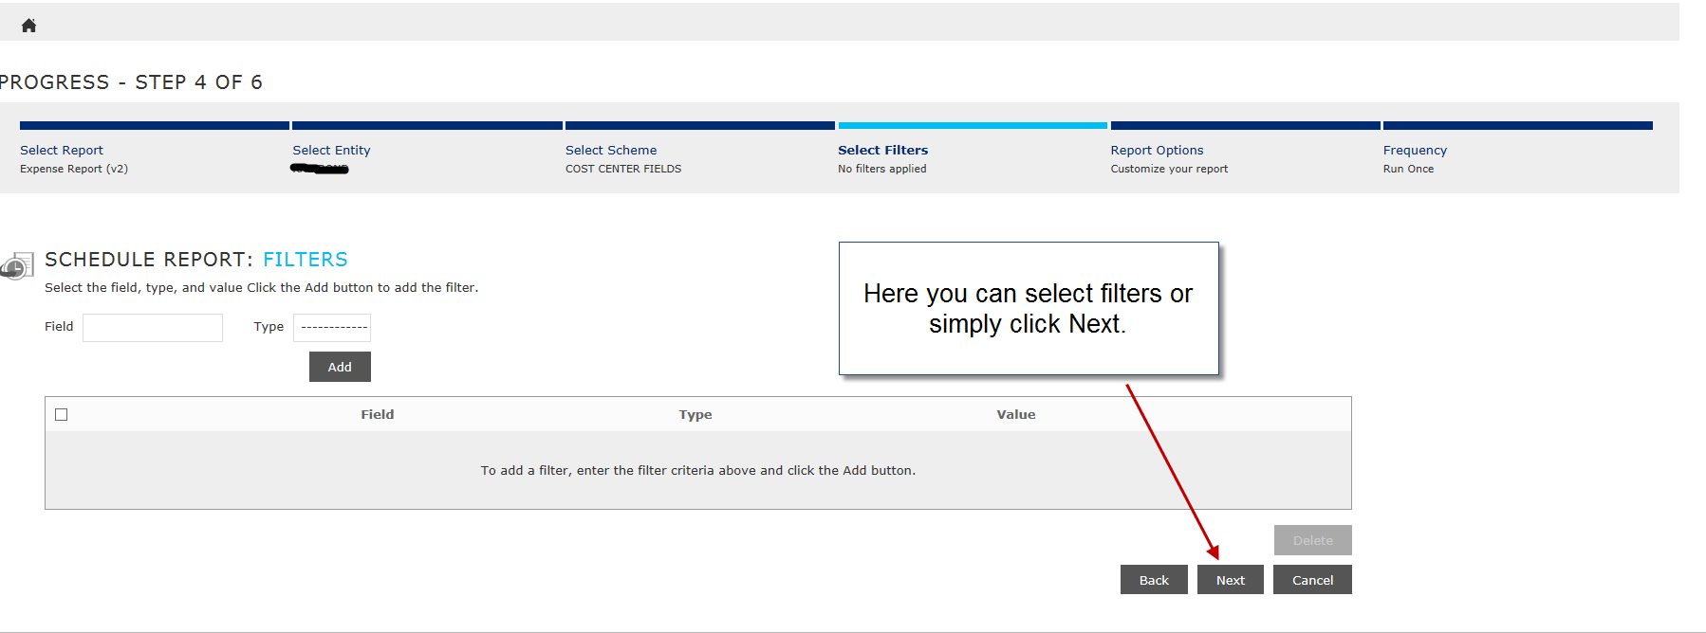
Report Options/Filters

Slide 35
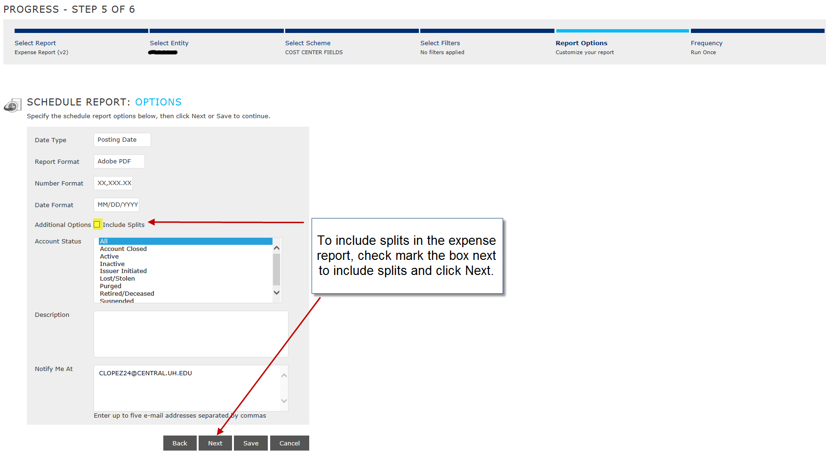
Report Options/Filters

Slide 36
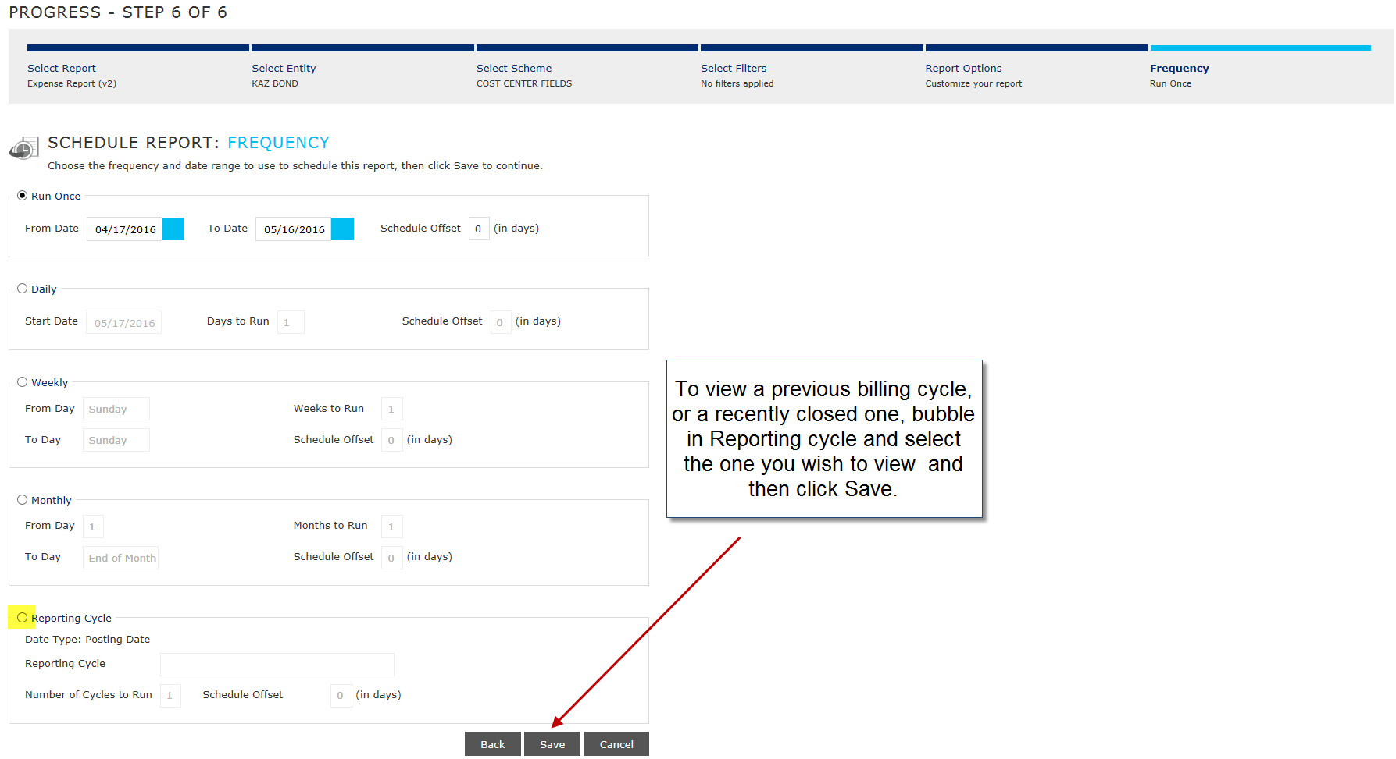
Select Reporting Cycle

Slide 37
Tips for selecting the Reporting Cycle
The billing cycle closes on the 3rd of every month. You should wait 3 full business days before running the report to make sure all of your transaction get posted.
If you wish to view transactions in an open cycle, you would select the “Run Once” option and specify dates.
If you select the 4th of last month until today, the report will run and be available the next business day.
Make sure to select the 4th of last month until yesterday.

Slide 38
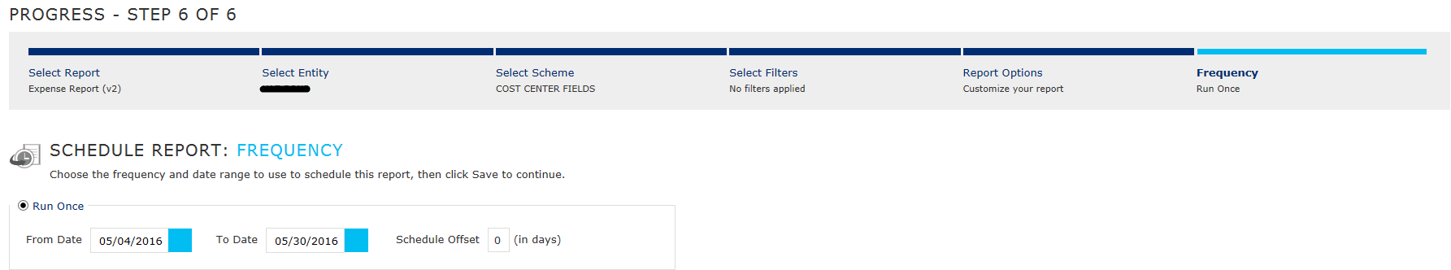
Run Once Option
Example: today is 5/31/2016; Currently we are in the open June billing cycle.
If you wish to view transactions from May 4th until today, select “Run Once” and specify the dates below as 5/4/2016 until 5/30/2016. This report will run and be available to view today.
If you had entered in 5/31/2016 as the “To Date”, that report will run and be available the next business day.

Slide 39
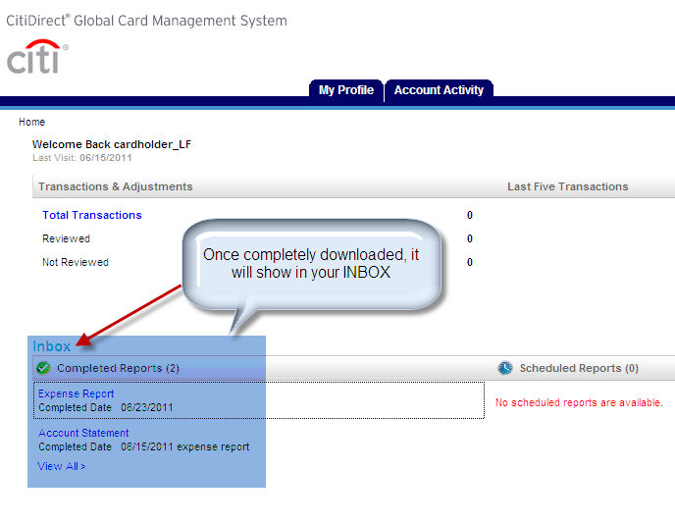
Expense Reports in your Inbox

Slide 40
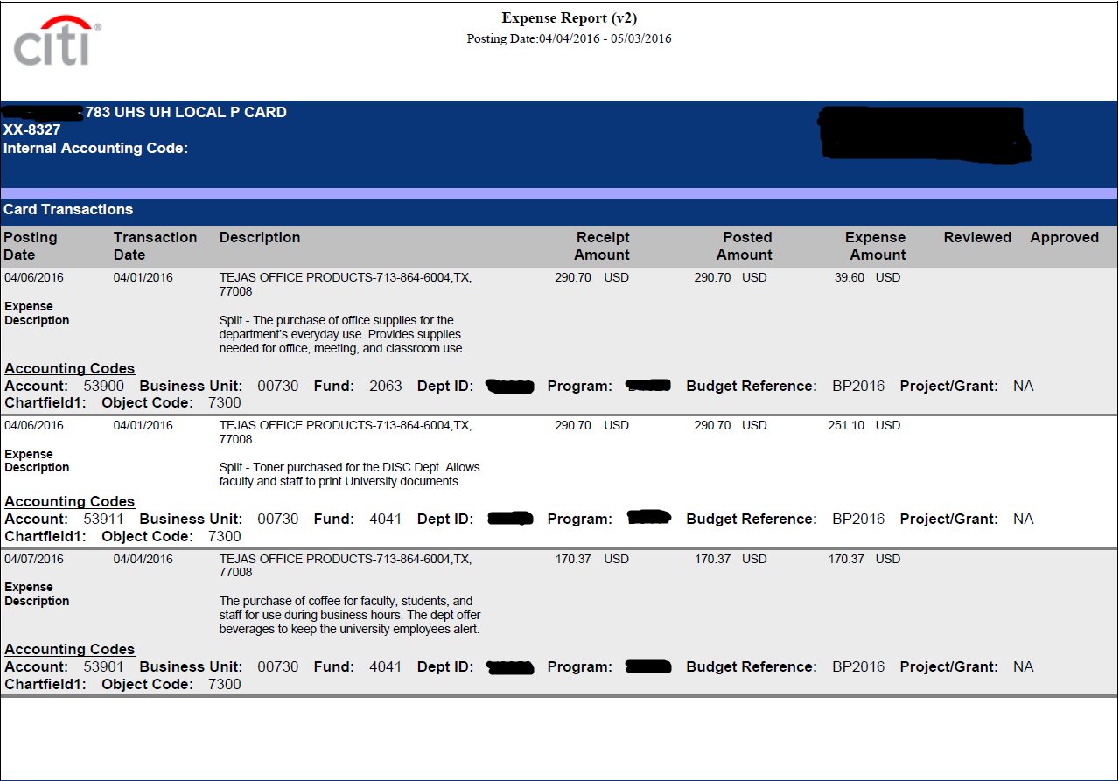

Slide 41
P-Card Contacts
Cassandra Lopez, A/P Manager
713-743-5660, clopez24@central.uh.edu
Teresa McComb, Program Administrator
713-743-8700, tlmccomb@central.uh.edu

