Slide 1

University of Houston
Property Custodian Online Training
Notes:
Welcome to Property Custodian Training for Fiscal Year twenty fifteen

Slide 2
Objectives
To understand the duties and responsibilities assigned to departmental property custodians and gain overview of property management.
Notes:
The objective of this training is to acquaint Property Custodians with the duties and responsibilities of that role, and to gain an overview of property management.

Slide 3
Topics
Who is Responsible?
Who are the departmental Property Custodians?
What are my responsibilities if I am assigned as the Property Custodian?
Why property management is important?
What are capital and non-capital assets?
How should I keep track, maintain, and/or dispose of university property?
Whom should I contact for more guidance?
Notes:
Topics that will be covered are:
Who is Responsible?
Who are the departmental Property Custodians?
What are my responsibilities if I am assigned as the Property Custodian?
Why property management is important?
What are capital and non-capital assets?
How should I keep track, maintain, and/or dispose of university property?
Whom should I contact for more guidance?

Slide 4
Who is Responsible for University Assets ?
Everybody
Head of the Agency/Institution
Chief Financial Officer
Property Manager
Departmental Property Custodian
Agency/Institution Employee
Notes:
Everyone is responsible for safeguarding the assets of the institution, from the Agency head to each employee.
Some of the reasons that assets must be safeguarded are:
The University receives state funding as well as funding from donors, including both gifts and sponsored research. The University has a fiscal responsibility to tax-payers and donors to ensure that we utilize their resources as efficiently as possible.
As a state agency, the university is required to conduct an annual physical inventory. The results of this inventory are submitted to the State of Texas Comptroller’s Office. That office reviews the losses from missing and stolen items. If missing and stolen items exceeds the allowable tolerance level, the university could suffer a loss in state funding.

Slide 5
Who are the Departmental Property Custodians?
The property custodian is the person who has been designated to be a departmental Property Custodian in charge of a department’s assets.
Notes:
The Departmental Property custodian role is defined by MAP zero three zero three zero one and SAM zero three E zero two and in the Property Management Handbook as the individual in a department who is charged with the safekeeping of capital and controlled property in the department’s possession, including tagging assets, submitting annual off-campus forms, and conducting the annual inventory.

Slide 6
Property Custodian Responsibilities
What are my responsibilities if I am assigned as the Property Custodian?
Notes:
What are the responsibilities of a Departmental Property Custodian?

Slide 7
Property Custodian Responsibilities
The Property Custodian is specifically responsible for the management and control of University property within the department, ensuring that:
Fixed assets are reported to Property Management.
Property is used for University purposes only
Property is not loaned, exchanged, discarded, or removed without approval of Property Management.
Property is not defaced or damaged in any way
Property is not returned to a vendor as a trade-in without approval of the Property Management.
Notes:
Departmental Property Custodians are responsible to help ensure that:
Capital and controlled assets obtained through means other than purchase are reported to Property Management.
Property is only used for University business purposes.
Property is not loaned, exchanged, discarded, or removed without approval from Property Management.
Property is not defaced or damaged.
Property is not returned to vendors for trade-in without approval from Property Management.

Slide 8
Property Custodian Responsibilities
Obsolete and surplus property is turned in to Property Management for appropriate disposal or redistribution
Equipment is used for its intended purpose by properly trained personnel
Property within the department is tagged as required and listed on the department’s property inventory record
Annual physical inventory is conducted in a timely manner
Notes:
Obsolete and surplus property is turned in to Property Management for disposal or redistribution to other campus departments.
Equipment is used for its intended purpose, by employees with appropriate training.
Departmental property has asset tags affixed, and is listed in the Departmental Property Listing.
Annual physical inventory is conducted in a timely manner and submitted by scheduled due dates.

Slide 9

Designed Property Custodian Form
Notes:
The Departmental Property Custodian must be designated each fiscal year.

Slide 10
Property Custodian Forms
Form PRP-6A, Designation of Property Custodian, is due at the start of each fiscal year.
Form PRP-6B, Change of Property Custodian, is required whenever there is a change of Property Custodian during the year. Submit this form as soon as the Property Custodian changes.
Conduct a full physical inventory when the custodian changes
Notes:
Form P R P 6 A is used to annually designate the Departmental Property Custodian.
Form P R P 6 A is due at the start of each fiscal year.
Form P R P 6 A enumerates the responsibilities of the Departmental Property Custodian.
Form P R P 6 B is used to document changes in the Departmental Property Custodian that occur during the fiscal year.
Form P R P 6 B is due whenever the Departmental Property Custodian changes.
A full physical inventory should be conducted when the Departmental Property Custodian changes.
Form P R P 6 B also enumerates the responsibilities of the Departmental Property Custodian.

Slide 11
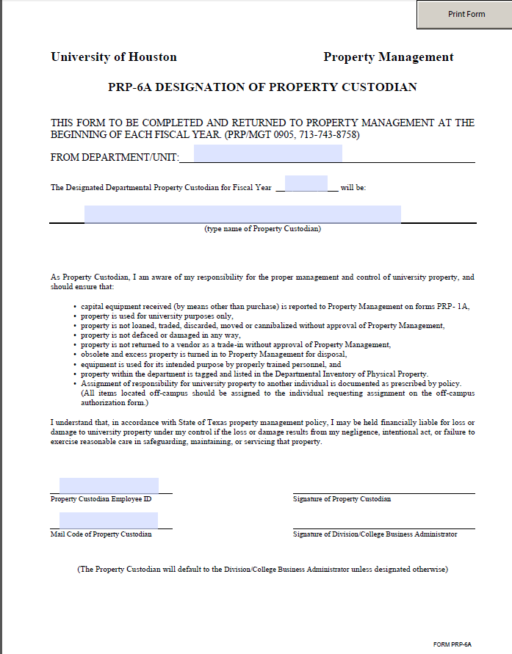
PRP-6A
Complete and submit the Form PRP 6-A, Designation of Property Custodian at the start of each fiscal year.
Notes:
Form P R P 6 A enumerates the responsibilities of the Departmental Property Custodian, including ensuring that:
Capital equipment received is reported to Property Management
Property is used for university purposes only
Property is not loaned, traded, discarded, moved, or cannibalized without the approval of Property Management
Property is not defaced or damaged
Property is not returned to a vendor for trade in without the approval of Property Management
Obsolete and excess property is turned in to Property Management for disposal
Equipment is used for its intended purpose by properly trained personnel
Property within the department is tagged and listed in the Departmental Inventory
Equipment located off-campus is assigned to an individual and that assignment is documented on an off-campus form that is submitted to Property Management for approval

Slide 12
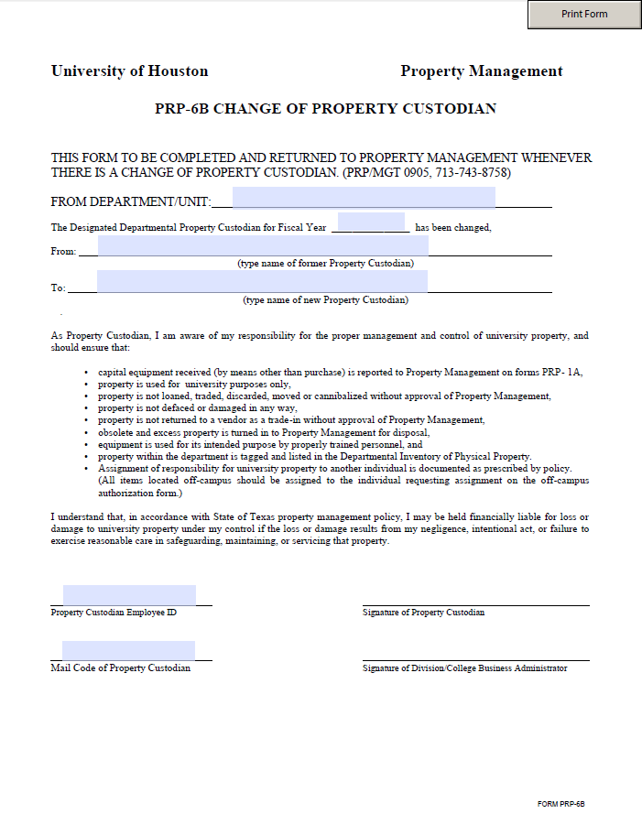
PRP-6B
Form PRP-6B, Change of Property Custodian, is required whenever there is a change of Property Custodian during the year.
Notes:
Form P R P 6 B is used to document changes in the Departmental Property Custodian that occur during the fiscal year.
Form P R P 6 B is due whenever the Departmental Property Custodian changes.
Form P R P 6 B also enumerates the responsibilities of the Departmental Property Custodian.

Slide 13

Why is Property Management important?
Notes:
Why is it important to manage the University’s property?

Slide 14
As an agency of the State of Texas, the University follows the procedures set forth by the State and applicable University of Houston System Administrative Memoranda.
The University is responsible for proper record maintenance and safekeeping of the state and federal property in its possession.
This helps to ensure that the University:
  Is in compliance with State Guidelines
  Is in compliance with Federal Guidelines, particularly those related to sponsored research
  Maintains accurate and timely records
  Maximizes the use of resources
  Has proper stewardship of assets and supplies
Notes:
Compliance:
The University is a Texas state agency, and must comply with the guidelines of the State including meeting maximum thresholds for missing, stolen, and lost items and meeting requirements for the destruction of data processing equipment.
The University of Houston System provides guidelines for the management of capital and controlled assets.
The University receives federal funding for sponsored projects. In addition to general federal guidelines for asset management, many projects come with guidelines for the use and retention of capital and controlled assets.
Accountability
The University must be accountable to donors and other sources of capital and controlled assets .
This requires that we demonstrate proper stewardship of assets and supplies.
Maximization of Resources
Proper management of capital and controlled assets can help to eliminate duplicate purchases and allow the redistribution of useable items, both of which allow funds to be used for other purposes.

Slide 15
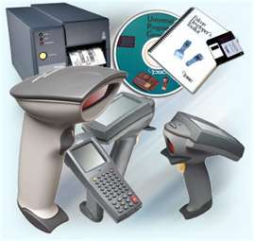
Capital vs. Controlled Assets?
Notes:
What are Capital and Controlled Assets?

Slide 16
Capital assets
Real or Personal Property that have a single unit value of $5,000 or greater and an estimated useful life of more than one year. Generally, a capital asset must be self-contained for its primary use and have sufficient size to make its control feasible by means of marking with identification numbers and/or manufacturer’s serial numbers. These assets are reported in the University’s annual financial report.
Controlled assets
Assets that the State Comptroller’s office determines must be secured and tracked due to the nature of the items, with a cost between $500 and $ 4,999.99 and an estimated useful life of more than one year. These assets are classified as expendable and are not listed in the University’s annual financial report. For a listing of controlled assets, refer to the Most Commonly Used People Soft Account for Recording Capital and Controlled Asset Expenses.
Notes:
A Capital Asset is either Real or Personal Property with an estimated useful life of one year or more and a value equal to or exceeding the minimum threshold defined by the State for that asset type. Generally, a capital asset must be self-contained for its primary use and have sufficient size to make its control feasible by means of marking with identification numbers and or manufacturer’s serial numbers. These assets are reported in the University’s annual financial report.
State controlled assets are items that do not meet the capitalization threshold for the general class of assets, but must be secured and tracked due to their high risk nature. Controlled assets are tagged and maintained in the same manner as capital assets. These assets are classified as expendable and are not listed in the University’s annual financial report.

Slide 17
Most Commonly Used PeopleSoft Accounts for Recording Capital and Controlled Asset Expenses
If you are looking for a General Ledger Expense account when purchasing capital, controlled, or non-controlled assets, the list of Most Commonly Used PeopleSoft Accounts for Recording Capital and Controlled Asset Expenses is available on the Property Management Website at the link below:
http://www.uh.edu/finance/pages/PM_Website.htm
Notes:
If you are looking for a General Ledger Expense account when purchasing capital, controlled, or non-controlled assets, the Account List is available on the Finance Web page.

Slide 18
Looking for an Expense Account
State Controlled and Capitalized Equipment
Property Management Accounts
 |  | STATE
ACCOUNT | BRIEF DESCRIPTION | CONTROLLED | CAPITALIZED
*State Controlled Equipment $500.00 - $4,999.99 per unit
54354 | Firearms (all); TVs, Cameras, Camcorders, VCRs, Stereo Systems, Data Projectors $500-$4,999.99 per unit and useful life of 1 year or more | X
54355 | Desktop, Laptop, Smartphones, Tablets, and Other Handheld Devices $500-$4,999.99 per unit and useful life of 1 year or more | X
Capitalized Equipment $5,000.00 - more per unit
58600 | Motor Vehicles $5,000 or more per unit and useful life 1 year or more |  | X
58601 | Furnishings/Equipment $5,000 or more per unit and useful life 1 year or more |  | X
58602 | Computer Equipment $5,000 or more per unit and useful life 1 year or more |  | X
58603 | Telecom Equipment $5,000 or more per unit and useful life 1 year or more |  | X
58604 | Software $100,000 or more per unit and useful life 1 year or more |  | X
58605 | Fabricated Equip (component parts, materials) total $5,000 or more and useful life 1 year or more |  | X
58607 | Boats/Marine Equipment $5,000 or more per unit and useful life 1 year or more |  | X
58610 | Computer Operating Systems $100,000 or more per unit and useful life 1 year or more |  | X
58611 | Database Software $100,000 or more per unit and useful life 1 year or more |  | X
58615 | Airplanes or aircraft costing $5,000.00 or more per unit and useful life 1 year or more. |  | X
CAPITALIZED AT ANY COST
58606 | Sculpture, Painting, Other Fine Art with useful life 1 year or more |  | CONTACT PROPERTY MANAGEMENT BEFORE USE
58900 | LIBRARY USE ONLY- Books permanently retained |  | LIBRARY USE ONLY
58901 | LIBRARY USE ONLY- Journals, Serials, and Other Periodicals permanently retained |  | LIBRARY USE ONLY
58902 | LIBRARY USE ONLY- Binding and Prep Cost for permanently retained publications |  | LIBRARY USE ONLY
58903 | LIBRARY USE ONLY- Film or Microfilm Library |  | LIBRARY USE ONLY
58904 | LIBRARY USE ONLY- Electronic Library |  | LIBRARY USE ONLY
Notes:
Accounts are broken into controlled and capital activities. This list is a summary of the most commonly used accounts for capital and controlled equipment and their minimum threshold as well as classification. This list is available on the Property Management website.

Slide 19
Common Misconceptions in Selecting Accounts for Assets
Unit Cost vs. Total cost
If more than one unit is purchased, consider the unit cost when selecting the account, not the total cost of all of the units combined.
Computer Equipment vs. Computer Accessories
Use account 54355 for computers and printers with a cost between $500 to $4,999.99 per unit.
Use account 54358 for computer accessories (e.g., monitor, mouse, keyboard, etc.) purchased separately from the computer.
Notes:
Some tips to help in account selection are:
When determining whether to use a capital or controlled account, it is the unit cost that determines whether the item meets the threshold. If the pricing was for multiple units, divide the total price by the number of units.
Computer equipment can be capital or controlled, computer accessories are always non-controlled or expensed.
Account 5 4 3 5 5 is used for computers and printers with a cost between $500 and $4,999.99 per unit.
Account 5 4 3 5 8 is used for computer accessories such as monitors, mice, and keyboards that are purchased separately from the computer.
If computer accessories are included in the price of the computer, include them with the computer’s capitalization.

Slide 20

How to properly track, maintain, or dispose of university property?
Notes:
How should I properly keep track, maintain, or dispose of university property?

Slide 21
Tagging Assets
A property tag (paper tag printed with name of the institution, a barcode and 6-digit number) must be affixed to all tangible items that are – “Capital assets with a cost of $5,000 and greater” and “Controlled assets with a cost between $500-$4,999.99”.
Property Management personnel in the Property Management department will work with departmental property custodians to help ensure tags are affixed to purchased property.
Any capital property of fixed assets received as donations or gifts are also marked with the standard University of Houston property tag. Contact Property Management for guidance on these items.
Notes:
Asset tags are the primary means used to track University capital and controlled assets.
The University of Houston property tag is a paper tag that bears:
The name of the institution
A six digit tag number
A bar code that corresponds to the six digit number.
All capital and controlled assets, whether purchased or received as gifts, must bear the standard University of Houston property tag.

Slide 22
Tagging Assets
Certain items purchased from Dell are delivered to the University with a tag already affixed.
  Purchases must be made via the Dell Premier page, which can be accessed from the Purchasing Website (http://www.uh.edu/purchasing/) by clicking on the “Dell” logo.
  This login page is used to generate a quote. These quote are submitted to Purchasing with a Requisition for processing. Although the Requisition is not required to have the tag affixed, the Requisition process is how the University obtains HUB credit for the purchase.
Property Management receives a list of these tags to update the Asset Management system.
Notes:
Items purchased from Dell via the University’s Dell Premier page will be delivered with a tag already affixed.
The premier page can be accessed via the Purchasing Department’s website.
These purchases should be processed via a Purchase Requisition, as this is how the University obtains HUB credit.
Dell submits a list of tag numbers and basic item descriptions to Property Management. The department ID in the cost center used to purchase the item is used to identify the custodian and owner department.

Slide 23
Annual Inventory
The University is required by state statute to conduct an annual inventory of all capital and controlled assets on campus.
48 scanners are available for check out each week, the department Property Custodian can contact Property Management to check out a scanner by providing the following information: your name, department ID(s) of inventory to be scanned, email address for scan results, and requested pick up date.
To reserve a scanner, send an email to mpnguye@Central.uh.edu with your name, department ID, email address to be used, and preferred scanner pick-up date.
After you have reserved a scanner, you will receive an e-mail confirming your scanner pick up date. The Departmental Inventory Listing will be sent to the e-mail address specified on the reservation along with detailed instructions prior to the initiation of the required annual property inventory.
Notes:
State statutes require that all state agencies conduct a physical inventory of all capital and controlled assets once per fiscal year.
Each year, Property Management will identify inventory time frames and the Property Custodian will be notified of: the start of physical inventory, when bar code readers can be reserved to conduct their departmental inventory, and applicable annual deadlines for completion of the annual inventory.
Each week, Property Management makes approximately 48 scanners available for check out. Reservations are made on a first come, first served basis. Please schedule your scanner for check-out as soon as possible.
To reserve a scanner for the inventory, contact Michelle Nguyen at the listed email address.
Provide:
Your name,
The Department ID for which you will be conducting inventory,
The email address where you would like scanner results sent
The date you would like to pick up the scanner
The Departmental Inventory Listing will be sent to the person once a scanner is reserved. The report contains the list of assets and locations assigned to the department, to assist the needed to perform a physical inventory process.

Slide 24
Annual Inventory
After the scanner is returned, Property Management extracts the scanned inventory report from the scanner. Once scanned inventory files are uploaded to PeopleSoft Asset Management, Property Management personnel will generate an inventory report for the Department and the inventory reports will be emailed to the department Property Custodian.
This report has six sections:
  Inventory Scanned List
  Off-Campus List
  Previous Missing List
  Inventory Not Scanned List
  Scanned by List
  Disposed Items List
The same due date for submitting inventories conducted with scanners provided by Property Management apply to inventories conducted with scanners owned by campus departments.
Notes:
Property Management uses the scanner to update the Asset Management System and generate an inventory report that identifies:
Items scanned that are on the department inventory listing
Items that are off-campus and are not scanned, but for which an off-campus form is needed
Items that were previously reported as missing but have been scanned, so that the department can confirm that these items should be returned to in-service status
Items not scanned that are on the department inventory, so that they may be located
Items scanned that belong to other campus departments, so that the department may identify whether these were scanned in error or submit transfer forms
Items that were previously reported as disposed but have been scanned, so that the department can confirm that these items should be returned to in-service status
Deadlines apply to inventories conducted with scanners owned by campus departments as well as to those conducted with scanners owned by the Property Management.
Departments that own scanners can contact Property Management to schedule an appointment to bring their scanners over for data extraction.

Slide 25
Inventory Confirmation
PRP-9 Form
Once the final Scanned Inventory is completed and all related forms are received (Missing/Stolen, Transfers, updated Off-Campus Equipment forms), Property Management will send the department the final Property Listing along with the form PRP-9
Departments complete Form PRP-9, Inventory Confirmation and submit to Property Management.
  This form requires the signature of the Property Custodian, the Department Manager/Director, or the appropriate Division Supervisor.
  This form is due to Property Management within 30 days of the Annual Inventory due date.
  For a detailing of Annual Physical Inventory processes, refer to UH Property Management Guidelines
Notes:
Form P R P nine is used to confirm the inventory submitted via scanner.
This form cannot be completed until the scanned inventory is turned in with all items identified as verified, reported as Missing or Stolen, reported as transferred to another department with complete transfer paperwork, and updated off-campus forms are received.
Once Property Management has received all documentation that the physical inventory is complete, they will forward a Final Property Listing to the Departmental Property Custodian. At that time, the Departmental Property Custodian will prepare the Form P R P nine, the Inventory Confirmation Form.
Form P R P nine is due back to Property Management within 30 days of the department’s receipt of the Final Property Listing.

Slide 26
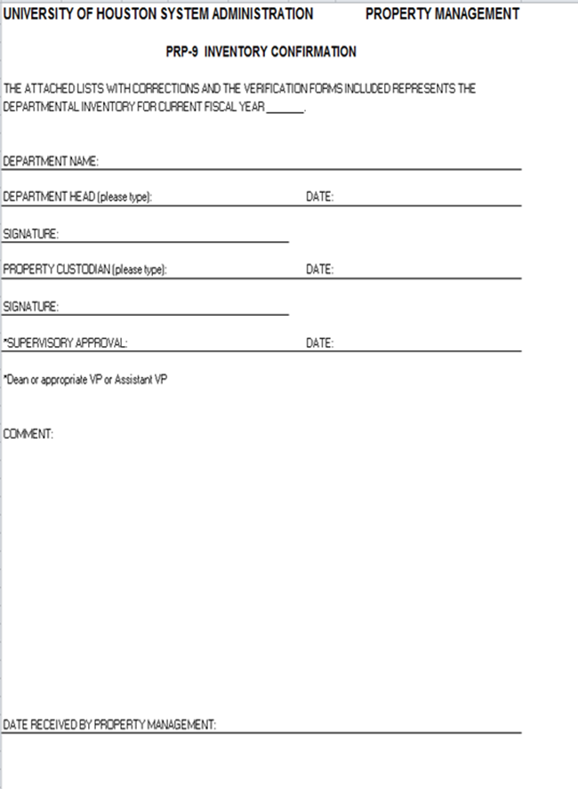
Inventory Confirmation
Form PRP-9
Complete Form PRP-9 when the final, completed Departmental Inventory Report is received from Property Management.
Obtain all required signatures.
Submit to Property Management within 30 days of the annual inventory completion date.
Notes:
This is form P R P nine, used for Inventory Confirmation

Slide 27
Departmental Audit
Each year, after all inventories are complete, 15 departments are randomly selected for inventory verification audits.
Once the department is selected, Property Management will contact your department to schedule the verification.
Inventory audit verification includes confirming the location and existence of a sample of departmental assets to the most recently submitted inventory report.
For a detailing of Annual Physical Inventory processes, refer to UH Property Management Guidelines at http://www.uh.edu/finance/pages/PM_Website.htm
Notes:
To help ensure the accuracy of the physical inventory, Property Management conducts inventory verification audits of fifteen campus departments.
Property Management selects the fifteen departments using a random number selection method. Once the department is selected, Property Management selects between two and ten assets per Department to re-verify.
If your department is selected, Property Management will contact you to schedule a time to view and confirm the asset’s existence and location.

Slide 28

Scanners
Notes:
The use of Inventory Scanners is required for all departmental inventories.

Slide 29
Scanners
All training on how to use the scanner is conducted one on one at the time of pick up
Scanners can be picked up after 9:00 AM on Mondays
Scanners are due by 12:00 noon on Friday of the same week
Scanner batteries will last for approximately five days if the scanner is turned off when not in use
Scanners are not available for weekend use
Notes:
The scanners are relatively easy to use.
Each department will receive a short walk-through of how to use the scanner when they pick up the scanner from Property Management. Please send the person who will be using the scanner to receive the training.
Scanners can be picked up after nine a m Mondays and are due back to Property Management by noon on Fridays.
Scanner batteries will last for approximately 5 days if the scanner is turned off when not in use. Due to the risk of loosing data due to battery drain, all scanners must be returned to Property Management within 5 days. This means that scanners cannot be checked out over the weekend.

Slide 30
Scanners
If you experience any problems with the scanners, contact Langston Royster at x3-8760 for technical assistance
If a scanner is not functioning properly, please notify Langston before or when the scanner is returned to Property Management
Notes:
If you check out a scanner and it is not working properly, please contact Property Management immediately. They will attempt to troubleshoot the problem as quickly as possible.
If you notice that a scanner is functioning but experiencing signs of bugs or failures, please notify Property Management when you return the scanner for the week. This will allow them to have the scanner checked.

Slide 31
Scanner Tips
Carry scanners in the bags provided by Property Management.
One of the most common scanner problems is when the scanner does not read the location tags in the doorways. This can occur because the ink has dried out or the tag is damaged. Contact Property Management to obtain new doorway location tags.
Location and equipment tag numbers can be keyed directly into the scanner.
If location or equipment tags are missing or the scanner is not reading them, submit a request for replacement tags to Property Management.
Scan everything with a property tag. You do not have to scan the serial number tag, only property tags
Turn the scanner off when you are done scanning to conserve the battery
Notes:
Scanners should always be carried in the bags provided by Property Management.
Some of the most common scanner problems are:
The scanner will not read the location tags located in door frames. This occurs when the ink on the tag has dried out or the tag ha been damaged. If a department experiences this issue, they can:
Key location and tag numbers directly into the scanner
Request replacement tags from Property Management
Equipment tags are damaged
The user attempts to use the scanner to read other bar codes, not just those for UH Asset Tags
Please remember to turn off the scanner when it is not in use to conserve the battery. Failure to do so can result in lost data.

Slide 32

Property Management Forms
Notes:
What are the Property Management Forms?

Slide 33
Departmental Asset Transfers – PRP-1A
Form PRP-1A is used for transfers from one campus department to another campus department. Form PRP-1A is completed and approved via email as follows:
When a tagged item is to be transferred, the sending custodian will fill out the form, including the tag number and serial number. This form is emailed to the Property Management department. If a work order is required for moving the items, include a copy of the completed work order.
Property Management will respond via email with “Approved” or “Rejected”.
The sending custodian will print a copy of the approved PRP-1A and attach it on to the tagged item to be moved.
Note: No tagged item can be moved until both the sending custodian and Property Management have approved the transfer and a copy is attached to the item.
Notes:
When capital and controlled assets are transferred from one campus department to another, Form P R P one A is used.
Form P R P one A can be submitted and approved by email.
Form P R P one A is submitted as follows:
Form is completed by the sending department, including obtaining the approval of the recipient department.
Form is emailed to Property Management, with a copy of any work orders required to move the assets.
Property Management responds with approval or denial due to a need for additional information or asset restrictions.
If the asset to be moved requires a work order, attach the approved P R P one A to the asset for Facilities personnel.
If the asset to be moved does not require a work order, retain a copy of the approved P R P one A until the completion of the next annual physical inventory.
Forward a copy of the completed P R P one A to the recipient department.

Slide 34
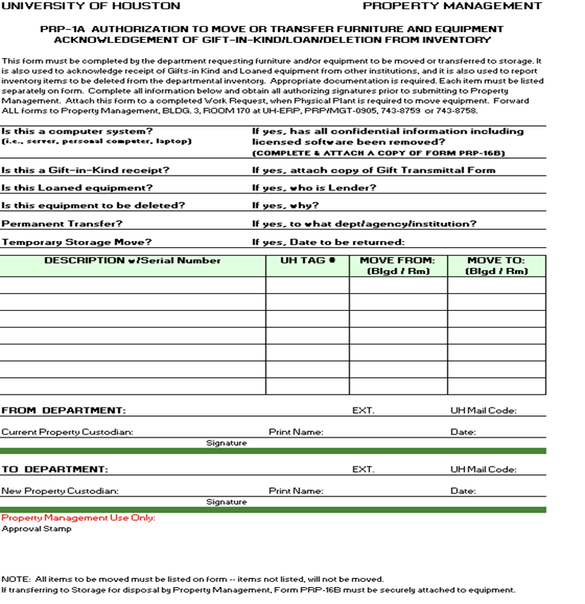
Form PRP-1A
Complete Form PRP 1-A for transfers between departments. If a work order for moving services is required, attach a copy of the completed work order. Submit to Property Management by email.
Notes:
This is Form P R P one A used for Departmental Asset Transfers

Slide 35
Surplus Warehouse Asset Transfers
Form PRP-1B
Form PRP 1-B is used for transfers to the Surplus Property Warehouse.
An overview of this process is as follows:
  Department completes the forms listed below, providing information on the assets to be transferred, the cost center to be used for the work order, and contact information.
    Form PRP 1-B, Surplus Property Transfer Request Form
    Surplus Transfer Property List
    Lab Equipment Safety Form (if required)
    Form PRP 16-B, if data processing equipment is being transferred
  Property Management requests a work order for moving services and submits to the Facilities Service Center.
  If the transfer includes a Lab Equipment Safety Form, this form is submitted to Environmental Health and Safety.
Notes:
When capital and controlled assets are transferred from a campus department to the Surplus Property Warehouse, Form P R P one B is used.
Form P R P one B can be submitted and approved by email.
Form P R P one B is submitted as follows:
Form is completed by the sending department, including attaching other required information such as the Surplus Transfer Property List, Form P R P sixteen B for data processing or storage equipment, and the Lab Equipment Safety Form if required.
Form is emailed to Property Management.
Property Management will request a work order for moving services. Work orders will be charged to the departmental cost center designated when requesting the transfer.
If the transfer is for laboratory or other potentially hazardous materials, Property Management will submit the Lab Equipment Safety Form to Environmental Health and Safety for their review. No potentially hazardous items can be moved without the approval of E H S.

Slide 36
Surplus Warehouse Asset Transfers
Form PRP-1B
Overview, continued
  Facilities Management Labor Shop will schedule the pick-up of items. If Environmental Health and Safety review is required, the pick-up will be scheduled after that review is completed.
  Property Management notifies the department of the scheduled pick-up time.
  Requests for changes in pick-up times should be submitted to the Property Management department for coordination.
  Facilities Management Labor Shop picks up the items on the scheduled date. Only items submitted on the Surplus Transfer Property List will be picked up.
  Property Management will update inventory records to reflect the transfer and provide the department with an updated inventory report.
Notes:
Once necessary approvals from Environmental Heath and Safety are obtained, or upon receipt of the work order request if no potentially hazardous items are being transferred, the Facilities Management Labor Shop schedules the pick-up of the items.
Property Management serves as the primary coordinator of the transfer of items to the Surplus Warehouse. They will contact the Labor Shop and the Department with notifications of scheduling needs and conflicts.
Once items are transferred to the Surplus Warehouse, Property Management will update inventory records to reflect the transfer and provide the department with an updated inventory report.

Slide 37
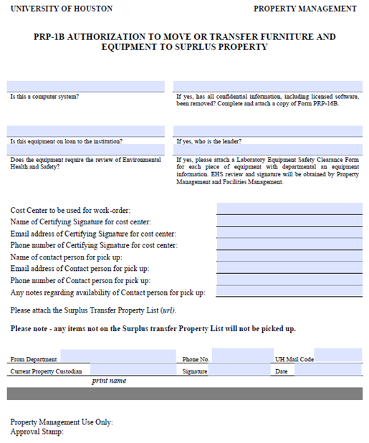
FORM PRP-1B
Complete Form PRP 1-B for transfers to the Surplus Warehouse. Submit by email with other required forms.
Notes:
This is form P R P one B, used for Authorization to Move or Transfer Furniture and Equipment to Surplus Property.

Slide 38
Surplus Warehouse Asset Transfers
Form PRP-16B
Items sent to the Surplus warehouse are disposed of as follows:
  All items are retained for a period of 1 – 2 months to allow other departments to request them. In the case of computers and peripherals, departments can also harvest useful items such as video or RAM cards.
  To help meet the requirements of Texas Administrative Code section 202.78, which requires that we remove all data from data processing equipment, all computing equipment is disposed of through a vendor that specializes in such items.
  Non-computing and peripheral equipment that is still in good condition is sent to auction.
  Items that are in poor condition are removed as heavy trash.
Notes:
Items sent to the Surplus warehouse are disposed of as follows:
All items are retained for a period of 1 – 2 months to allow other departments to request them. In the case of computers and peripherals, departments can also harvest useful items such as video or RAM cards.
To help meet the requirements of Texas Administrative Code section two zero two point seven eight, which requires that we remove all data from data processing equipment, all computing equipment is disposed of through a vendor that specializes in such items. They remove all hard drives and destroy them or destroy the data, remove all University of Houston identifying marks, and recycle all materials that can be reclaimed. The vendor also provides required reports to document the data destruction.
Non-computing and peripheral equipment that is still in good condition is sent to auction.
Items that are in poor condition are removed as heavy trash.

Slide 39
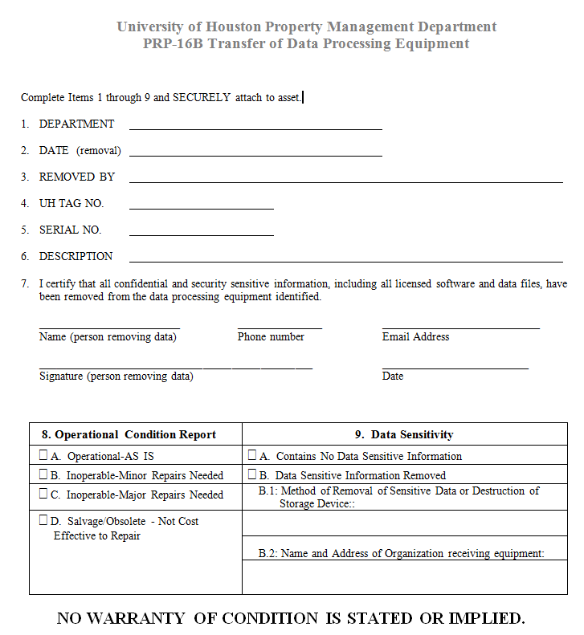
PRP-16B
Complete form PRP 16-B for transfers to the Surplus Warehouse, if any items being transferred are used for data storage or processing. Submit by email with other required forms.
Notes:
Form P R P sixteen B is used for the transfer of data storage and processing equipment. This form requires:
Property description, including tag and serial number
Information on whether the item contains sensitive materials
Information on whether sensitive materials have been removed from the item.
Information on who removed sensitive materials.
Property Management contracts with an external vendor to remove all data from data processing and storage equipment in accordance with Texas Administrative Code section two zero two. Data removal and destruction is done only for items removed from the university; it is not done for items that remain in the Surplus Warehouse which may be selected for use by other campus departments. As such, departments are encouraged to remove all sensitive information from data processing and storage equipment prior to its submission to the Surplus Warehouse.

Slide 40
Removing Property from Campus
Form PRP-2
Request for Authority to Remove Property From Campus and Verification of Property Return (commonly called Off-Campus Equipment), is used when property is to be utilized in a location other than the university campus.
Completed by: Departmental Property Custodians
When: Property will be located off campus and property is subsequently returned to campus
Send To: Property Management Department
Form PRP-2 Guidelines
  PRP-2 must be completed and all signatures obtained before property is removed off-campus
  Property may be removed from campus only when necessary to conduct University business.
  A new PRP-2 must be completed every fiscal year that the property is held off-campus.
  Any employee who has University property at an off-campus location is responsible for that property and should consider providing insurance coverage under his or her own personal property insurance.
  Forms are also submitted when off-campus items are returned
Notes:
Form P R P two is used to designated equipment as off-campus. The form can be used to designate equipment as off-campus through the end of the current fiscal year.
Property Custodians are responsible for submitting off-campus equipment forms, but should work with their departmental Business Personnel to complete and submit the forms.
when a department determines that equipment is going to be taken off-campus, all signatures must be obtained before any equipment leaves the university’s grounds.
The form must be completed each fiscal year to renew off-campus items.
Any employee who has University property at an off-campus location is responsible for that property and should consider providing insurance coverage under his or her own personal property insurance.
The same form is used when items are returned to campus.

Slide 41
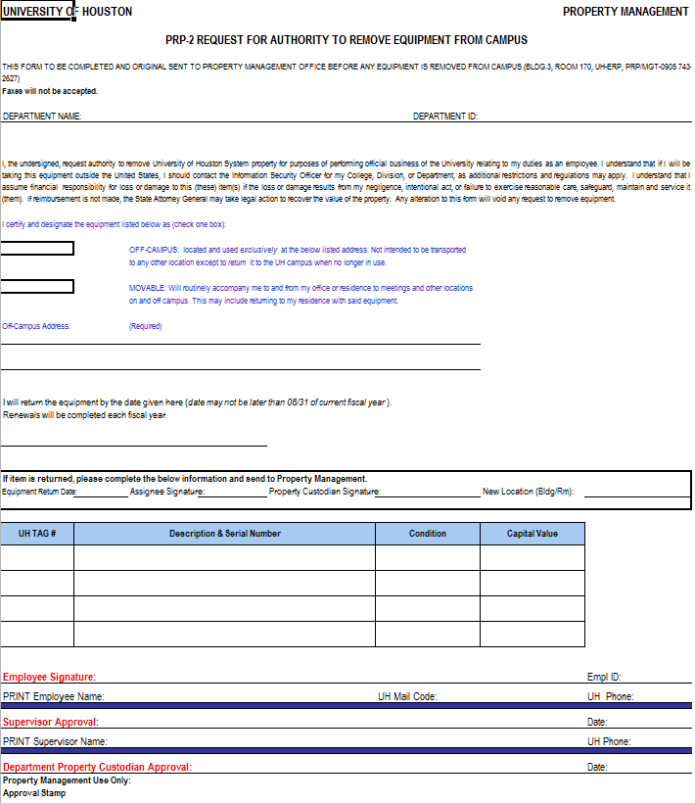
PRP-2 Form
Form PRP-2 must be fully completed to be approved.
Provide a valid off campus address, return date, tag number, and employee and property custodian signatures and Employee ID numbers.
Form are also submitted when off-campus items are returned.
Notes:
This is form P R P two, used for Requests for Authority to Remove Equipment from Campus.
Please provide a valid off-campus address, a return date that does not extend past the current fiscal year, and employee ID numbers of the property custodian and the employee responsible for the property.
All signatures must be obtained prior to submission.

Slide 42
Missing/Stolen Property
Property Management is required to report newly identified capital and controlled asset losses to the State Auditor’s Office each fiscal year. Missing and/or stolen property will continue to display on departmental property listings for three years; at the end of three years, the Property Manager may request that the asset be deleted.
Please consult Property Management if property is missing or believed to have been stolen. Contact the UH Police Department to report stolen property.
Missing/Stolen Forms
Comptroller Form 74-194, Missing, Damaged, or Stolen Property Report
  Required for the first report of missing/stolen property.
  Submit to Property Management with copy of Police Incident Report, if applicable.
Request for Authority to Remove Property From Departmental Inventory
  Required to have 3-year missing property removed from inventory records.
  Completed by Property Management.
Notes:
State regulations require Property Management to report the loss of capital and controlled assets each fiscal year. This report is of newly identified missing items, and is what the state uses to determine whether we have excessive missing, lost, or stolen items. The University uses Comptroller Form seven four dash one nine four to identify Missing and Stolen items.
When items are first determined to be missing or lost, please contact Property Management for assistance in completing the necessary forms. If items are believed to have been stolen, first contact the University Police Department then contact Property Management after the Police Incident Report has been obtained.
Although items are only reported to the State in the first year in which they cannot be found, the missing items will remain on the Departmental Property Listing for two years after the report is filed in compliance with the State of Texas Comptroller’s Policy. If the assets have not been located during the third year, Property Management dispose of the items in the property system.

Slide 43
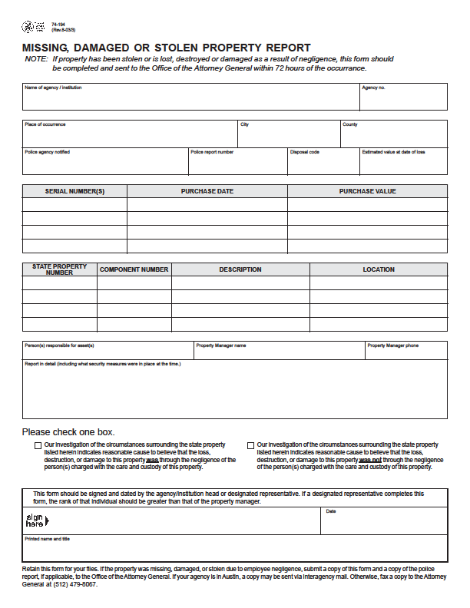
Missing, Damaged or Stolen Property Report
If the property was stolen provide the police report number and send a copy of the police report along with the form
Property custodian responsible for the item has to sign as well as the DBA, same person cannot sign twice.
Notes:
The Missing, Damaged, or Stolen Property report is a State form. This form should be completed by the Departmental Property Custodian, signed by the Department Business Administrator and submitted to Property Management. If a Police report was filed, please include a copy of the Police Incident Report with the form.

Slide 44
Property Management Forms
Link to Property Management forms can be found at: http://www.uh.edu/finance/pages/PM_Website.htm.
Notes:
Most forms are on the Property Management website

Slide 45

Whom should I contact for more guidance?
Notes:
How do you contact Property Management?

Slide 46
Property Management Team
Minhthu Pham – Property Manager
  Phone: 713-743-8757
  Email: Mpham@Central.UH.Edu
Victor Wongchukit – Assistant Property Manager
  Phone: 713-743-8758
  Email: Vwongchukit@Central.UH.Edu
Ana Chavez – Accountant II
  Phone: 713-743-2627
  Email: ARChavez@Central.UH.Edu
Langston Royster – Accountant II
  Phone: 713-743-8760
  Email: LFRoyster@Central.UH.edu
Raymon Matthews – Coordinator
  Phone: 713-743-8759
  Email: Rmatthews@Central.UH.edu
Michelle Nguyen – Accountant I
  Phone: 713-743-8749
  Email: mpnguye@uh.edu
Notes:
Property Management contact information is available on the Property Management website

