Slide 1
Game User Experience and Serious Game Research
DEPARTMENT OF COMPUTER SCIENCE
2013 FACULTY MINI-TALKS
Chang Yun
September 20, 2013

Slide 2

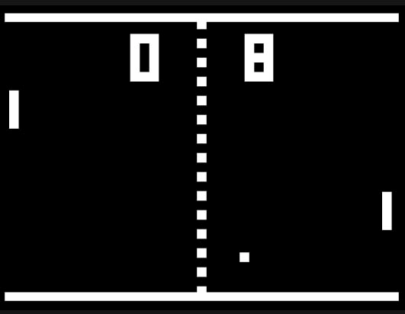
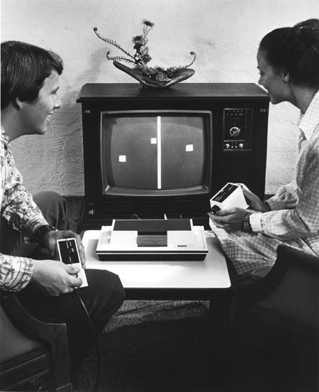
The “Pong” Game (circa 1972)

Slide 3





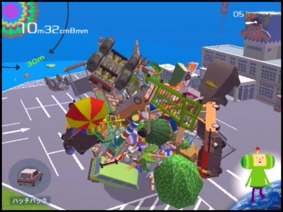
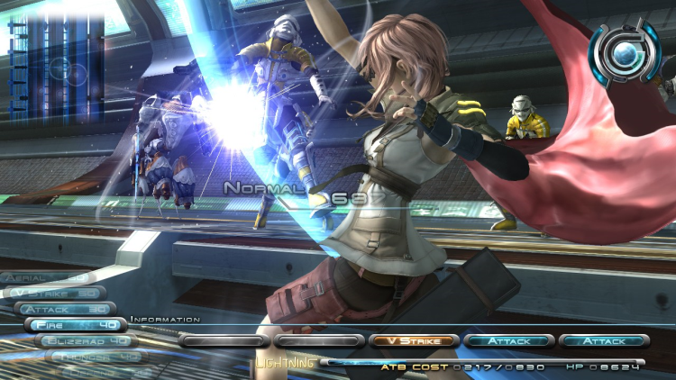

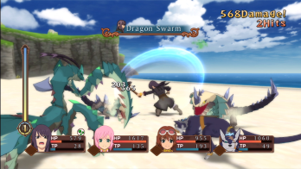
Modern Day Games
Madden 2013
Mass Effect 3
Forza Motorsport 4
Final Fantasy XIII

Slide 4
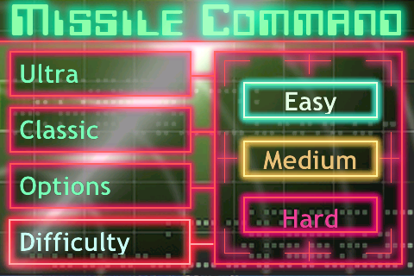
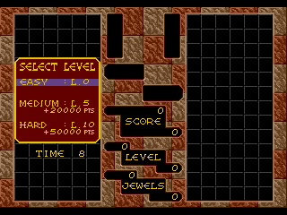
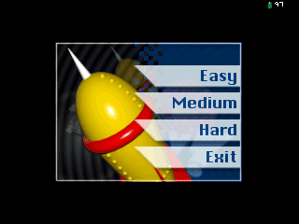
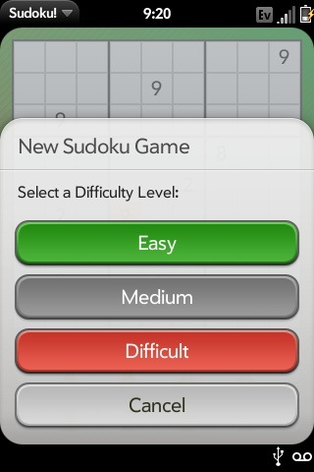
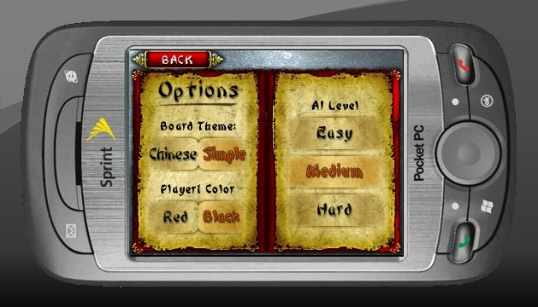
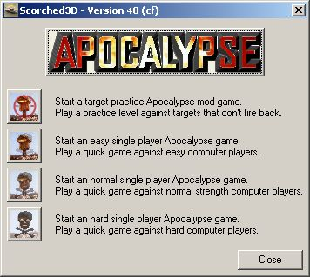


Game Difficulty and DDS

Slide 5
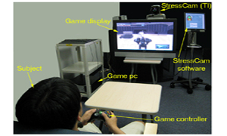
Human Physiology and DDS

Slide 6
Gamer Profiles
Experience-Based Components
  Beginner
  Intermediate
  Advanced
  Expert
Player-Preference Components
  Challenge Seeker
  Balance Seeker
  Victory Seeker

Slide 7
PADS

Slide 8
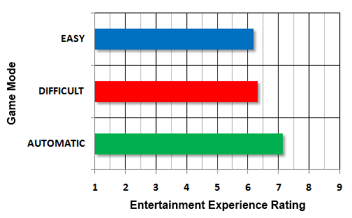
Entertainment Rating
Post-Game Survey on Entertainment Experience
6.19
6.32
7.14
QUALITATIVE Improvement on Entertainment Experience
(F_{2,112} = 9.48, p < .0001)

Slide 9
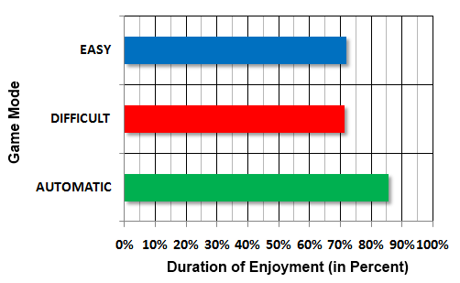
Entertainment Duration
In-Game Survey on Entertainment Experience
7 minutes 13 seconds
7 minutes 7 seconds
8 minutes 34 seconds
QUANTITATIVE Improvement on Gaming Experience
(F_{2,112} = 5.38, p < .01)

Slide 10

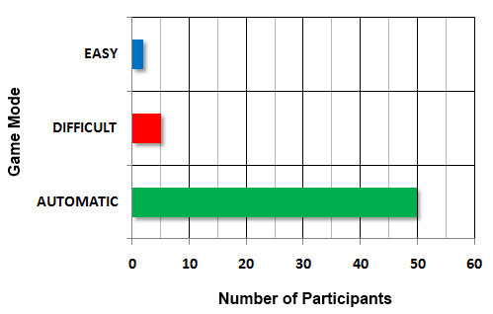
Game Mode Preference
Post-Game Preference Survey on Game Mode
2 (3.51%)
5 (8.77%)
50 (or 87.22%)
Both Qualitative and Quantitative improvements in entertainment prompted the participants to choose the AUTOMATIC MODE over EASY or DIFFICULT MODE

Slide 11


Related Publications
1. W. Holtkamp, P. Trevino, C. Yun and Z. Deng, Dynamic Difficulty with
Personality Influences, Proceedings of GLS 8.0: GAMES + LEARNING +
SOCIETY Conference, pp. 153 – 160, Madison, Wisconsin, June 13 – 15 , 2012.
2. C. Yun, P. Trevino, W. Holtkamp, and Z. Deng, PADS: Improving Gaming
Experience Using Profile-Based Adaptive Difficulty System, Proceedings of 5th
ACM SIGGRAPH Symposium on Video Games, pp. 31 – 36, Los Angeles,
California, July 24 – 29, 2010.
3. C. Yun, D. Shastri, I. Pavlidis, and Z. Deng, O’ Game, Can You Feel My
Frustration?: Improving User’s Gaming Experience via StressCam,
SIGCHI 2009: The 27th Annual CHI Conference on Human Factors in
Computing Systems – New Input Modalities, pp. 2195-2204, Boston,
Massachusetts, April 4 – 9, 2009.

Slide 12
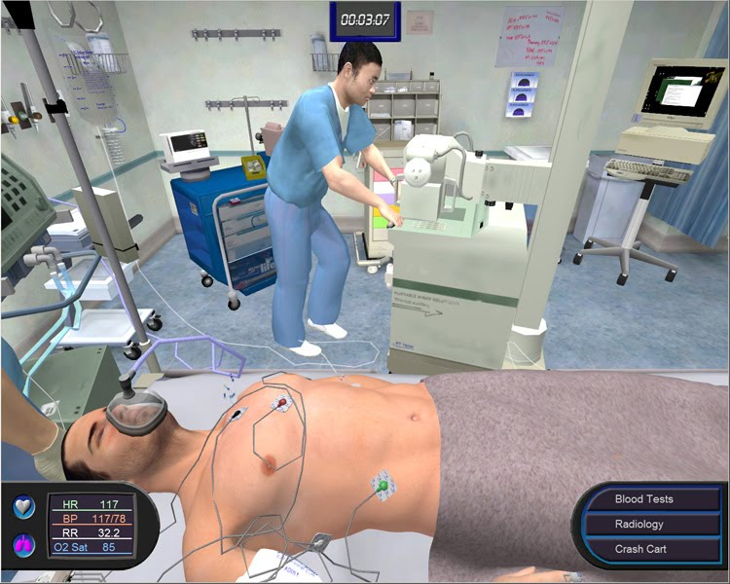
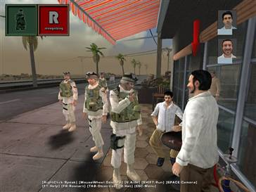
SERIOUS GAME
DEFINITION
Games designed for education, training, simulation, public awareness, and advertisement

Slide 13


HPV/CC HEALTH GAME
Framing Effective Cervical Cancer Prevention
Messages for Women
Raise awareness and educate public
Human Papillomavirus (HPV) that leads to cervical cancer (CC)
Endorse the lifestyle that prevents HPV/CC
Inform Pap test and HPV vaccination
Inform the myths and truth concerning HPV/CC
UH Department of Computer Science
UH Department of Educational Psychology

Slide 14
HPV/CC HEALTH GAME
Framing Effective Cervical Cancer Prevention
Messages for Women
Public Health Game:
Inform 56 myths and facts concerning HPV/CC
Effectiveness of informing public using game over traditional
Brochures/pamphlets
UH Department of Computer Science
UH Department of Educational Psychology

Slide 15
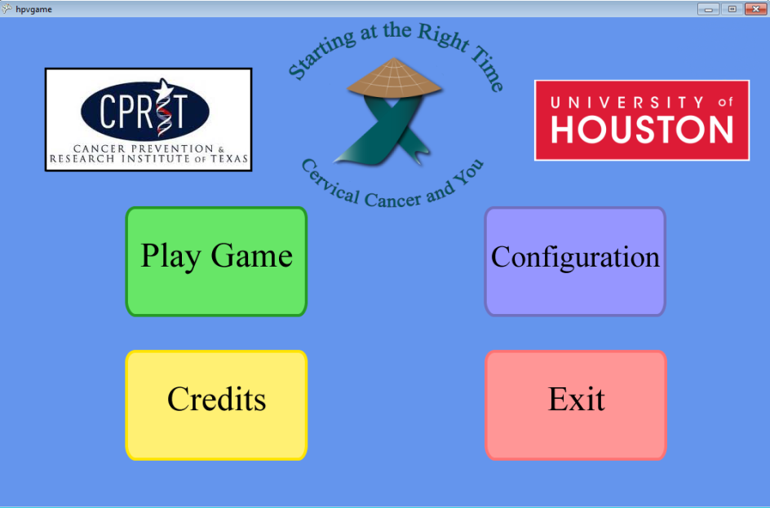
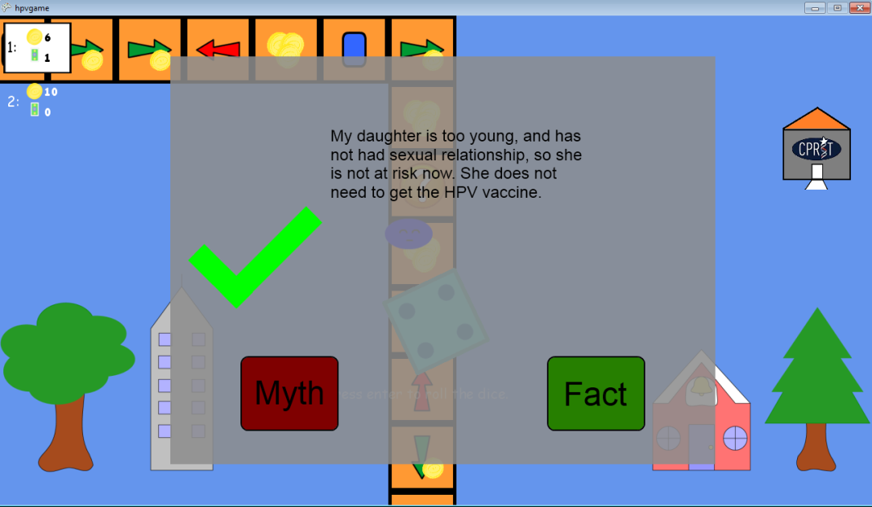
HPV/CC HEALTH GAME
Framing Effective Cervical Cancer Prevention
Messages for Women
UH Department of Computer Science
UH Department of Educational Psychology

Slide 16


Related Publications
1. (To appear) R. Nirmal, C. Yun, P. Trevino, Jenny Yi, M. Le and
P. Patipoonnanonda, Digital Health Game on Cervical Health And its Effect on
Vietnamese Women’s Cervical Cancer Knowledge, 141st American Public
Health Association (APHA) Annual Meeting and Expo, Boston, MA,
November 2 – 6, 2013.
2. (To appear) R. Nirmal, C. Yun, P. Trevino, M. Le, P. Patipoonnanonda and
Jenny Yi, Digital Health Game on Cervical Health And its Effect on American
Women’s Cervical Cancer Knowledge, IEEE International Game Innovation
Conference (IGIC), Vancouver, Canada, September 23 – 25, 2013.

Slide 17


Thank You
<>
QUESTIONS
Notes:
on

