Slide 1
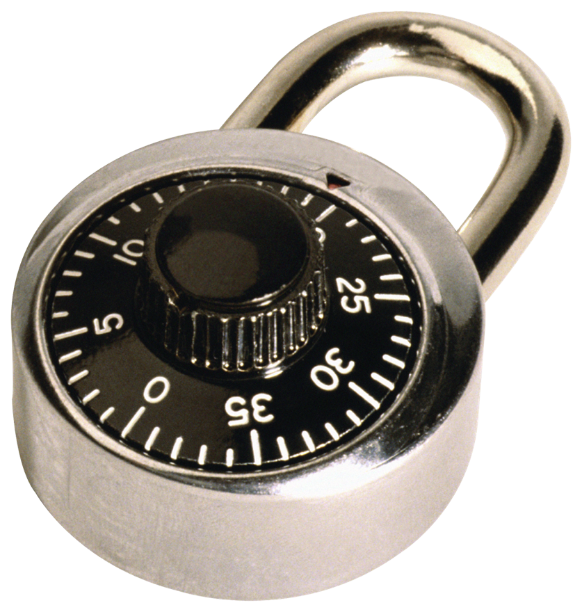


→, &
Rakesh Verma
http://www.cs.uh.edu/~rmverma
Research Interests and Projects
Rewriting – LRR, Basic Decision Problems, Applications
Data/Text Mining – Summarization, Q/A, Data Mining Course
Computer Security – Phishing, Protocols, WSNs, Education
Notes:
LRR – Laboratory for rapid rewriting – an interpreter for rewriting
Q/A – Question/Answering System

Slide 2
Equations or Identities
X + 0 = X
X + -(X) = 0
X + (Y + Z) = (X + Y) + Z
What happens if we turn them into rules?
X + 0 → X
X + -(X) → 0
X + (Y + Z) → (X + Y) + Z

Slide 3
Rewriting → (supported by NSF 1990-2011)
Rewrite System: rules of the form l → r, l and r are first-order terms with universally quantified variables
Example: fib(x) → fib(x-1) + fib(x-2) if x > 1 fib(0) → 1 fib(1)→ 1
Projects:
  Programming Without Tears (RTA93, RTA99, WRS04, SAC08, UNIF11)
  Algorithms for basic decision problems: reachability, confluence, unicity for subclasses (RTA97, STACS03, APAL04, AAECC04, TOCL05, FI 09, AAECC10, FSTTCS10)
  Applications to verification (IJCAR04 Workshop)

Slide 4



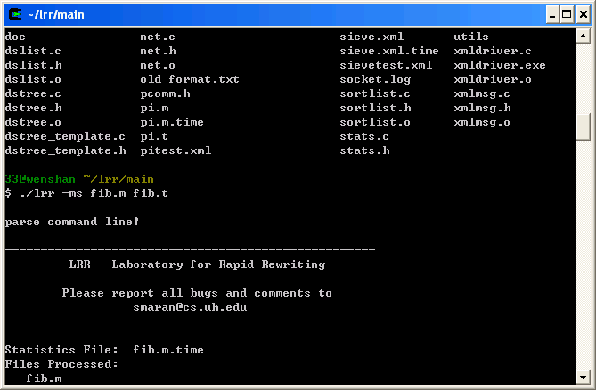
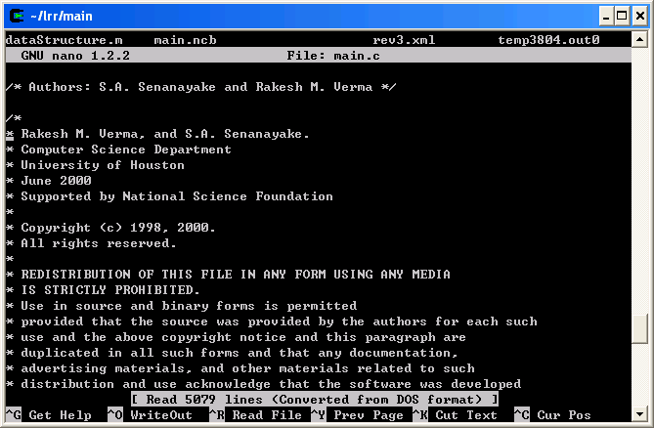

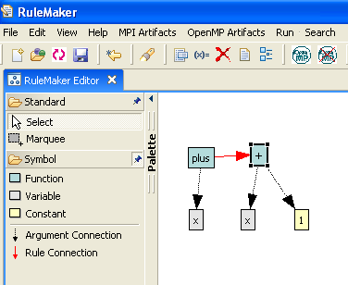
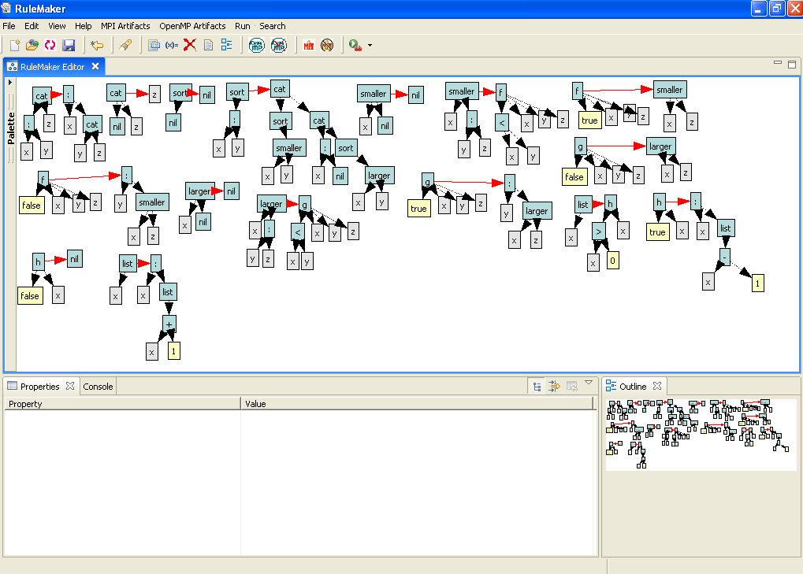
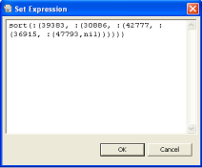
Programming Without Tears
.m .t
XML Parser LRR
RuleMaker
Notes:
RuleMaker is a GUI that lets the programmer design programs by dragging and dropping and minimal typing. It lets the programmer to forget about lots of irritating silly parentheses and other syntactic stuff.
RuleMaker interfaces with LRR an interpreter for rule-based programming.
Together they form a rule-based programming environment.

Slide 5
Laboratory for Rapid Rewriting
Fastest interpreter in comparisons with Maude and Elan for full history option
Based on congruence closure approach
Download at: http://www.cs.uh.edu/~rmverma
Graphical User Interface available upon request

Slide 6
Data/Text Mining
The quest for patterns in data and text.
Projects:
  Association Rule Mining – Controlling rules through a semantic network (FLAIRS 2008)
  Automatic Summarization – SynSem & M-SynSem Systems (CBMS06, DUC07, DUC08, TAC10, CICLING12)
  Question Answering - SemQuest System (TAC11)
  An undergraduate data mining course with industrial-strength projects (CCSC09, CCSC10, CCNE11) – NSF Award

Slide 7
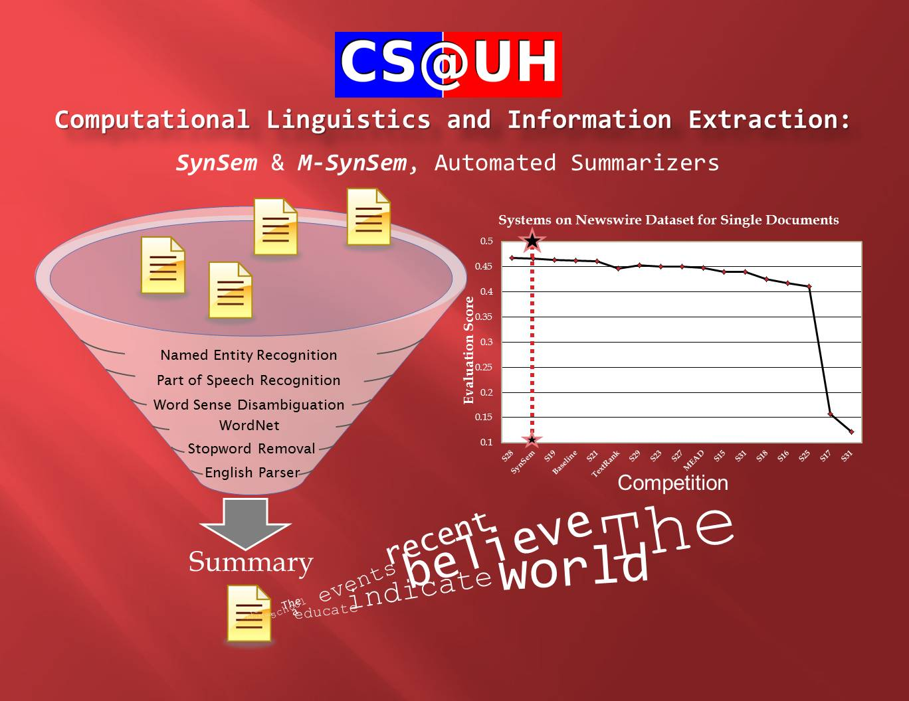

Slide 8
Computer Security
The task of securing computers, networks and data
Projects:
  Automatic phishing email and web site detection (ARES12, ESORICS12, ACSAC12)
  Protocol Verification (FCS-ARSPA07, ARES08, USENIX08, ICISS08, ICISS09)
  Key management protocols for wireless sensor networks (SAC10)
  Enriching computer security through innovative modules – NSF Award
  NLP techniques for automatic phishing and opinion spam detection – NSF Award

Slide 9
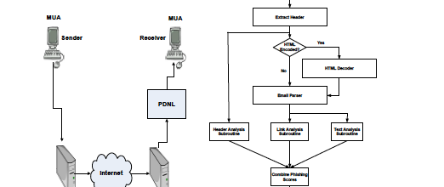
Phishing

Slide 10
Students
LRR, Rewriting: KB Ramesh, SA Senanayake, H Liu, W Yu, J Zinn, S Liao, N Radcliffe, W Guo, L Morales
Text Mining, NLP: W Lu, F Filozov, D Kent, A. Barrera (NSF Graduate Fellow), R Vincent, N Hossain, V Vuppuluri
Security: Z Liang, B Basile, S Blackshear, N Hossain, T Thakur, E Lee, K Gordon
Visitors (2013): Prof. Y. Tong, M. Meseure
External Collaborators (last 5 years): S. Dalal (AIG), W. Chan (UTHSC), J. Meininger (UTHSC), P. Chen (UHD), L. Ghemri (TSU), W. Li (TSU), F. Khan (TSU)

Slide 11
Thanks!
Questions/Comments

