Slide 1

RESEARCH TALK
Jaspal Subhlok
University of Houston

Slide 2
Research Areas
Parallel and Distributed Systems
  Current focus: Reliable execution when failure/errors are routine (MTBF in minutes)
  Very large scale systems (1000s of nodes)
  Volunteer computing – 100s of ordinary PCs distributed around the world solving scientific problems
Educational Technologies
  Indexed Captioned Searchable (ICS) Videos

Slide 3
Background
Video medium is ubiquitous and growing for coursework
  MOOCS, iTunes U, MIT Courseware, UH…
  Supplement or replace lectures
Key shortcoming of video format is the inability to quickly access content of interest
  Loud and clear in surveys and interviews
  Students wants answers to questions for review, not watch an hour long video

Slide 4
ICS Videos in a Nutshell
Custom video player that allows quick access to video content of interest
  Indexing: Video divided into logical segments with clickable index points
  Search: Keyword search in video
  Captioning: Scrolling captions for audio.

Slide 5
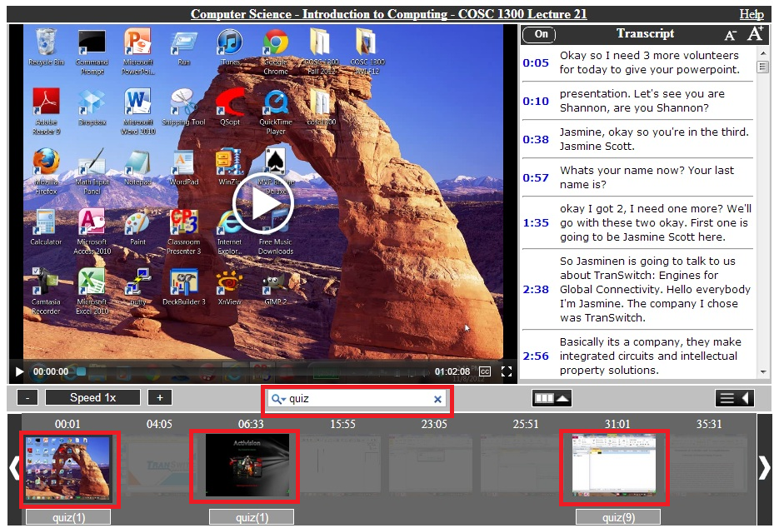
ICS Videos in a Nutshell

Slide 6
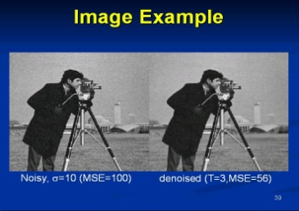
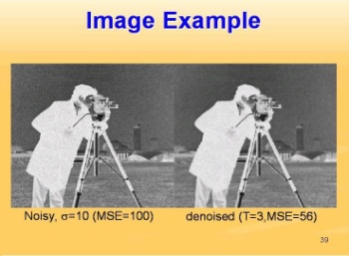

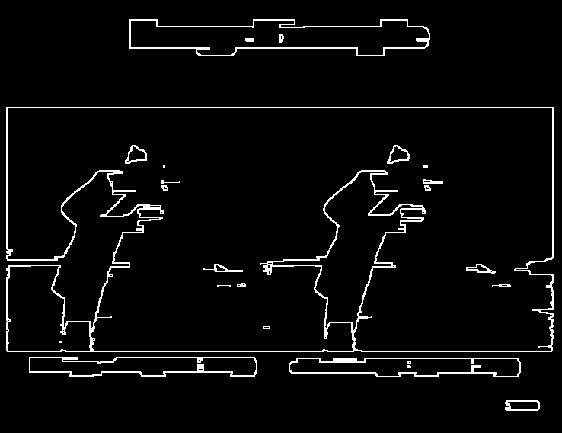
Text Search
User types a keyword -- all segments of the video that match are presented
Challenges:
Recognize text on video frame: OCR enhanced with custom image transformations for text recognition
Semantic search ?
Original Image
Inversion
Dilation
Edge Detection

Slide 7
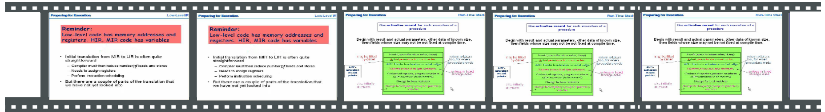
Automatic Indexing
The video is presented as a series of clickable segments, each with a visual index frame
Challenges:
Identify Topic Changes, beyond scene changes. Based on recognition and analysis of text patterns
Combined with semantic and audio input ?

Slide 8
Text Captions
Video player supports captions:
Semi-automatic caption generation employing speech recognition (YouTube)
ICS Caption Editor for correcting captions manually
  “Crowdsourcing” option

Slide 9
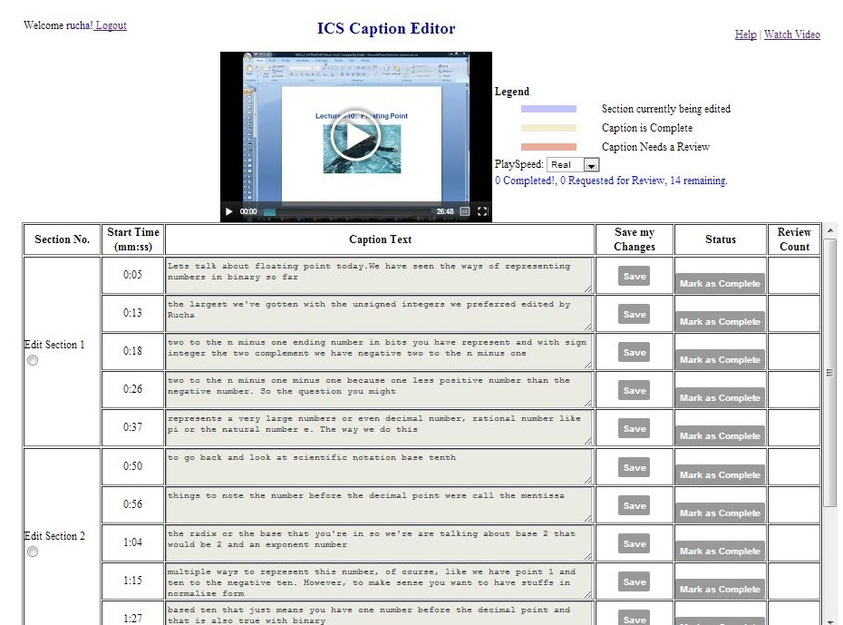
Text Captions

Slide 10
Deployment and Experience
Widely used at University of Houston in the Departments of Biology, Chemistry, Computer Science, Geology, Mathematics
Estimate ~10,000 student users in past 3 years in ~70 courses in 6 STEM fields at UH
~3000 participated in surveys

Slide 11
Reasons For Using Videos

Slide 12
Student Evaluation of Videos
Evaluation Item | Mean
Lecture videos help clarify material that was not clear in class. | 5.45
Lecture videos are useful for reviewing. | 5.63
Having access to video lectures for this class is important to me. | 5.61
The lecture videos helped me to study for quizzes or tests. | 5.51
Scale: 1 = Disagree Strongly , 6 = Agree Strongly

Slide 13
Videos as a Resource

Slide 14
Student response: Indexing
Q: The Index made it easy to navigate videos
Q: The Index points separated a lecture into logical segments

Slide 15
Student Response: Search
Q: The Search tool made it easy to navigate videos
Q: The Search tool helped me find the part of video I was looking for

Slide 16
Project Team
CS Faculty: Zhigang Deng, Olin Johnson, Shishir Shah, J. Subhlok
Students: Tayfun Tuna, Varun Varghese, Rucha Borgaonkar, Mahima Joshi
X-Students: J. Li, C. Yun, G. Bhatt, T. Tuna. A. Verma, R. Kushalnagar
NSMIT Staff: S. Baez-Franseschi, Pradeep Krishnan, Andrea Arias
Assessment: Lecia Barker (UT Austin), Yumei Liu, Erin Hodges (UH)
Deployment, usage and assessment
UH Computer Science, UH Geosciences, UH Biology and Biochemistry
  UH Downtown (Richard Alo), Texas School for the Deaf (David Coco)
  icsvideos.cs.uh.edu
  jaspal@uh.edu
  Many small and large projects for BS, MS or PhD students!

