Slide 1
Justice, Injustice, and History: An EITM Approach
Jonathan Woon University of Pittsburgh
EITM Conference & Francisco Cantú Memorial
University of Houston
March 28, 2025

Slide 2
Outline
EITM
Justice and injustice
Experimental design

Slide 3
What is an EITM approach?
Empirical implications of theoretical models
(Experimental)
Theoretical Model
Empirical Implications
Formal model
Hypothesis
Social choice
Regression
Game theory
Structural model
Experimental Model
Empirical Test

Slide 4
How do people choose to structure a just society?

Slide 5
Theory of Justice (theoretical model)
Collective choice under uncertainty by rational agents about principles of fairness
Original position
Veil of ignorance
Maximin decision rule $⇒$Difference Principle
Notes:
– one of the most influential works of Twentieth Century philosophy; justice as fairness

Slide 6
Choosing Justice (experimental test)
Small group deliberation
Incentivized experiment
Veil of ignorance: Uncertainty about positions, distributions
Choose distributive principle $⇒$ Maximize wealth with floor constraint
Frohlich and Oppenheimer

Slide 7
How much inequality is acceptable?
Hypothetical societies
Scott et al 2001
Michelbach et al 2003
Inequality aversion
Fehr and Schmidt 1999
Meritocratic beliefs
Cappelen et al 2007
Cappelen et al 2013
Notes:
Broadly related to question of “how much equality do people want? Or how much inequality will people accept or tolerate?”

Slide 8
SOMETHING IS MISSING FROM THESE MODELS

Slide 9
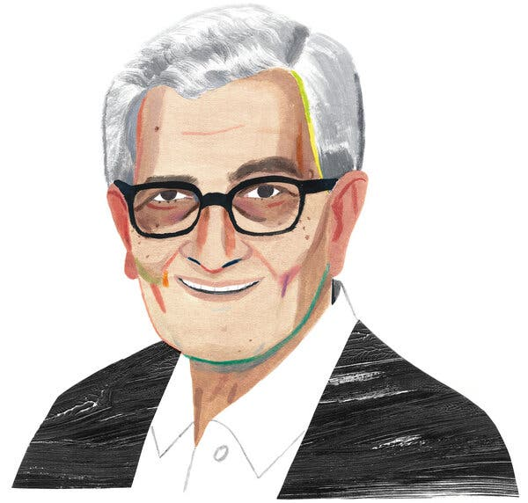
Critiques of Ideal Theory
Society is structured by racial hierarchy
Injustice is inherited—not bad luck
Historical, intergenerational
Structural, institutional
Justice should be comparative, achievable—not purely ideal
Charles Mills
Iris Marion Young
Amartya Sen

Slide 10
Hypotheses
People are more likely to choose
fairer institutions when they are
aware of history
aware of privilege

Slide 11
Goals of experimental design
Choose institutional rules instead of distribution of wealth
Vary awareness of sources of injustice: history, privilege
Stylized model (representation) of a non-ideal world

Slide 12
Sequence
Pre-history
Historical production
Information treatments
history x privilege
Institutional choice
Contemporary production
Payoffs received

Slide 13
Pre-history
Random group assignment: Red and Blue
Induced group identity (Chen and Li 2009)
“Real effort” task (Niederle and Vesterlund 2007; Kanthak and Woon 2015)
Task score (“ability”) is privately known

Slide 14
Historical production (baseline)
Red
Action A
Action B
$5
$9

Slide 15
Contemporary production (baseline)
Part 1: Assigned (possibly different) number of tasks to complete
$1 x
x $1
Contest: Success proportional to Part 1 tasks completed, winner receives higher Part 2 wage
Part 2: Assigned (possibly different) number of tasks to complete
$2 x
x $1
Variation: Winner’s score is a social payoff
Notes:
probability of winning proportional to tasks completed

Slide 16
Institutional choice
Random dictator (individual choice) to determine how Part 2 wages will be assigned
Which institution is fair? Will participants choose it?
Will information about society affect their choice?
Proportional Contest
Completely Random

Slide 17
Historical awareness
Red
Action A
Action B
Red’s task score
$5
$9
Red’s task score
+ ½ Blue’s task score
Blue’s task score
$8
$4
½ Blue’s task score

Slide 18
Privilege awareness
Part 1: Assigned (possibly different) number of tasks to complete
Part 1: Assigned (possibly different) number of tasks to complete
Number of tasks depends on Red’s historical choice
$1 x
x $1
Contest: Success proportional to Part 1 tasks completed, winner receives higher Part 2 wage
Part 2: Assigned (possibly different) number of tasks to complete
Part 2: Assigned (possibly different) number of tasks to complete
Number of tasks depends on pre-history tasks (“ability”)
$2 x
x $1
Notes:
probability of winning proportional to tasks completed

Slide 19
Inequality in a non-ideal world
Pre-history
Historical production
Information treatments
history x privilege
Institutional choice
Contemporary production
Payoffs received

Slide 20
Hypotheses
Participants are more likely to choose
random selection (equal opportunity) when…
aware of history
aware of privilege

Slide 21
Discussion
Justice, injustice are not ahistorical
Preliminary experimental design
Bridges (normative) theory (philosophy) and behavior
Inequality is produced in a non-ideal world
Work in progress, theoretically underdeveloped (payoffs, analysis)
Can lifting the veil of ignorance—of history, privilege (Mills), not societal position (Rawls)—increase the fairness of institutions?

