Slide 1

The Legacy of Francisco Cantú
Deploying broad historical knowledge and sharp methodological tools for the public interest

Slide 2
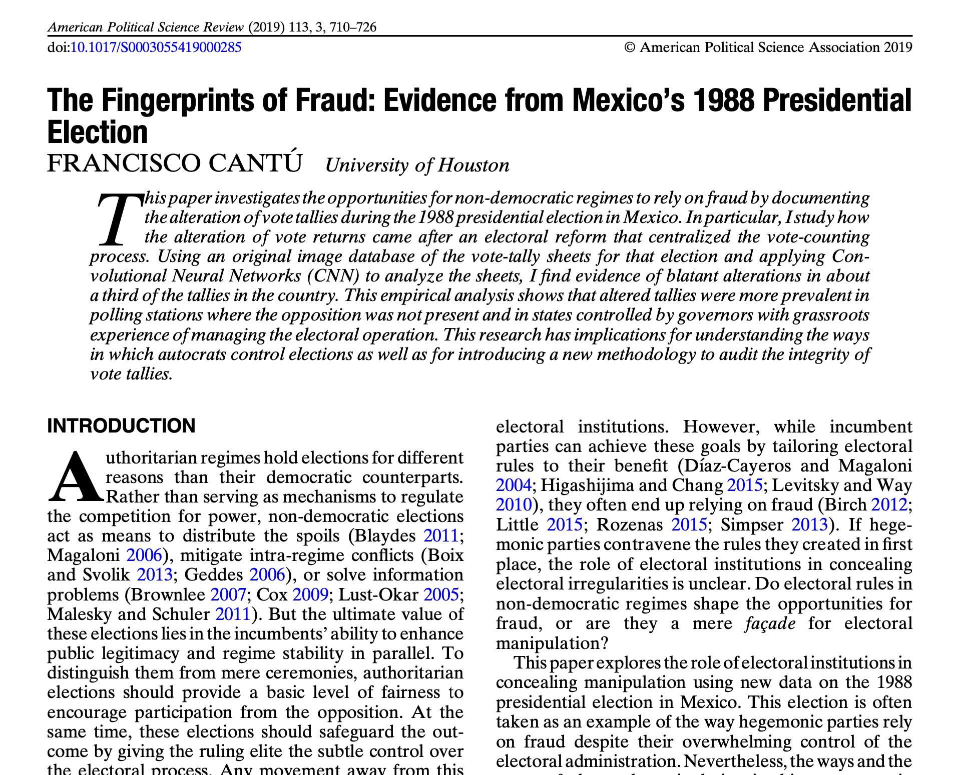
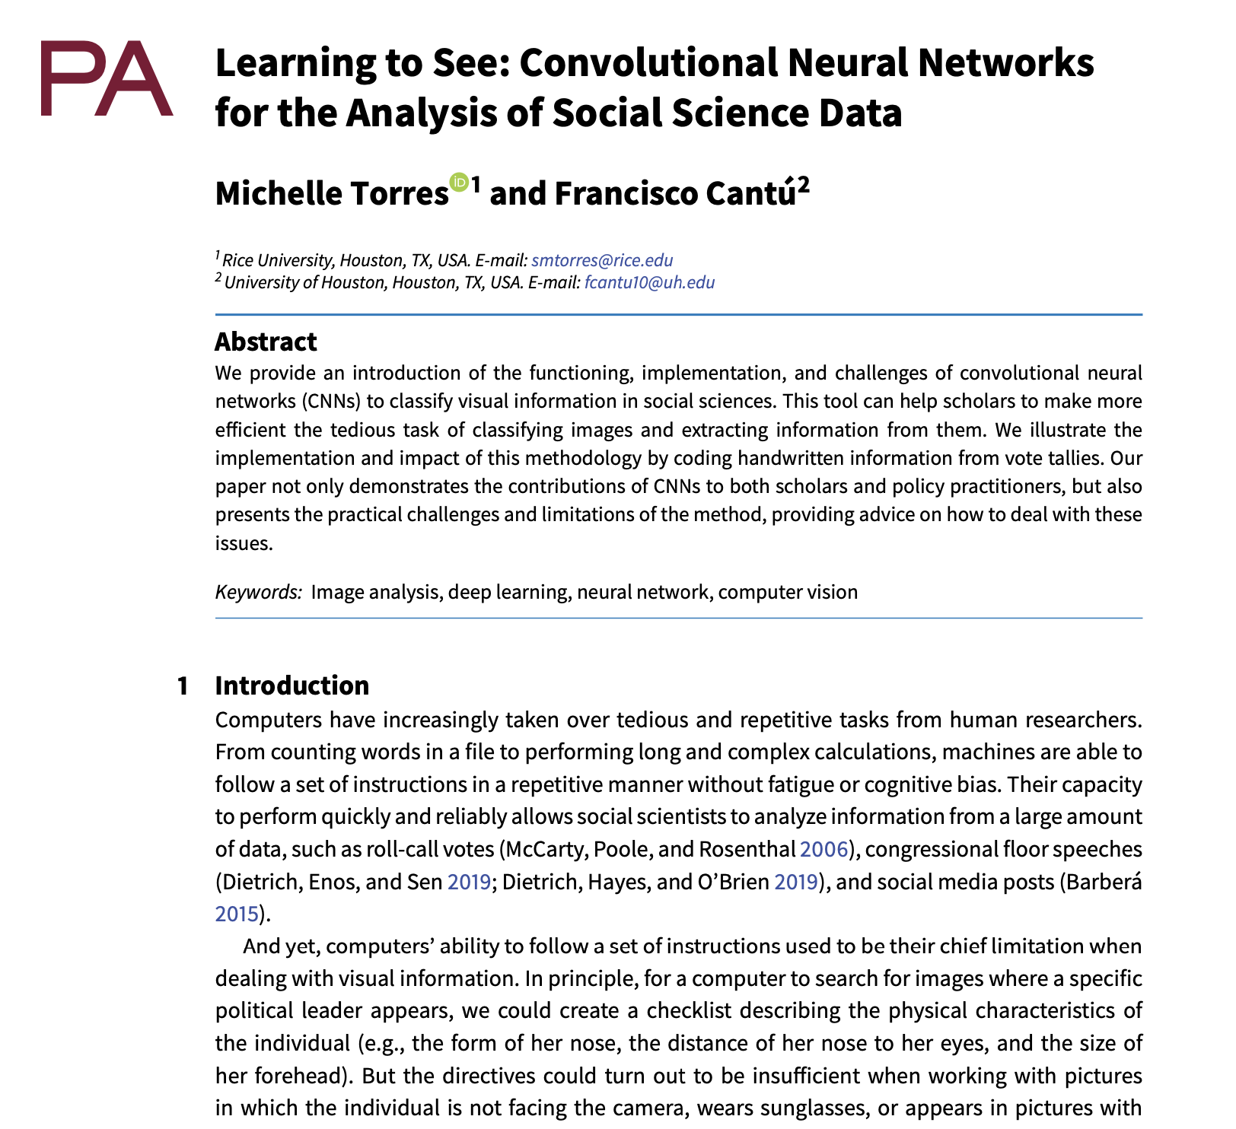
Selected contributions

Slide 3
Why these papers?
They showcase some of Francisco’s key academic virtues:
Knowledge and interest of political history
Commitment to hard work: scanning 53,000 electoral tallies by hand
Capacity to deploy cutting-edge tools to understand pressing political problems
This amounts to invaluable public service. Done in the most discreet and humble way.

Slide 4
Scholarly contribution
Research Question: Can we identify the existence and extension of election fraud in competitive authoritarian systems?
Method: Apply Convoluted Neural Networks to IMAGES to identify fraud.
Complements previous forensic tools. Identifies a clear how. Can identify cases that were not identified before.

Slide 5
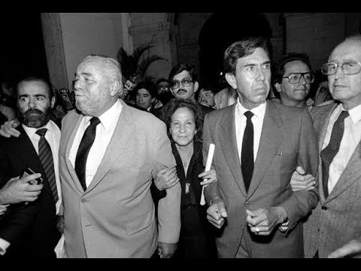
Case: 1988 Mexico Presidential election
PRI is the incumbent. Competitive Authoritarian system.
Live counting is interrupted suddenly. (Se cayó el sistema)
Days later, incumbent proclaimed winner with >=50%
Two years later, votes are destroyed. Only tallies are kept.
Suspicion of aggregation fraud

Slide 6
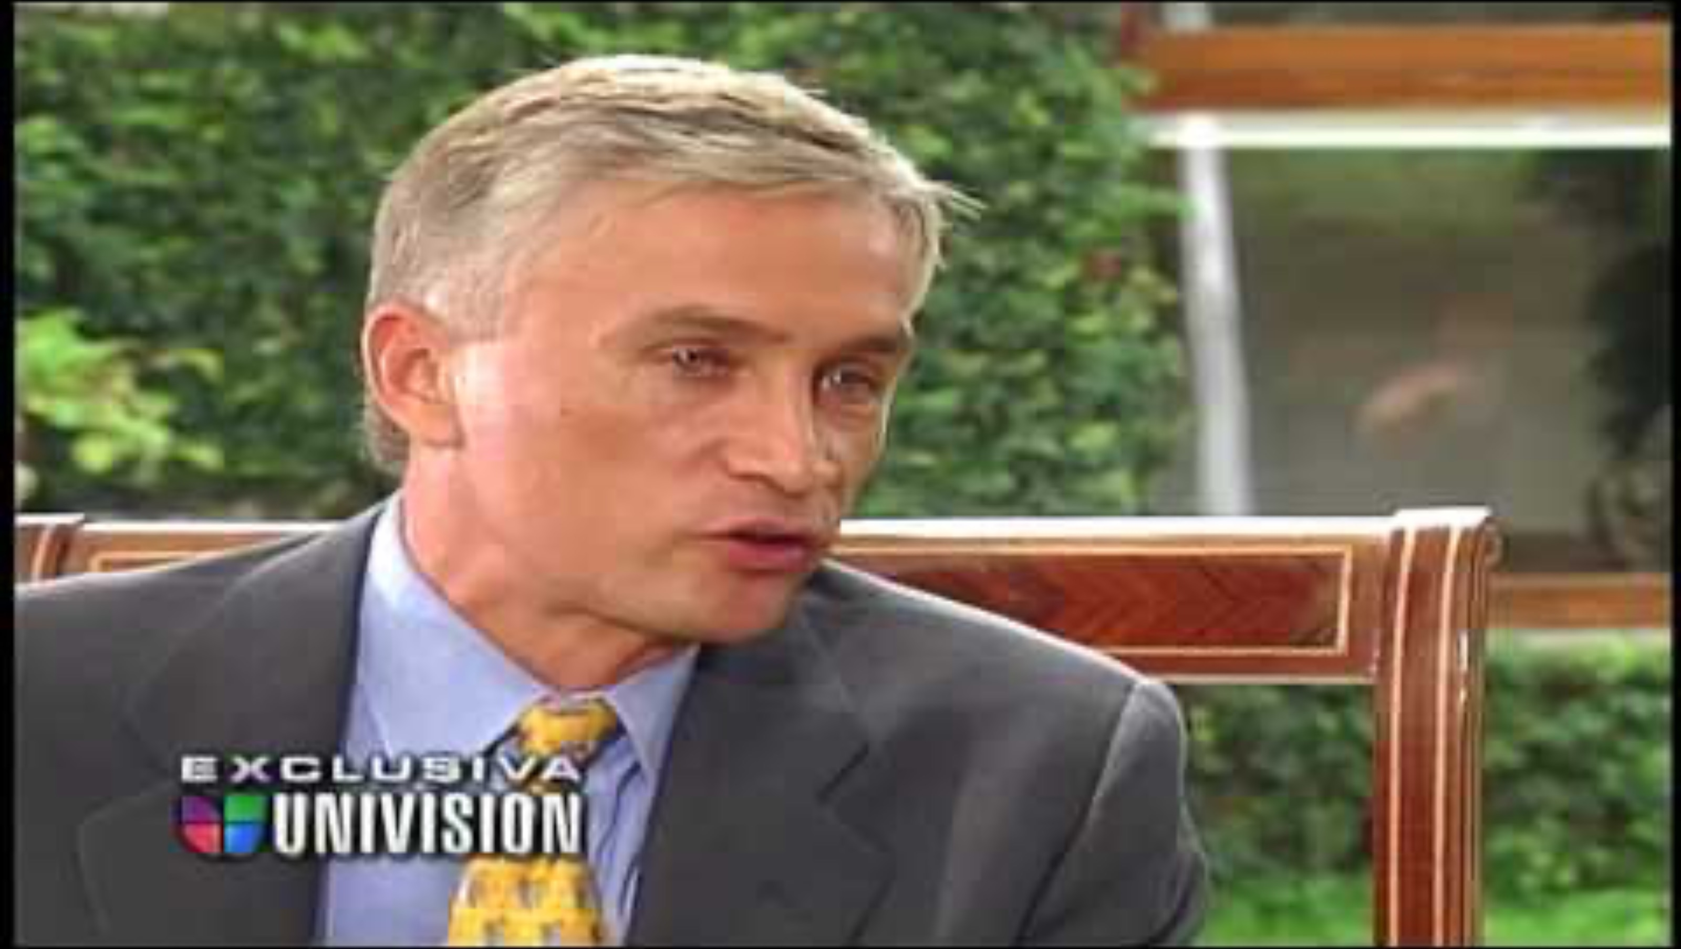
The Challenge posed by the winner (Salinas)

Slide 7
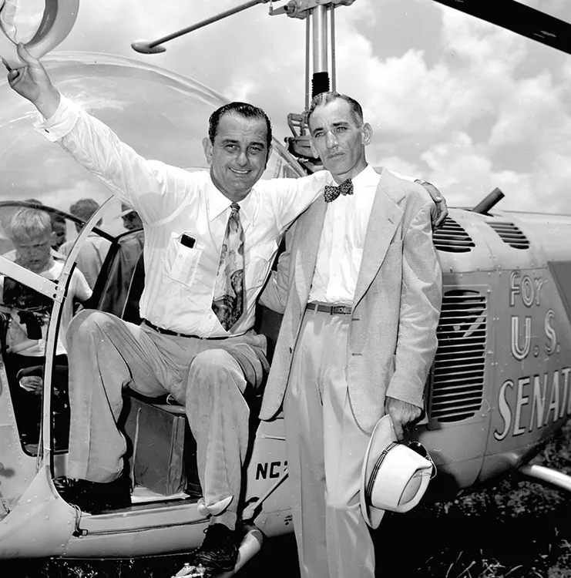
Other cases of possible aggregation fraud
Lyndon B. Johnson election as US Senator from Texas in 1948
A tally in Jim Wells County is altered to add 200 votes for Johnson. (Precinct 13)
Johnson “won” by less than 80 votes

Slide 8
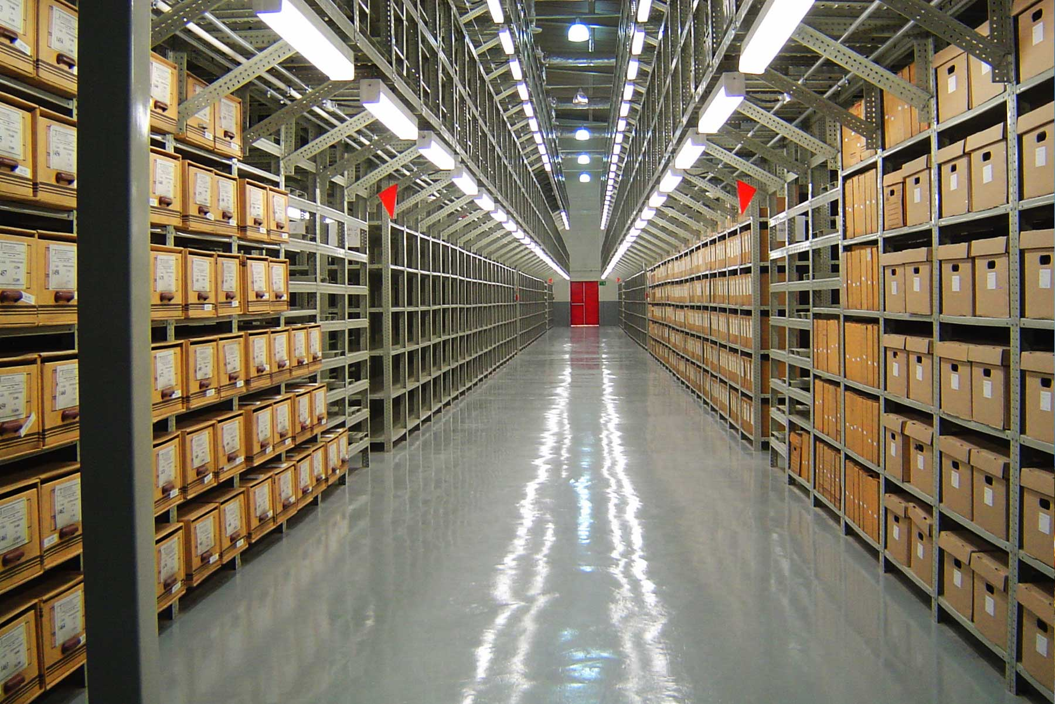
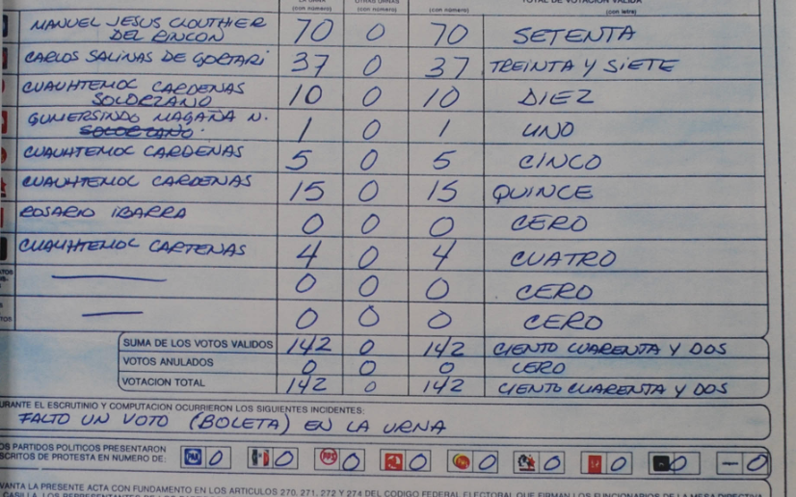
Why this work is great
DATA COLLECTION
Photograph and pre-processing of ~53,000 vote tallies from the 1988 presidential election, stored in the National Archive of Mexico.

Slide 9
Why this work is great
METHOD to IDENTIFY AGGREGATION FRAUD
Deployment of Convolutional Neural Networks (CNN)
Careful choice of Training Set
Cross-Validation
Minimizing false positives (Type-I error)

Slide 10
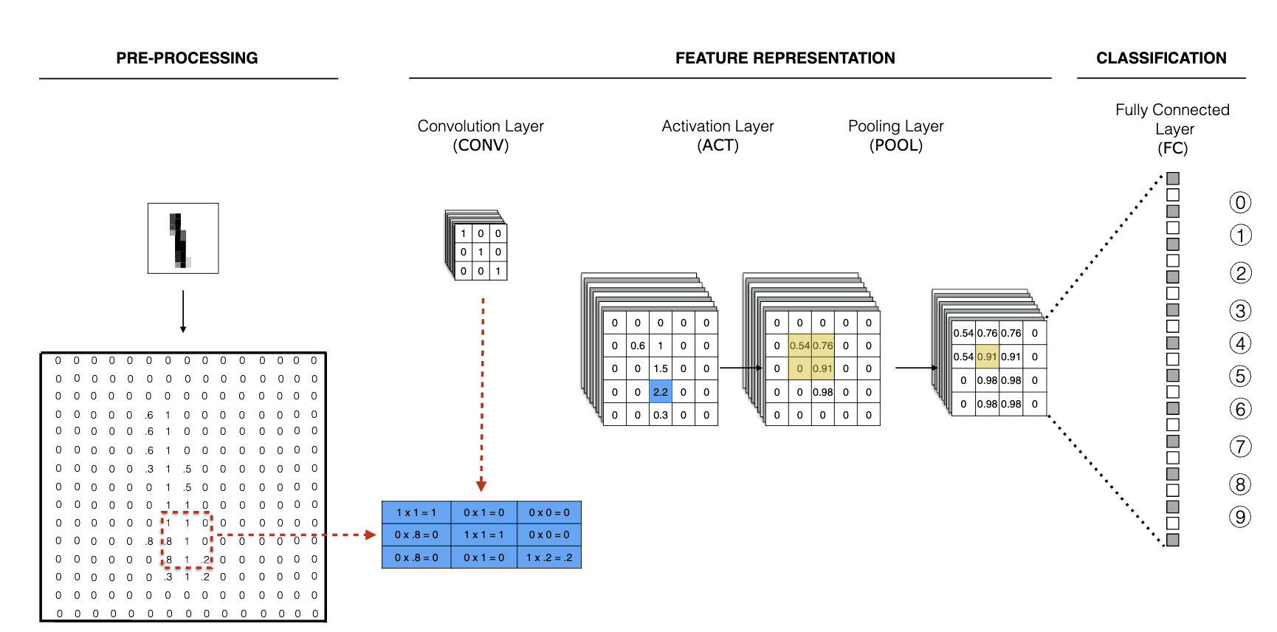
Method: Convolutional Neural Networks (CNN)

Slide 11
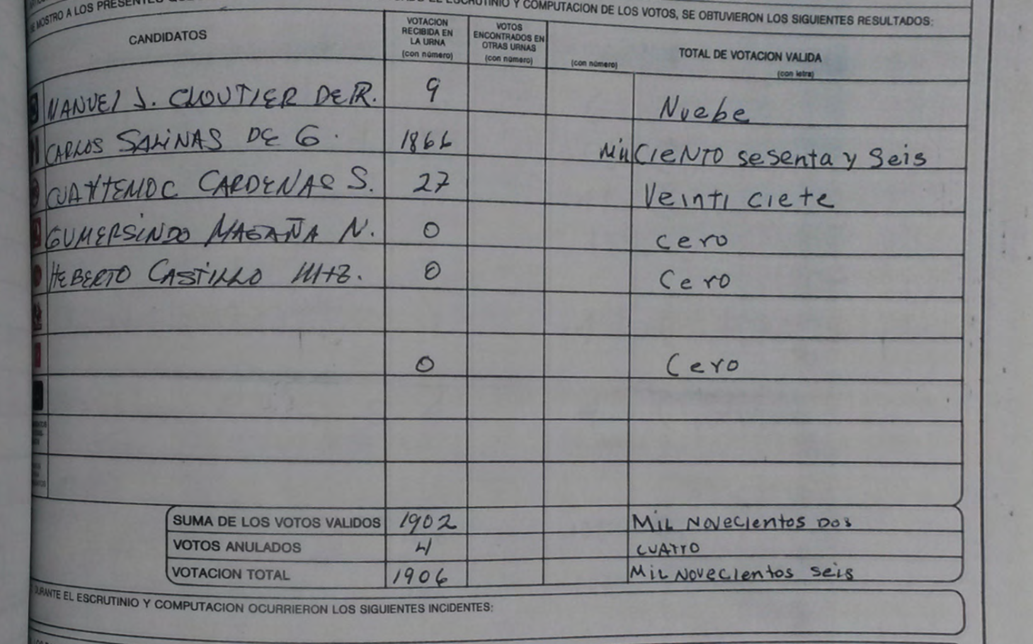
Training set
Class balance (equal number of altered and clean tallies)
Active Learning (Informativeness – clear cases of fraud and also benign alternations)

Slide 12
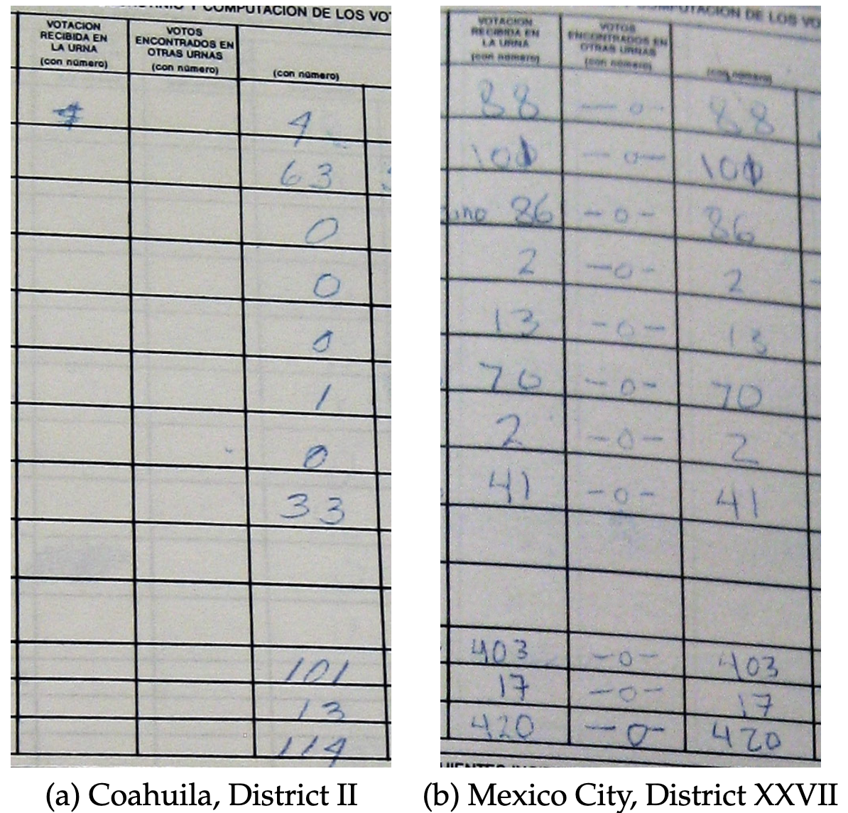
Training set
Class balance (equal number of altered and clean tallies)
Active Learning (Informativeness – clear cases of fraud and also benign alternations)

Slide 13
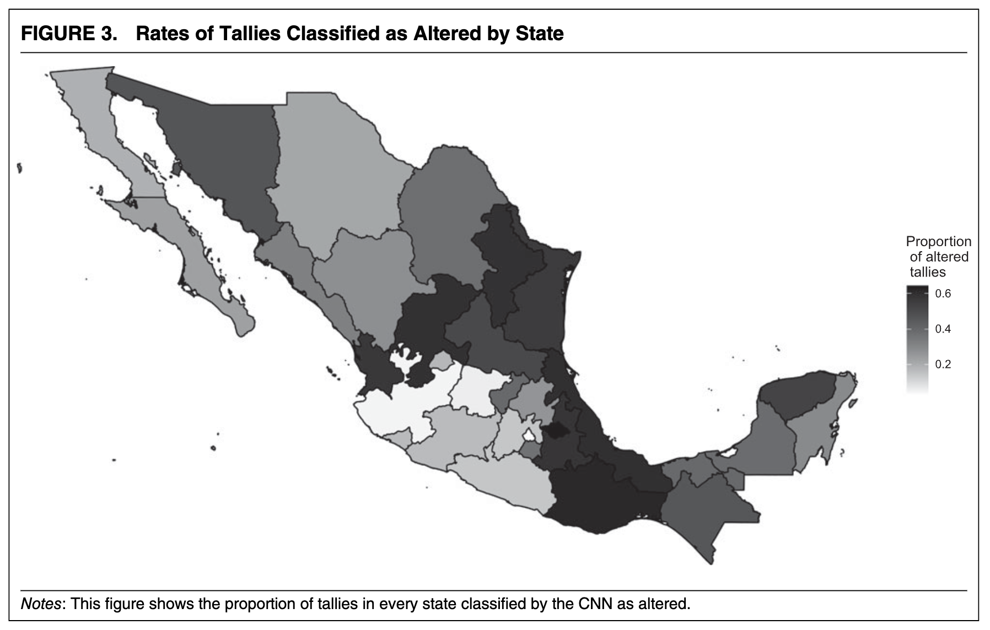
Why this work is great
PRODUCTION OF DESCRIPTIVE DATA THAT ALLOWS TO:
Identify fraud and map its extensive margin

Slide 14
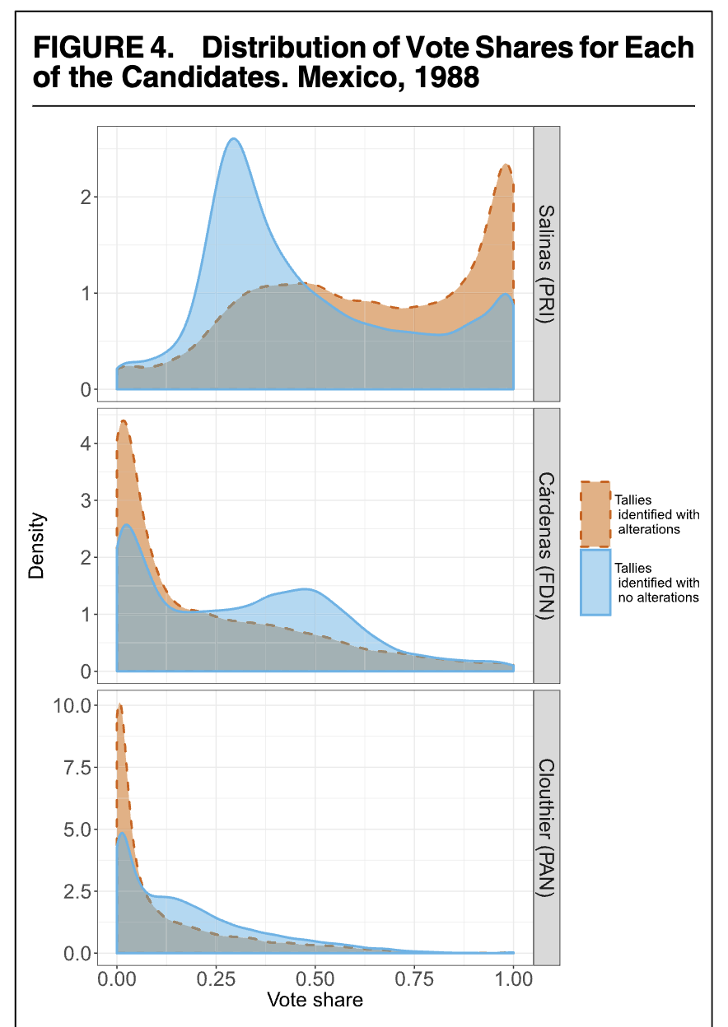
Why this work is great
PRODUCTION OF DESCRIPTIVE DATA THAT ALLOWS TO:
Benchmark the pro-incumbent bias of the fraud

Slide 15
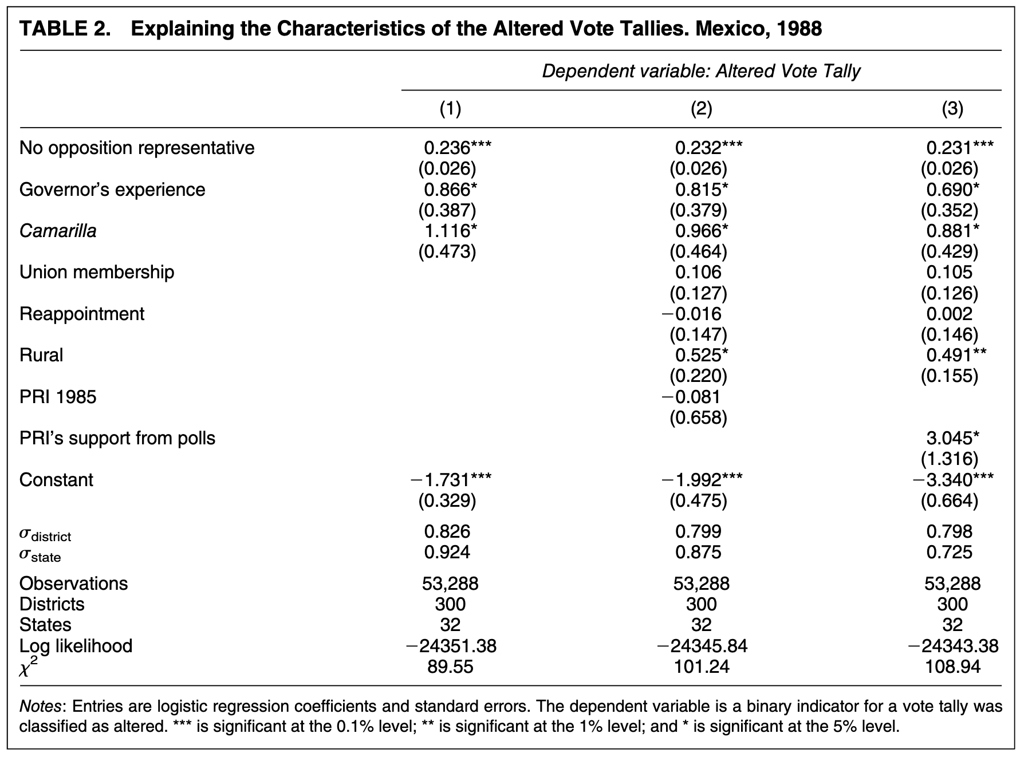
Why this work is great
PRODUCTION OF DESCRIPTIVE DATA THAT ALLOWS TO:
Identify the political predictors of fraud

Slide 16
Influence in Academia
94 and 84 citations, respectively (Google Scholar)
Cited in Political Analysis, APSR, AJPS, BJPOLS, Cambridge University Press book…
Most citations focus on the methodological and images-as-data contribution of the papers.

