Slide 1

Public Expectations and Social Science:
Their Role in Policy Success and Failure
www.uh.edu/hcpp

Slide 2

When and Why Policy Fails

Slide 3
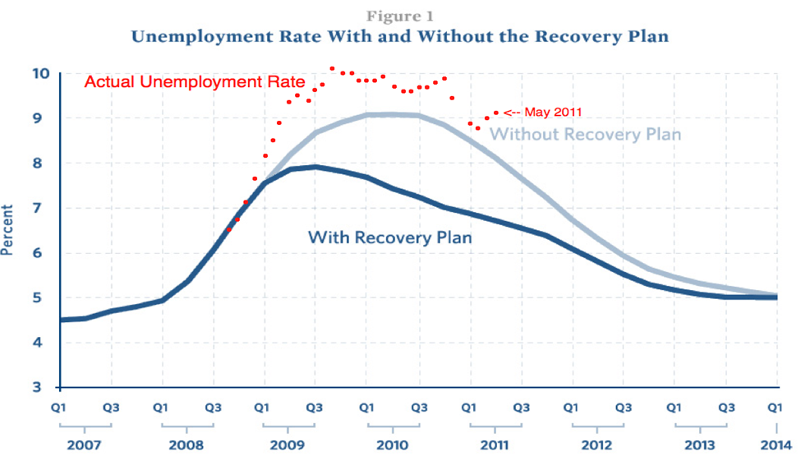
Source: Romer and Bernstein, 2009 and e21, 2011.

Slide 4
What Happened?

Slide 5
A Failure to Engage Public Reaction.
A Failure to Use Basic Social Science Research Findings.

Slide 6
More generally…a major social science breakthrough in the past few decades has been the effort to incorporate public expectations into models.
Expectations about the future influence current behavior.

Slide 7
What Does Social Science Tell Us?

Slide 8
Plenty!
What is relevant for this particular policy is the public’s consumption behavior --- and the role expectations play in this behavior.

Slide 9
The Major Social Science Works
  Keynes
  Fisher
  Modigliani
  Friedman

Slide 10
Keynesian Consumption Theory
MPC is between 0 and 1.
APC falls as income rises.
Current income is the main determinant of current consumption.
Tests (contradictory findings)
Household Data (Cross-section): support.
Time Series Data: APC does not fall as income rises.

Slide 11
Fisher’s Theory of Intertemporal Choice
Consumers choose current and future consumption to maximize lifetime satisfaction subject to an intertemporal budget constraint.
Current consumption depends on lifetime income, not current income, provided consumers can borrow and save.

Slide 12
Modigliani’s Life-cycle Hypothesis
Income varies systematically over a lifetime.
Consumers use saving and borrowing to smooth consumption.
Consumption depends on income and wealth.

Slide 13
Friedman’s Permanent-Income Hypothesis
Consumption depends mainly on permanent income.
Consumers use saving and borrowing to smooth consumption in the face of transitory fluctuations in income.

Slide 14
Summary
Keynes: consumption depends primarily on current income. The APC falls as income rises.
Tests rejected his predictions.
Subsequent work: consumption also depends on:
expected future income, wealth, and interest rates.

Slide 15
Summary (cont.)
Policy Takeaway:
If the public expects permanent changes in their income (all else equal) then they are more likely to change their consumption behavior.
Tax rate changes.
Tax rebates.

Slide 16
Tests

Slide 17
1975 Tax Rebate

Slide 18
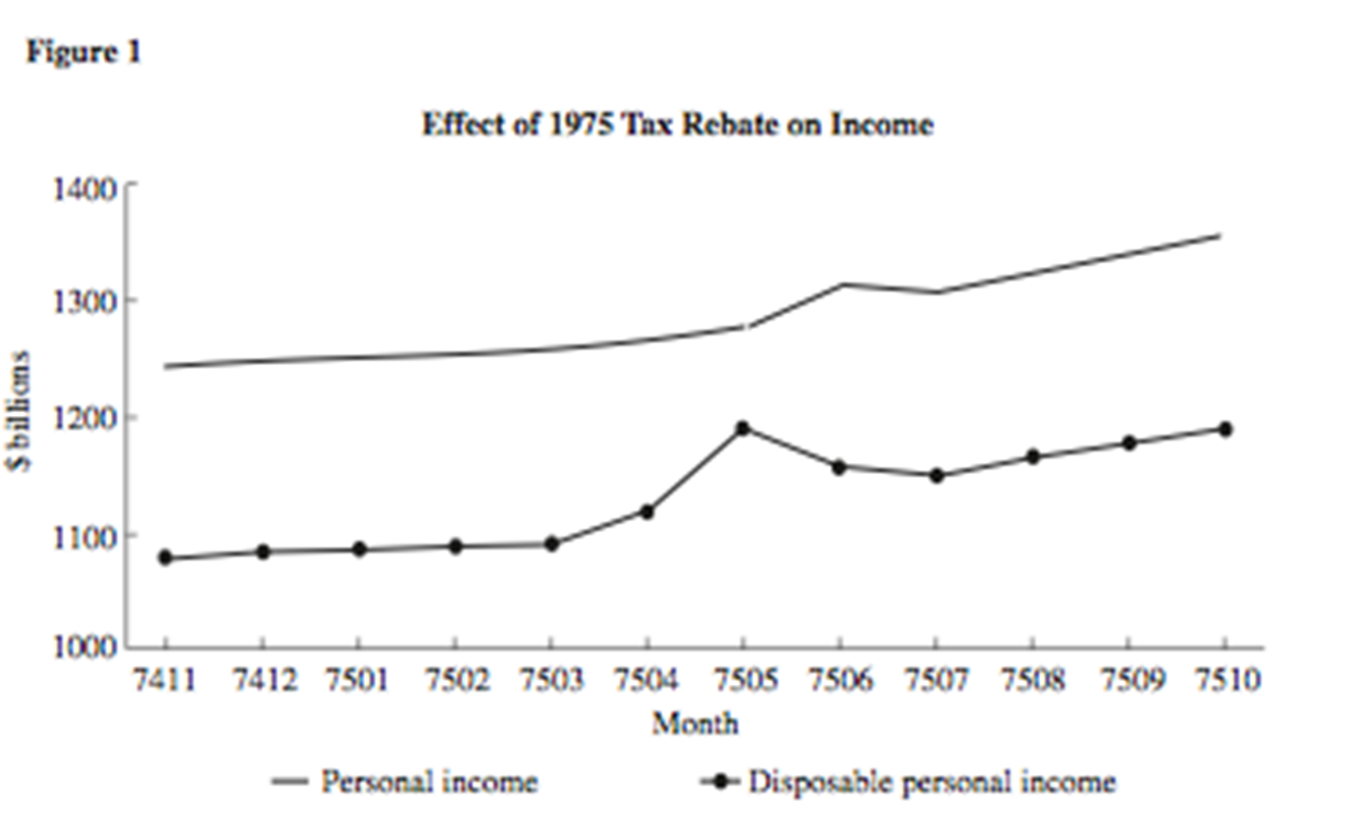
Source: Mankiw, 2010 (Chapter 17).

Slide 19
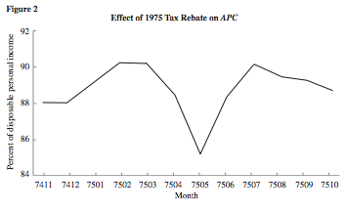
Source: Mankiw, 2010 (Chapter 17).

Slide 20
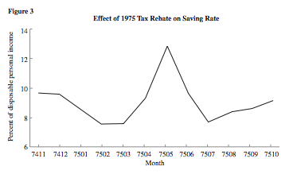
Source: Mankiw, 2010 (Chapter 17).

Slide 21
2008 Tax Rebate

Slide 22
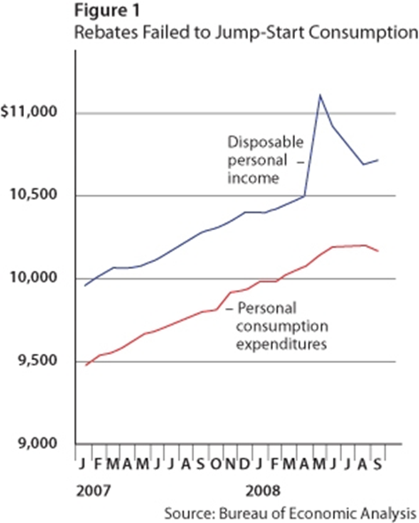
Source: Taylor, 2008.

Slide 23
What People Expect Today

Slide 24
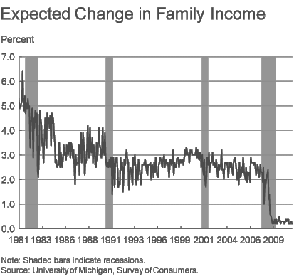

Slide 25
What to Do?
Expected future income is flat.
Wealth is down.
This means…policy can help … but it must focus on “permanence in rewards” and “permanence in reducing future income liability.”

Slide 26
Hobby Center Contact
Jim Granato, PhD, Director, Hobby Center for Public Policy
jgranato@uh.edu, 713 743 3887
www.uh.edu/cpp

