Slide 1
Candy Abshier WMA Coastal Prairie Restoration Project
Philip Pauling, TPWD

Slide 2
Candy Abshier Wildlife Management Area
Approximately 209 acres in size
Purchased by Texas Parks and Wildlife Department in 1989
Named after a dedicated former TPWD employee Catherine “Candy” Cain Abshier in 1991
Located near the community of Smith Point in Chambers County, Texas
Sits along the shore of Galveston Bay
Part of the Upper Coast Wetland Ecosystem Project administered by TPWD

Slide 3
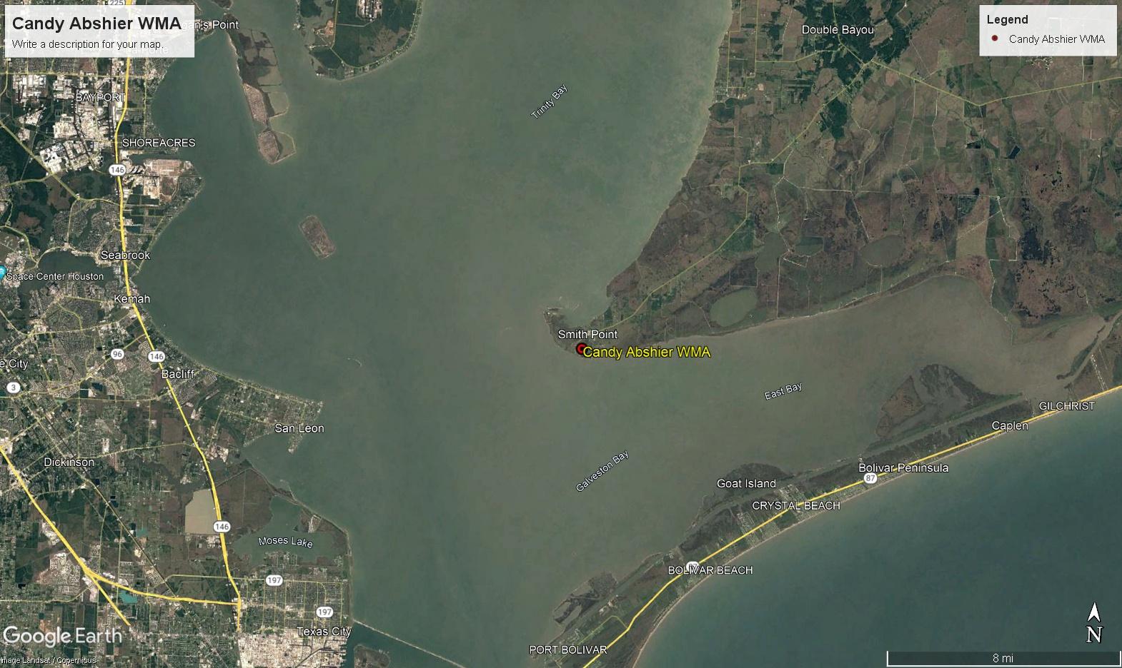

Slide 4
Purpose
The WMA is dedicated to the management and preservation of coastal prairie and oak motte habitats
These habitats are crucial for resident and migratory wildlife species
Area is heavily utilized by migrating neo-tropical passerine species as a stop-over point during the fall migration
Gulf Coast Bird Observatory conducts a Hawk Watch from Aug. 15 – Nov. 30 each year.

Slide 5
Habitat Features
Oak Mottes
Wetlands
Pimple mounds and inter-mound prairie areas in the center of the WMA
High prairie on the north end of the WMA along F.M. 562

Slide 6
Native Vegetation
Oak mottes
Live Oaks
Prairie areas
Little bluestem
Brownseed paspalum
Bushy bluestem
Smutgrass
Carpetgrass
Wax myrtle
Rattlebox
Wild indigo

Slide 7
Changes in Habitat over time
Oak mottes
Oak mottes have greatly expanded in size and species composition. Pine trees, Chinese Tallow trees, Yaupon holly, and Laurel cherry now make up a significant portion of the mottes and areas between the historical mottes
Pimple mounds and inter-mound areas
Pimple mounds are now heavily dominated by thick stands of Yaupon holly. Inter-mound areas are dominated by a mix of Marsh hay cordgrass, Chinese tallow trees, Yaupon holly, and Groundsel trees
High prairie
This area has become dominated with Gulf coast cordgrass, Marsh hay cordgrass, Groundsel trees, Chinese tallow trees, and news stands of Live oaks

Slide 8
Changes over time
1970
November 2023

Slide 9
Past Management Actions
1989-2001
Mowing
Cattle Grazing – ended in 2001
2001 – Present
Sporadic mowing when equipment and conditions allowed
2014 – early 2019 was a very wet period for the wma that made mowing virtually impossible. Saw a significant increase in size and area coverage of woody species during this period
2019
Brush and tree mulching over an area encompassing approximately 85 acres
March 2021
Conducted a prescribed burn on approximately 70 acres that was previously mulched

Slide 10
Prairie Restoration Efforts
May – June 2019
Established 4 photo stations to track before and after results
We used 2 rented track loaders with brush cutting attachments along with a amphibious marsh buggy with a mower deck to clear small trees, brush, and cordgrass
Initially focused on areas around the historical oak mottes and pimple/inter mound areas covered in small oaks, pine trees, yaupon holly, chinese tallow, and groundsel trees
Pimple mounds with thick yaupon holly proved difficult for the machines and took considerable time to clear
Towards the end of our rental period we shifted our focus to creating a good perimeter to use for a future prescribed burn and clearing more of the inter-mound areas which the machines were able to clear at a quicker rate

Slide 11
Prairie Restorations Efforts Cont.
Post Mulching Observations
Mulching disturbed and exposed the top layer of soil within a large portion of the area
The response of the native seed bank to the soil disturbance was quick and impressive
By fall we had seen a significant increase in the amount of native grasses within the mulched area

Slide 12
Prairie Restoration Efforts Cont.
February 2021
Prepared firebreaks around the perimeter of approximately 70 acres using a combination of a tractor on drier areas and amphibious marsh buggy in the wetter areas.
Mowed and disced to create fire breaks.
March 2021
A prescribed burn was conducted on the 70 acres that was prepared the month before.
Observed good fire behavior within finer fuels and stands of Yaupon holly
Saw good fuel consumption in areas cleared of brush in 2019

Slide 13
Mulched Area

Slide 15
Motte Trail Pre-Mulching

Slide 16
Motte Trail Post-Mulching (4 week)

Slide 17
Motte Trail Post-Mulching (8 weeks)

Slide 18
Pipeline Post Mulching (1 week)

Slide 19
Pipeline Post-Mulching (8 weeks)

Slide 20
Mowed Trail 1 Pre-Mulching

Slide 21
Mowed Trail 1 Post-Mulching (8 weeks)

Slide 22
Mowed Trail 2 Post-Mulching (4 weeks)

Slide 23
Mowed Trail 2 Post-Mulching (8 weeks)

Slide 24
Aerial Image

Slide 25
Aerial Image

Slide 26
March 2021 Prescribed Burn

Slide 27
Pre-Mulching 2017

Slide 28
Post Mulching 2020

Slide 29
Post Mulching 2023

Slide 30
Challenges to Management Going Forward
Distance
Candy Abshier WMA is approximately 1hr. 10 min drive from main UCWEP headquarters by vehicle or up to 1hr. 30 min when hauling equipment
Lack of facilities
There are no facilities within the WMA to store equipment
All equipment has to be trucked to and from the WMA
Equipment has to be parked out of sight overnight or on neighbor’s property if allowed
Soil conditions
Sandy loam soils often become very soft during wet periods and low areas can hold water for months at a time if rainfall continues

Slide 31
Challenges to Management Going Forward
Equipment Limitations
Aging equipment and frequent breakdowns
Tractors work well during dry periods but easily become stuck during periods of frequent rainfall.
Amphibious marsh buggies works well during wetter periods but only for small areas
Limited amount of equipment and competing needs with other parts of the UCWEP

Slide 32
Challenges to Management Going Forward
Use of Fire
Given the close proximity of residences, roads, businesses, and oil infrastructure to the WMA prescribed burning can be problematic. Weather parameters for burning are very narrow due to nearby residences
Current burn plan calls for due north winds to carry smoke over Galveston Bay and Gulf of Mexico
Some neighbors initially supportive of burning are now apprehensive due to smoke impacts from March 2021 burn.
Personnel needs

Slide 33
Challenges to Management Going Forward
Use of Herbicides
We have not used herbicides to a large degree on the WMA to this point
Due to nearby residences there is increased potential for unintended impacts from herbicide drift especially using aviation
We also do not want to have unintended impacts on the historical oak mottes
Grazing
WMA currently does not have a fence system in place that can hold cattle or other livestock
Perimeter fences have fallen into state of disrepair over the years or have been actively cut to facilitate access for atvs and utvs
WMA perimeter would need to be cleared and new fencing installed to implement a grazing program

