Slide 1
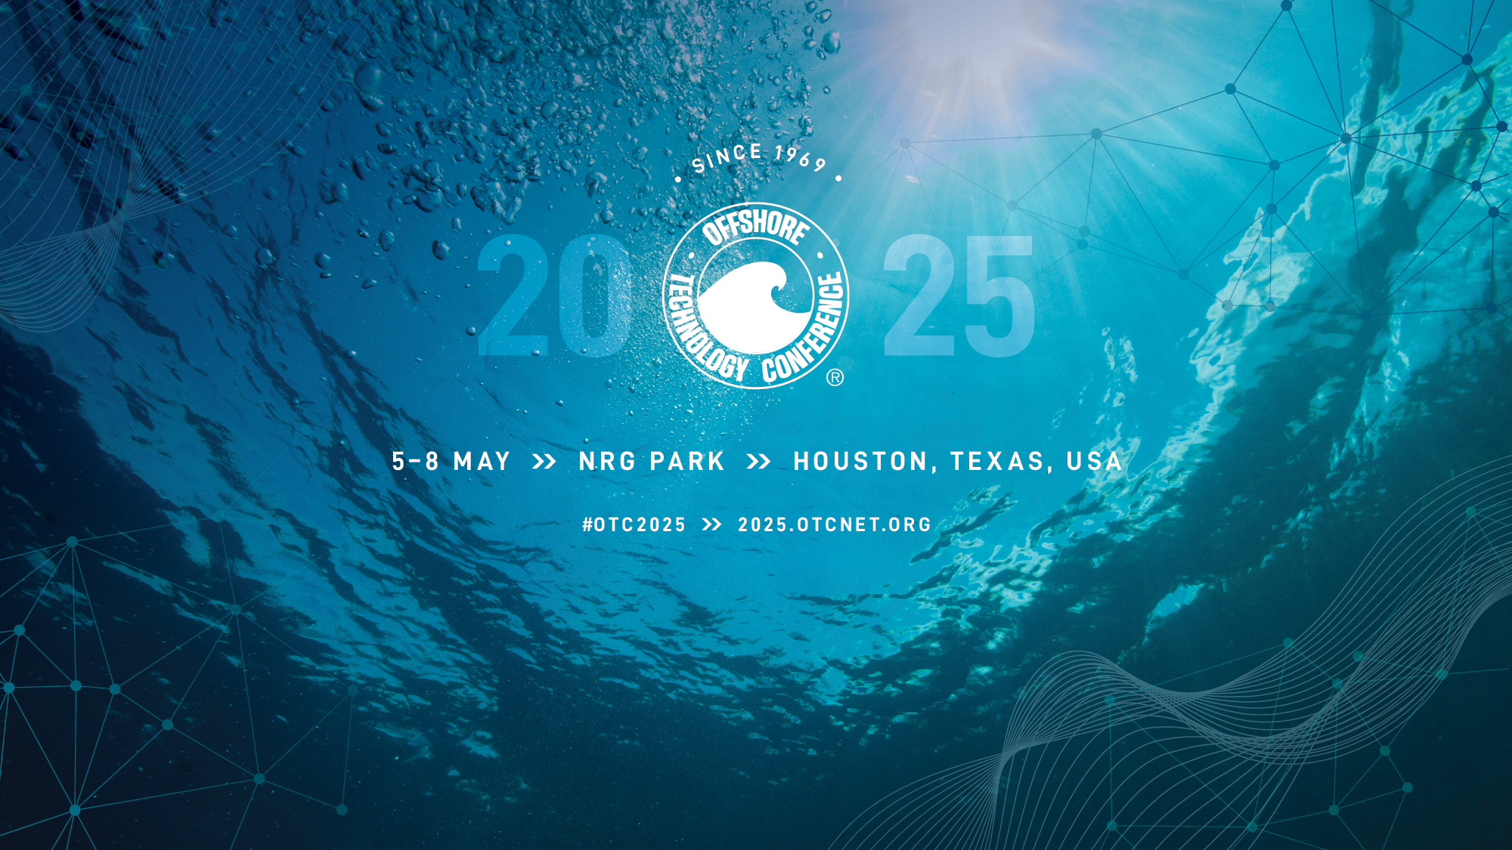
OTC-35964-MS | Repurposing GOM Platforms for Wind Power and Hydrogen
Paulo Liu, Yugbhai Patel, Muhammad Younas, and Ram Seetharam / ROICE Program, University of Houston

Slide 2
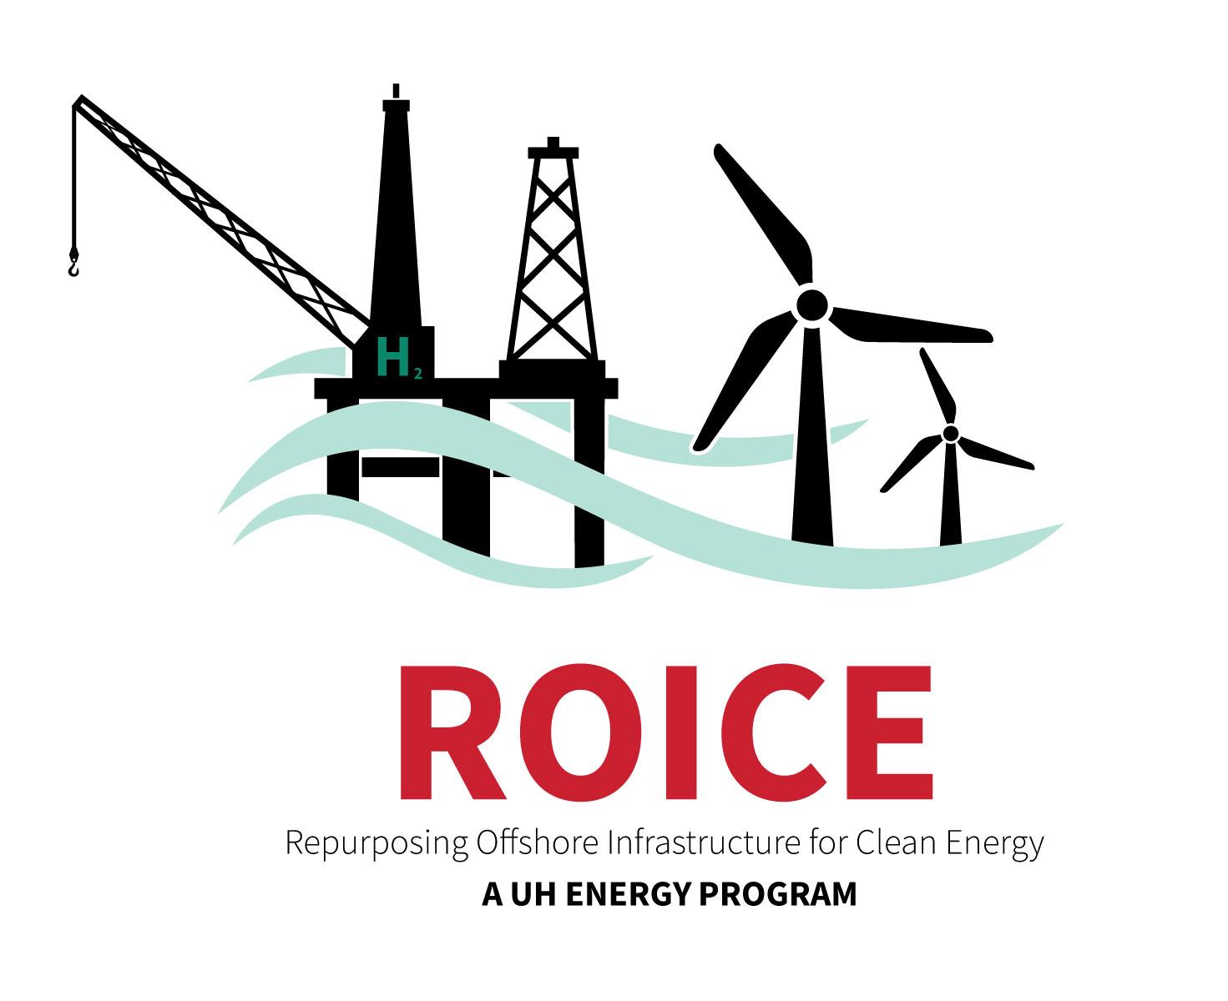
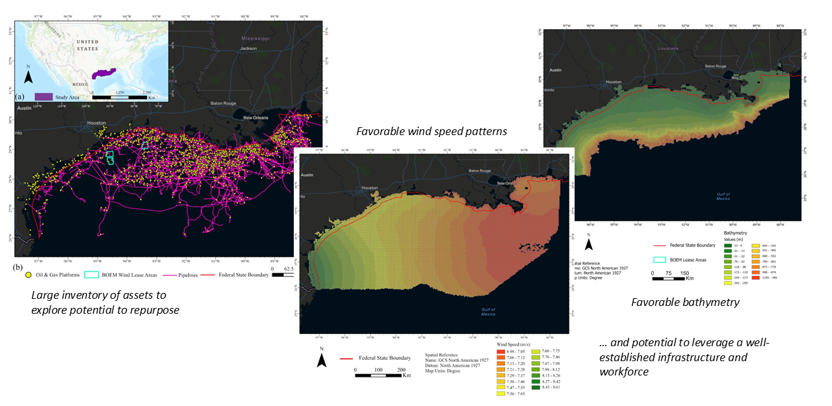

Repurposing Offshore Infrastructure for
Continued Energy (ROICE)
ROICE Potential in the Gulf for Wind and Hydrogen
for Continued Energy
The ROICE Program at UH and its advisory group, the ROICE Program Collaborative, are committed to defining pathways to repurpose offshore infrastructure for continued commercial energy solutions.
OTC-35964-MS • Repurposing Typical GOM Platforms for Wind Power and Hydrogen Generation - Design and Economics • Paulo Liu and Ram Seetharam

Slide 3
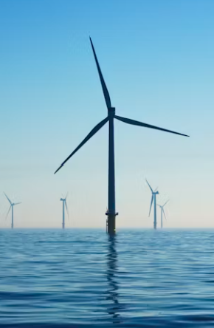
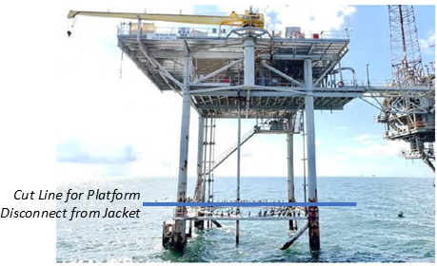
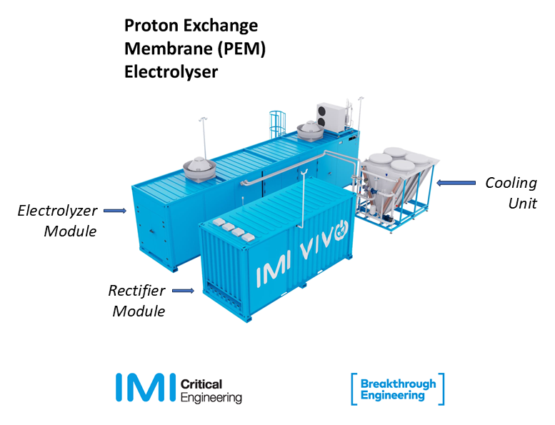
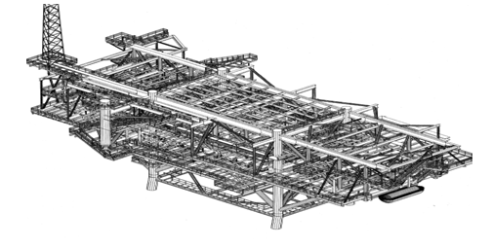
Wind Turbines Installed Around Repurposed Platform
ROICE for Wind Power and Hydrogen
Topsides Changeout for ROICE Phase of Asset
Wind Project: Offshore substation, transformers, switchgear
H2 Project: Electrolyzers, rectifiers and desal units
Example Offshore Platform To be Disconnected from Subsea Jacket (Courtesy: Hess)
Typical Modular Hydrogen Production Equipment (Courtesy: IMI)
Example Offshore Platform Structural Framework Retained to host ROICE Modules (Courtesy: Apache Corp.)
OTC-35964-MS • Repurposing Typical GOM Platforms for Wind Power and Hydrogen Generation - Design and Economics • Paulo Liu and Ram Seetharam

Slide 4
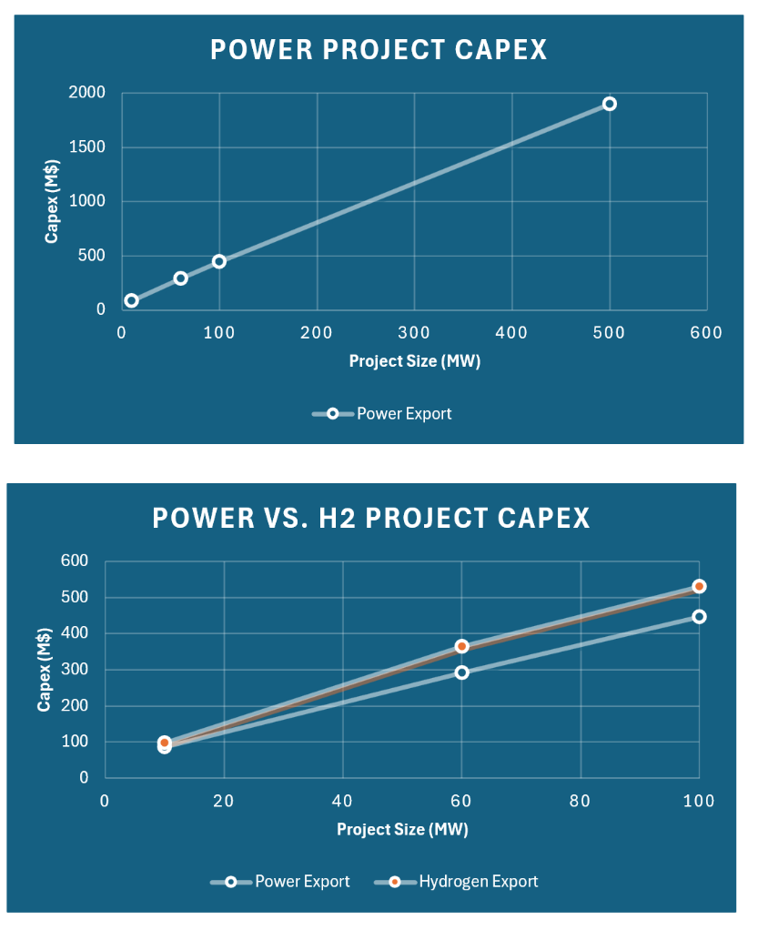
Project Design – Cost and Production Profiles
ROICE Levelized Cost (LC) Model Used to Generate Capex, Opex, Power and Hydrogen Production Profiles over Project Period
Wind Power Generation Modeling
Hydrogen Generation Modeling
Cost Estimation
  Wind Turbine Generators
  Foundations and other Structure Costs
  Array Cables
  Export Cables
  Transmission
  Electrolyzer
  Desalination
  Pipelines
  Installation
  Maintenance
  Oher Opex
Power and Power to Hydrogen Project Capex versus Project Size
OTC-35964-MS • Repurposing Typical GOM Platforms for Wind Power and Hydrogen Generation - Design and Economics • Paulo Liu and Ram Seetharam

Slide 5
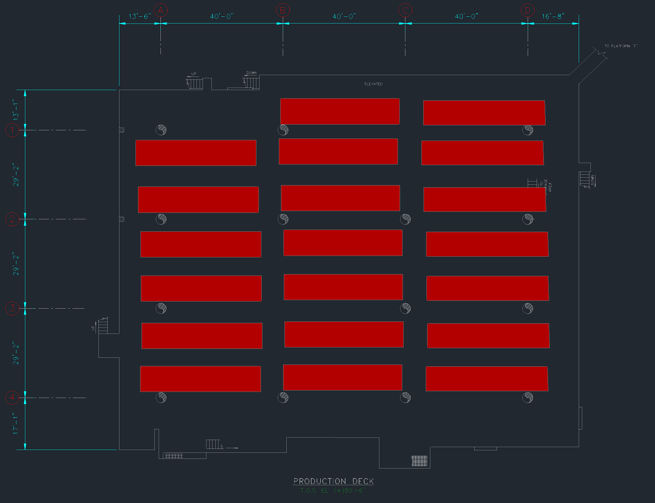
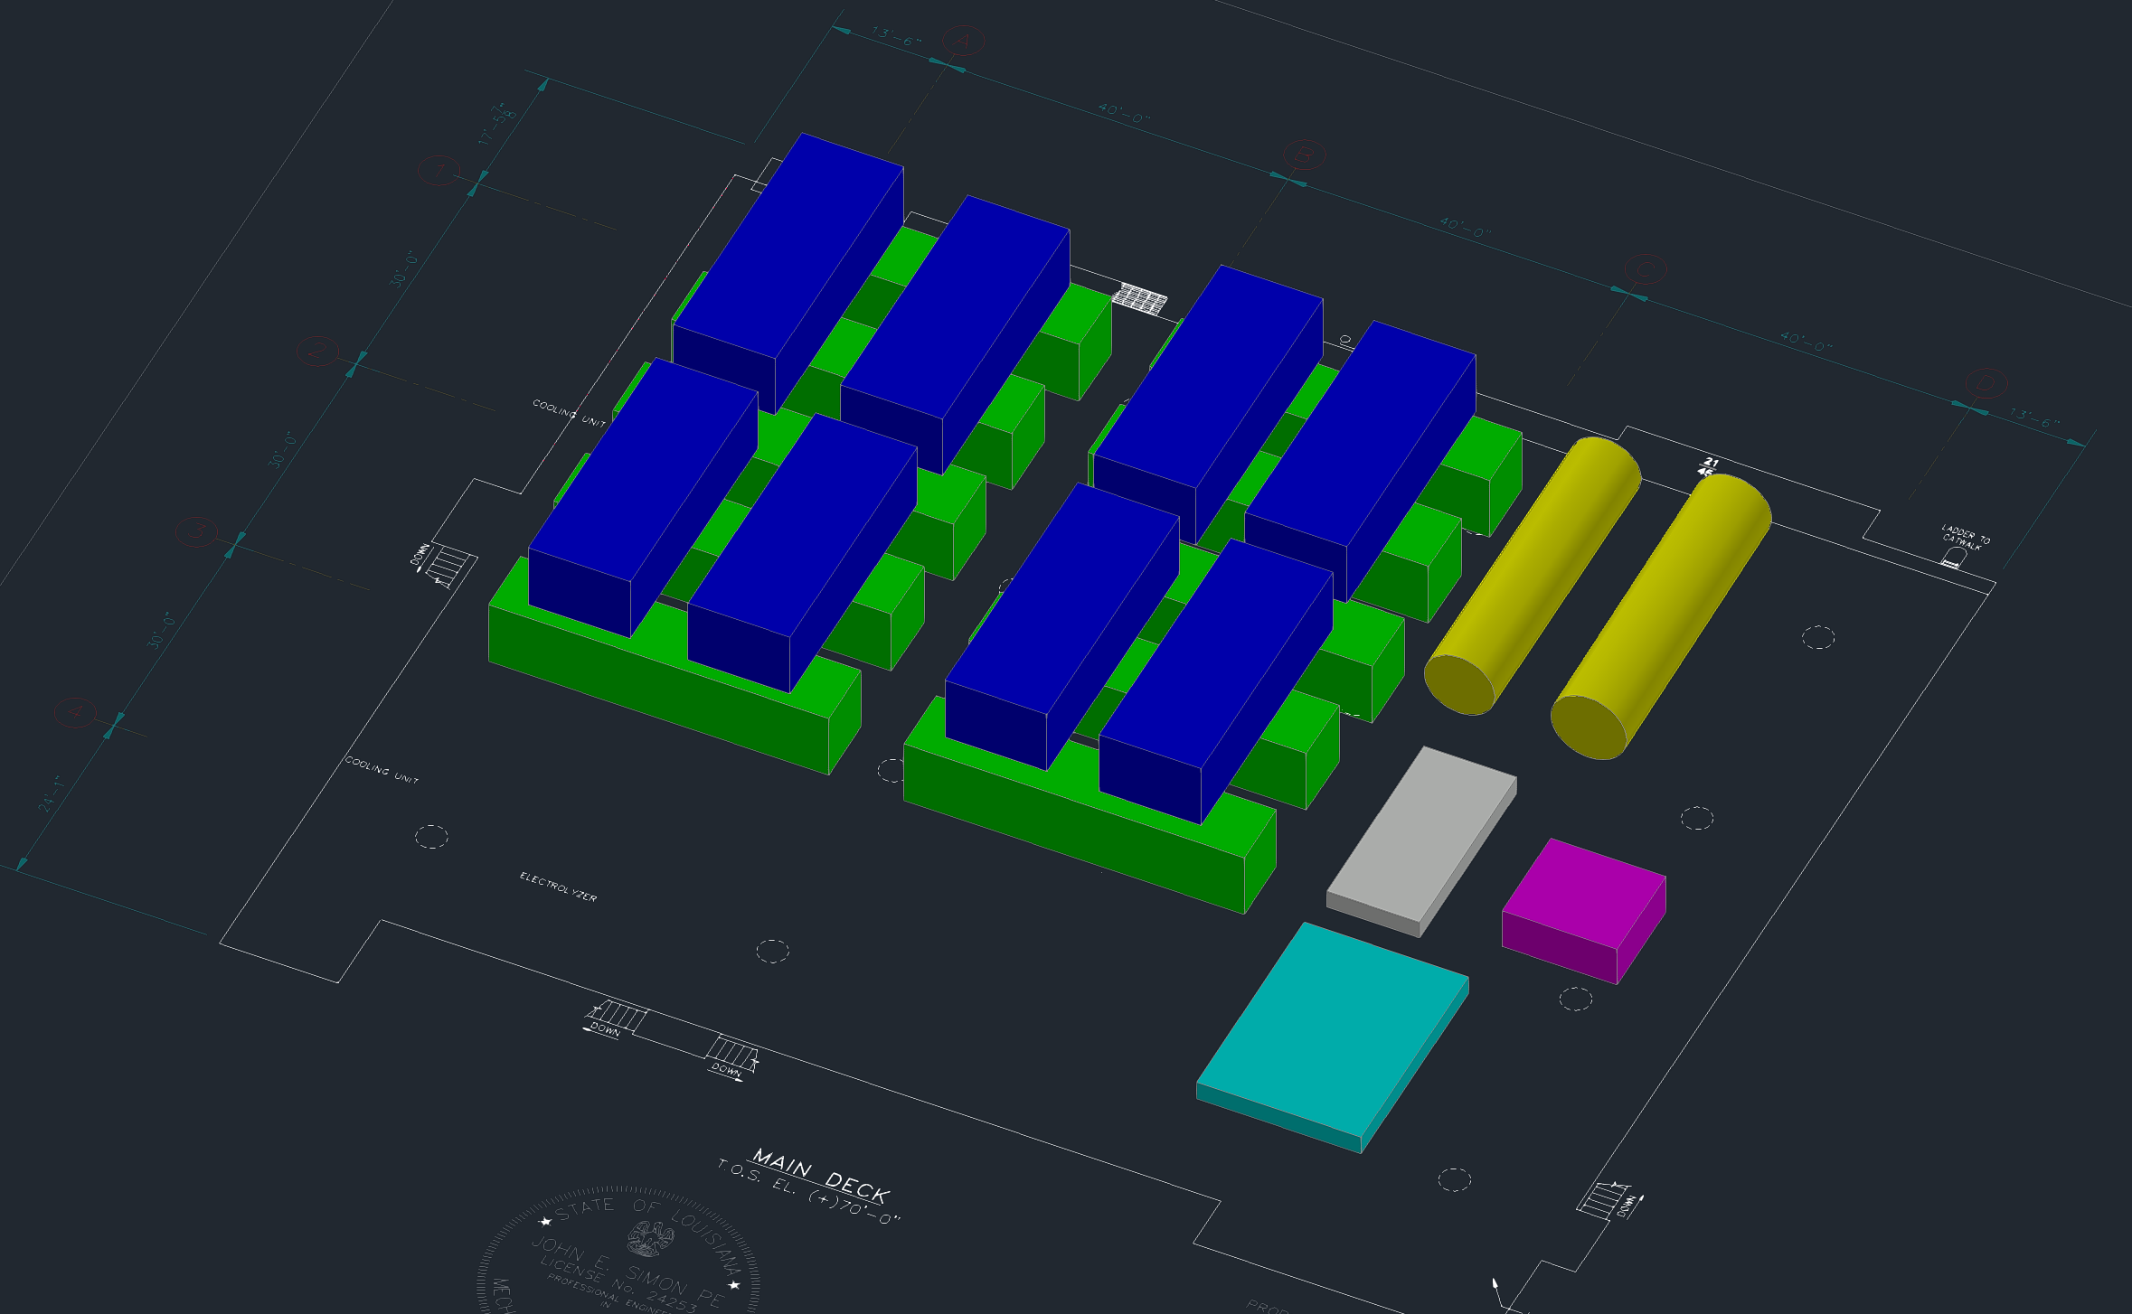
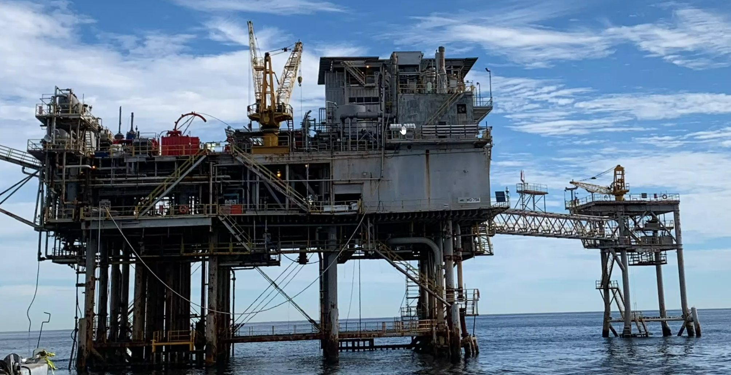
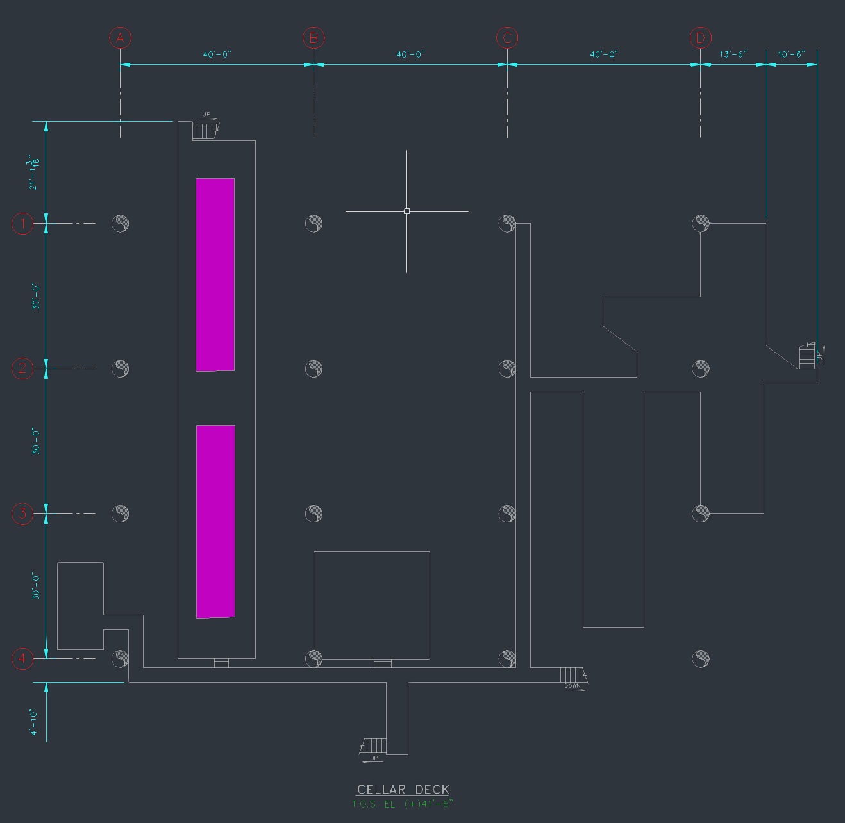
H₂ Project Design – Module Placement and Project Size
Deck space on all decks used to place modules for hydrogen generation and maximize project size
- 16 pile 147 ft x 112 ft platform can support a 100 MW Hydrogen Generation Project
Example Asset Used for Placement Workflow
(Courtesy: Hess)
Green: 10 MW Electrolyzer Units), Blue: Cooling Units, Red: Rectifier Units. Pink – Desal Units
OTC-35964-MS • Repurposing Typical GOM Platforms for Wind Power and Hydrogen Generation - Design and Economics • Paulo Liu and Ram Seetharam

Slide 6
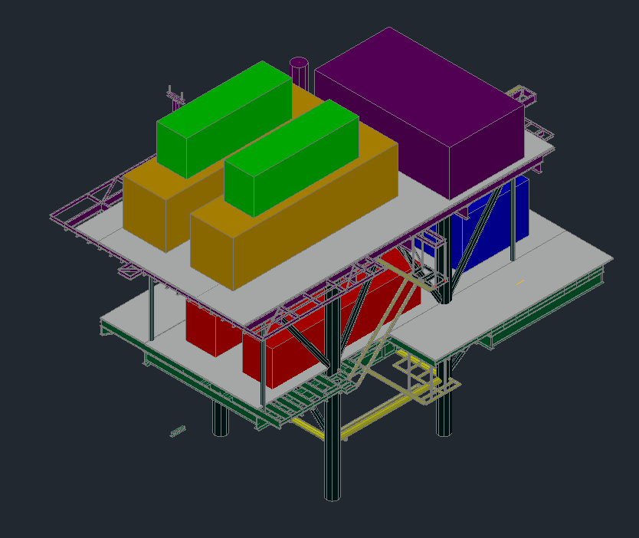
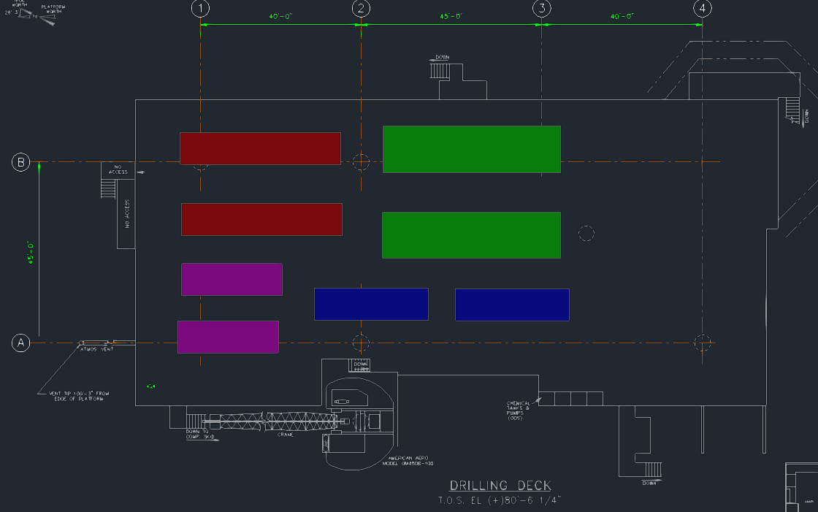
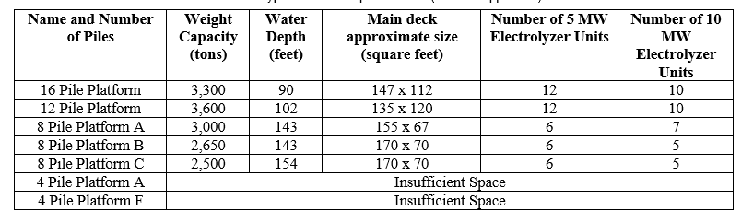
Smaller Platforms for 10 MW Demonstration Projects
8 Pile Platform (170 x 70)
(Red: Rectifier/Transformer, Green: Electrolyzer, Blue: Cooling Unit, and Magenta: Desalination Unit)
Placement Exercise Results
2 x 5 MW electrolyzer units, yellow)
on the Top Deck (84 x 64)
OTC-35964-MS • Repurposing Typical GOM Platforms for Wind Power and Hydrogen Generation - Design and Economics • Paulo Liu and Ram Seetharam

Slide 7
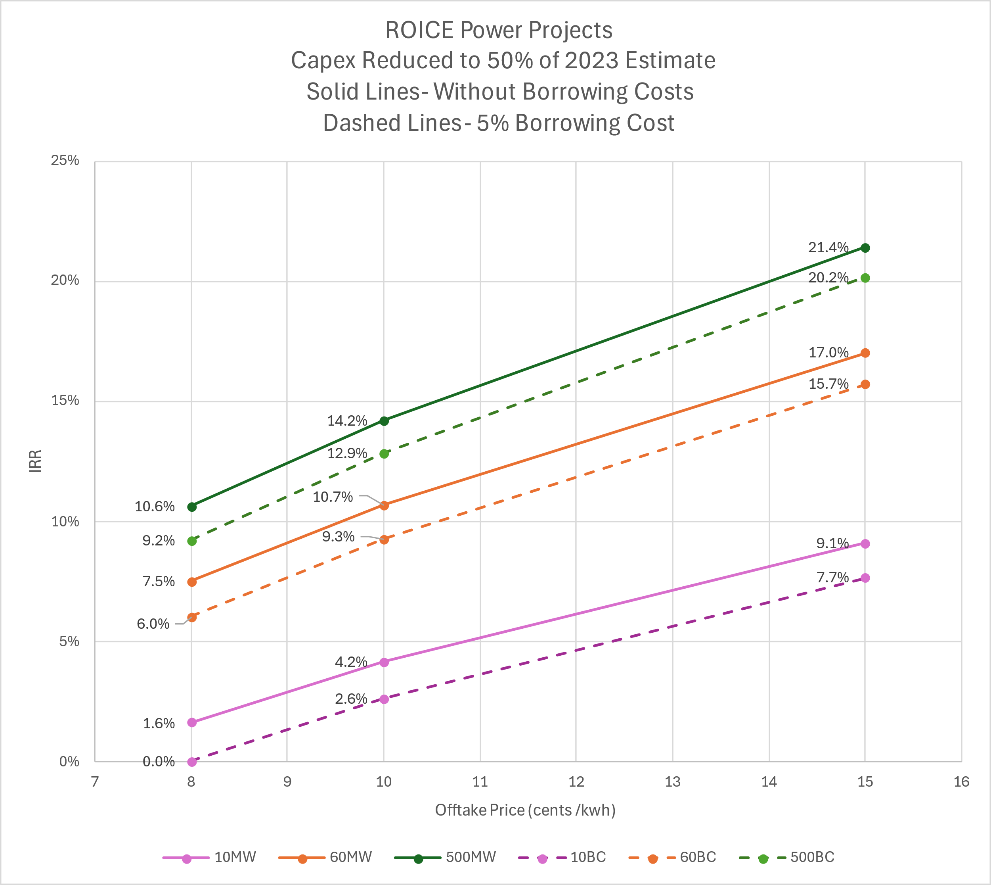
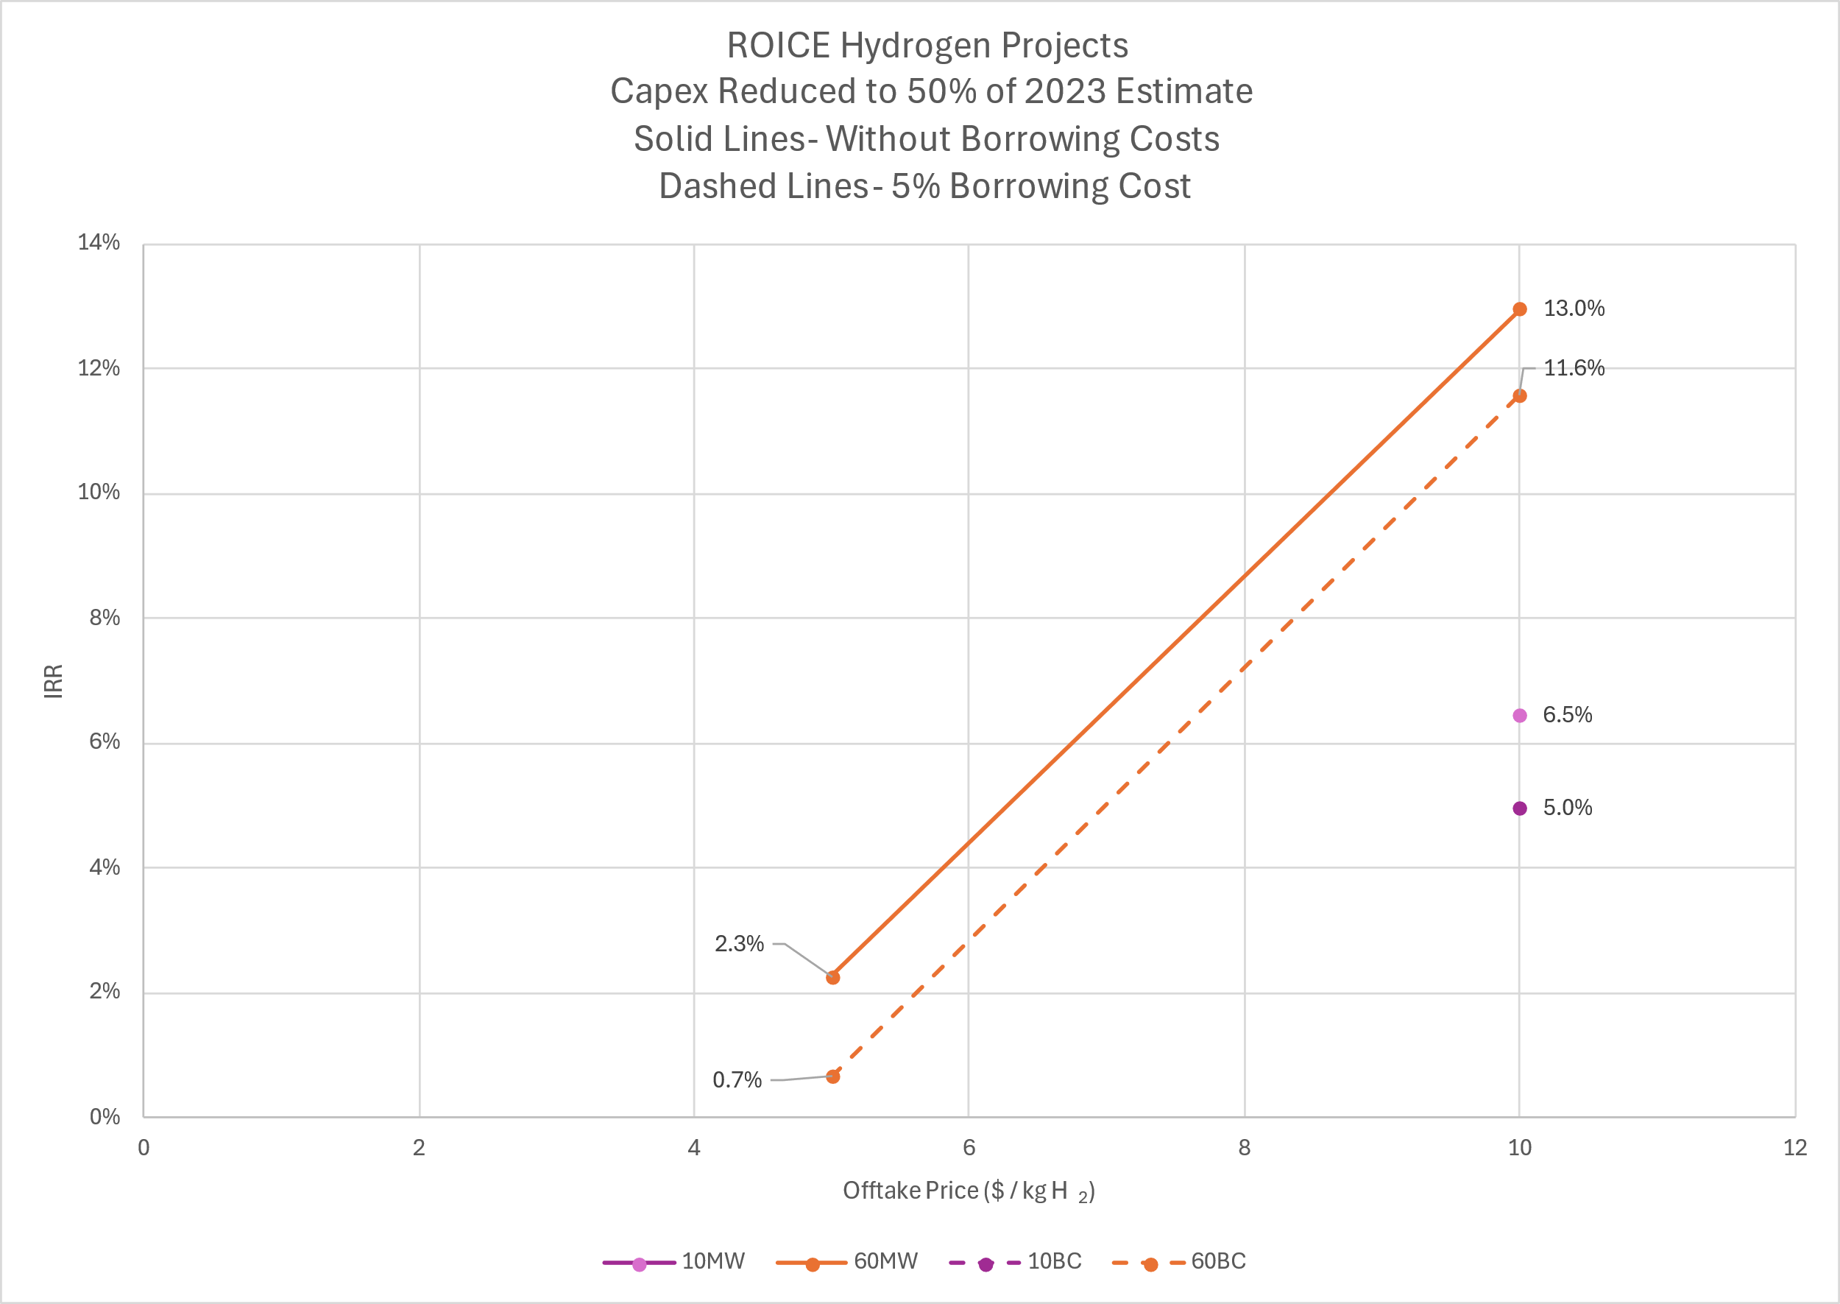
Project Economics – Incentives & Project Size Key
50% Capex Reduction Cases - combination of federal incentives (ITC) and cost structure improvements
Significant cost reductions needed
Large projects more profitable
Wind projects more profitable than hydrogen
Hydrogen projects limited by footprint
OTC-35964-MS • Repurposing Typical GOM Platforms for Wind Power and Hydrogen Generation - Design and Economics • Paulo Liu and Ram Seetharam

Slide 8
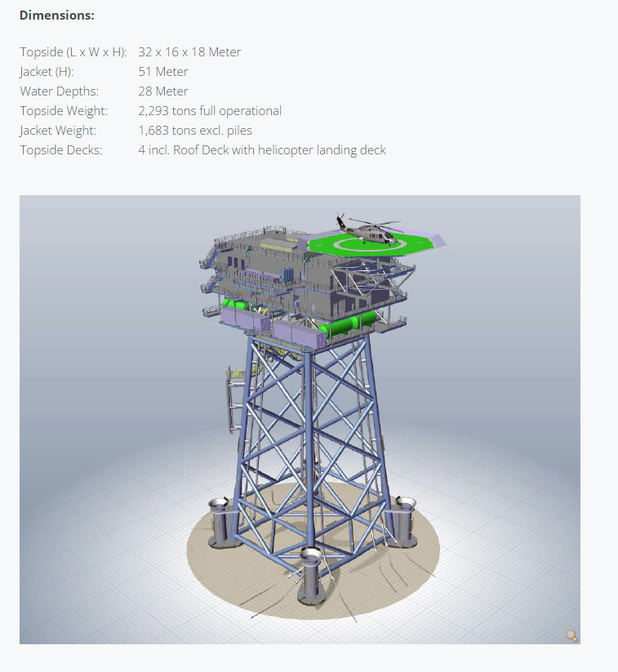
Conclusions – Potential for Repurposing
Repurposing (ROICE) projects offer an alternative to conventional decommissioning
Challenge is in generating an acceptable rate of return : all power and H₂ projects at varying sizes analyzed are challenging at today’s capex
Available footprint on platform decks determines, and in some cases, limits project size and economics
H₂ topsides footprint limits maximum project size to ~ 100 MW
Power projects are less limited and can be as large as 500 MW, allowing them to benefit from economies of scale
Path to profitability is combination of larger scale projects, low-cost loans, capex reductions through supply chain and technology improvements, and offtakers willing to pay a premium for power and H₂
OTC-35964-MS • Repurposing Typical GOM Platforms for Wind Power and Hydrogen Generation - Design and Economics • Paulo Liu and Ram Seetharam
Courtesy: Nordsee One GmbH

Slide 9
